Slide 1
Evolution of WMO Education and Training Guidelines
Presented to the BIP-M/MT Review Meeting
Geneva November 2018
Tim Spangler

Slide 2
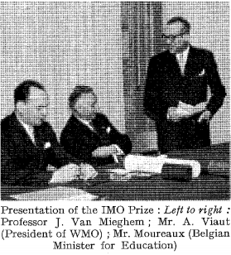
2) It is for qualified meteorological personnel, and not for users of meteorology, to
fix standards in respect of the knowledge of mathematics, physics and meteorology to be acquired by the personnel of national services,
Professor J. Van Mieghem 1967 Tech Note 50

Slide 3
Formation of ETRP Early 1960’s Three Reports by Prof Miegham
The problem of professional training of meteorological personnel of all grades in the less developed countries
Plan for the development of professional meteorological training in Africa
Plan for the development of professional training of meteorological personnel in South America
No effort should be spared in maintaining the training of meteorological personnel at as high a standard as possible in all regions of the world – Prof Van Mieghem 1969

Slide 4
Groups like this have created guidelines and standards over many years in WMO

Slide 5
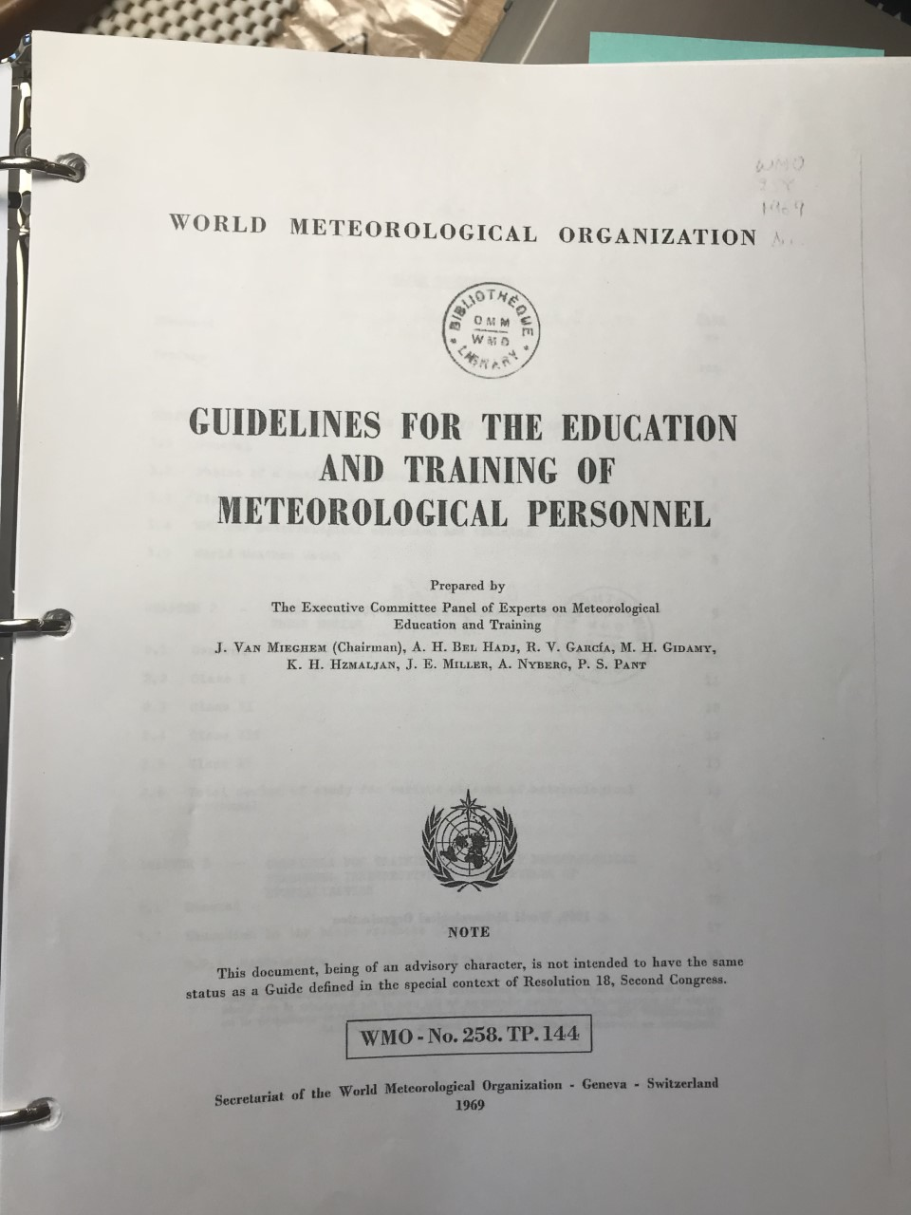

Slide 6
History of Editions
1969: First Edition of WMO 258
1977 Second Edition of WMO 258
1984 Third Edition of WMO 258
2002 Fourth Edition of WMO 258
2012 WMO 1083 Companion to WMO 49 Technical Regulations

Slide 7
Some History of Early Guidelines First Edition 1969
Developed primarily at the request of developing nations
Laid out in format of typical university curriculum
Specializations included Aviation, Agriculture, Climatology, Hydrometeorology
Proposed four classes of personnel*
*Preface noted that a substantial minority of WMO Members objected to the four classes and saying Class II personnel should not be substituted for Class I

Slide 8
Personnel Classes
Class I: University trained meteorologists working as weather forecasters etc
Class II: Secondary level and university level training to do analysis and provide weather forecasts under supervision
Class III: Secondary level education leading focus on observations and instruments
Class IV: sufficient training to provide observations and instrument maintenance

Slide 9
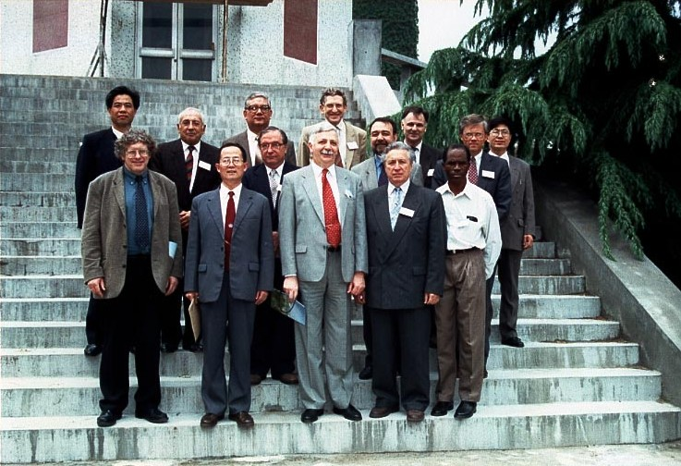

Slide 10
Evolution to fourth edition in 2002
The second and third editions made incremental changes
Hydrology was added after the WMO convention was changed in 1975
Education on remote sensing was added
More information about the use of computers and NWP
Radar meteorology and marine meteorology were added explicitly
NWP was added and enhanced but still very primitive
The four classes were retained
This was still an issue and was called a “compromise”
Access to university level education was still limited for most WMO Members

Slide 11
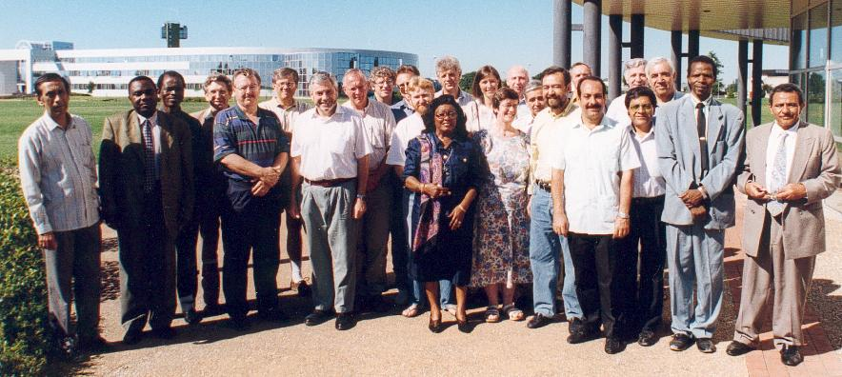
Fourth Edition was a major change in 2002
WMO Symposium (1995) recommended major review
University level education was more widely available
WMO Congress mandated a review
Well-developed Members pushed for two classes
They had probably been pushing this since 1969
A newly constituted EC Panel met in Nanjing (1996) with a mandate to make significant changes including review of RTCS, changes to WMO 258, lead by WMO President John Zillman

Slide 12
Changes in the Fourth Edition
Two classes of personnel were created
Meteorologist: with a university degree or equivalent education
Meteorological technician with post-secondary education
Many topics were added or expanded including
Satellite Interpretation, Radar Interpretation, Climate Prediction, Mesoscale NWP, Information Technology and data processing
The WMO community was encouraged to think in terms of job-competencies as well as qualifications

Slide 13
Examples of Job-competency requirements were added
Weather analysis and forecasting (R. Riddaway)
Climate monitoring and prediction (Y. Kimura)
Observations and measurements (R.A. Pannett)
Agrometeorology (H.P.Das)
Aeronautical Meteorology: Forecasting (T. Spangler and D.Wesley)
Aeronautical Meteorology: Regional (H. Pumpel)
Marine Meteorology (L. Karlin)
Environmental Meteorology (B. Angle)
Interpret model output: demonstrate awareness of which model output is valid

Slide 14
Normal Path to Meteorologist

Slide 15
Normal path for a meteorological technician

Slide 16
Alternate Path for a Meteorological Technician
An MT can become a Meteorologist through acquiring a university degree and satisfying the BIP-M

Slide 17
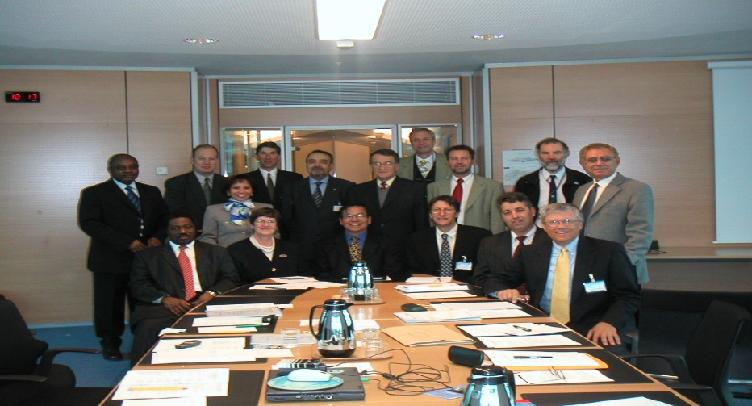
ICAO and the AMF Task Team 2007-2010
WMO convened a task team to consider new standards for the Aeronautical Meteorological Forecaster (AMF)
Chaired by David Bennetts, the task team worked to identify a path forward where ICAO would accept WMO guidance and recommended that the minimum qualifications to be an AMF be made a regulation
This effort was pushed within WMO as a way to avoid ICAO imposing more onerous requirements (similar to the licensing of dispatchers and mechanics) upon aeronautical forecasters

Slide 18
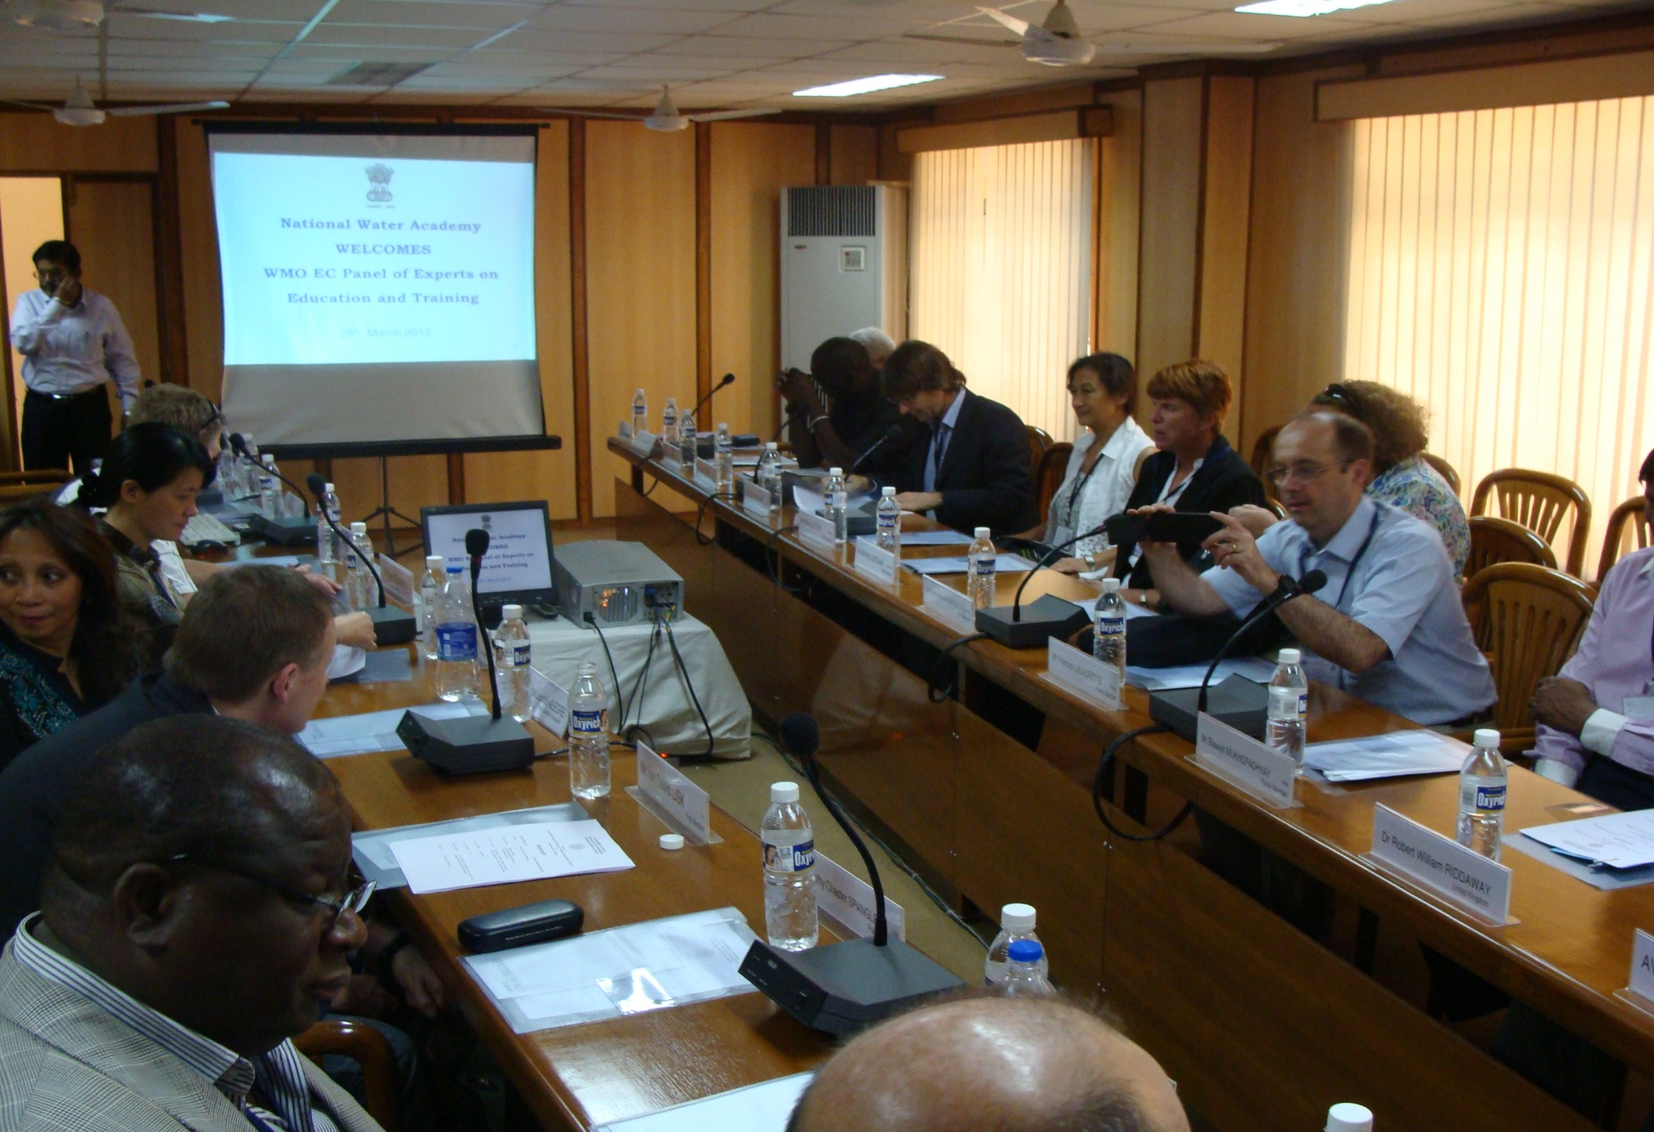
EC Panel India 2012

Slide 19
WMO 1083 Manual on the Implementation of Education and Training Standards in Meteorology and Hydrology (2012)
(De facto Fifth Edition 2012 and 2013)
Published in 2013 as a companion to Chapter b.4 of the WMO 49
Two classes of personnel were related to qualifications and education was described by learning outcomes
Jobs were described by competencies (what a person should be able to do)
Largely identical to the Fourth Edition except more details for areas like mesoscale models, climate models, radar, NWP, and the Integration of satellite meteorology into the forecast process

Slide 20
Paths to becoming a Meteorologist (required to issue aeronautical forecasts)
1)Degree path: University Degree in the atmospheric sciences or meteorology following guidelines in the BIP-M
2)Post-graduate path: University Degree in a related field plus additional study that satisfies the BIP-M
3)Non-degree path: a program of study where the program can be demonstrated to be as rigorous and intellectually demanding as a degree program
------------------------------------------------------------------------------------------------------------------
4) A limited path? – Tech Reg 49, V.1, Part V, 1.2.1.1 says that an AMF must have completed the BIP-M taking into consideration the area of responsibility . . .
5) WMO 1083 section 5.1: Permanent Representatives are expected to take the lead in consulting with the appropriate national and regional bodies to define the academic qualifications required by Meteorologists in their country . .

Slide 21
Example Description of Fronts
1969: Fronts- frontogenesis and frontolysis, structure of fronts, kinematics and dynamics of fronts (presented as a list of topics)
1977: Fronts and frontal zones, model of the polar front, system of jet streams, frontogenesis, frontolysis, vertical motions on fronts, classification of fronts (presented as a list of topics)
2002: very distributed discussion and does not cover fronts in the explicit way done earlier, but rather as a feature predicted and described by NWP products as well as surface data
2013: Describe the characteristics of warm, cold, and occluded fronts and the weather associated with their passage, and describe the relationship between jet streams and weather systems . . . (3.3.1)

Slide 22
EC 70 requested the Secretary General to review the Basic Instructional Package for Meteorologists (BIP-M) and Basic Instructional Package for Meteorological Technicians (BIP-MT) working with the EC Panel of Experts on Education and Training.
Recent advances in meteorology have been so swift and working methods developed with such rapidity, that it is absolutely essential to see to it that the various parts of the Guidelines are continually kept up to date. J Van Mieghem 1969

Slide 24
DISCUSSION

Slide 25
Short Summary of Surveys First: WMO did a survey in 2000 about changes to WMO 258
Strongly convergent opinions:
Most Members used the four classes of personnel in the past
A new classification should consider using formal education as a qualification
Moderately convergent opinions:
Job competencies can be used but specific job competencies are practically impossible
Full secondary education may be a mandatory prerequisite for future meteorological technicians
Weakly convergent opinions
A class called meteorological technologist is not a priority for a majority of Members but a substantial minority wanted it to be included
Don’t include a lot of detail in the traditional curricula – don’t like the lack of flexibility
Divergent opinions
Three highly advanced NMHS preferred a concentration on technical capabilities rather than on individual classes and classification should be based on job function rather than education qualification

Slide 26
Surveys in 2018 Focal points (50 countries)
Nearly all countries 90%) use the BIP-M and Most countries (80%) use the BIP-MT
Most countries (85%) offer some additional national training
Nearly all countries (90%) said that the BIP-M needed revision
Add new relevant content (70%)
Add qualifications in service areas such as aviation or marine (60%)
Add an assessment tool that demonstrates expected learning outcomes (50%)
Add regional topics like tropical or marine (35%)
Most countries (80%) said the BIP-MT needed revision
Add automatic weather observations (55%)
Add an assessment tool (45%)
Add content on WIGOS and data processing (40%)
Less frequent were calls for less math and physics, more personnel classes, and remote sensing

Slide 27
Duties of Meteorological Technicians (from 22 countries)
Information Technology and Data Processing
Mexico, UK, Korea, Latvia, Kenya, South Africa, France, Brazil
Social Media and Communication
Mexico, Russian Kenya, Mauritania
Observations
Russia, Costa Rica, Cape Verde, Philippines, Kenya, USA, CIMH, South Africa, Sierra Leone, Nigeria, Mauritania, Zimbabwe, Mozambique, El Salvador, Brazil, Cayman Islands, Sudan,
Managing Voluntary Observation Network
UK, USA
Observing Network Operations and Quality Control
UK, Korea, Central African Republic, Latvia, USA, CIMH, South Africa, Sierra Leone, Mauritania, Zimbabwe, Lesotho, El Salvador, Trinidad, France, Brazil, Sudan, Honduras
Forecasting
Central African Republic, Zimbabwe, El Salvador, France, Sudan, Honduras

Slide 28
Duties of Meteorological Technicians (from 22 countries - continued)
Climate and Climatology
Cape Verde, Zimbabwe, Mozambique, El Salvador, Jamaica, Trinidad, Cayman Islands, Honduras
Research Assistant
Philippines
Customer Service
Kenya
Training
Kenya, Mozambique

Slide 29
Areas Identified for changes in BIP-MT
Automatic weather stations (65%)
Add an assessment (45%)
More training on WIGOS (45%)
Information Technology (45%)
More MT personnel classes (30%)
Remote Sensing (30%)
Less on manual observations (20%)

Slide 30
Interviews with Technical Offices page 1
The BIP-M review team interviewed and received input from six technical offices including
• Service delivery (M. Andrioli)
• Aeronautical Meteorology (G. Brock) through the CAeM expert team
• Marine Meteorology and Ocean Affairs (S. Grimes)
• Data Processing and Forecasting (A. Harou)
• Capacity Building: Hydrology and Water Resources (C. Caponi)
• Observing and Information Systems (F. Belda)
The technical offices listed topics that should be added or expanded
polar meteorology - coastal weather - Storm surge - sea ice forecasting - marine satellite interpretation -
climate forecast verification - communication - Disaster risk reduction - Basic computer skills

Slide 31
Interviews with Technical Offices page 2
Some thoughts and ideas about personnel
Best forecasters may be the old Class II position
Create alternative paths to become an applied or specialist meteorologist
Require less math and physics
Require continuing education: the forecaster needs to be an intelligent users of sophisticated products
Thoughts on Meteorological Technicians
BIP-MT really needs work and needs to be rewritten for the future rather than describing a historical position
Consider a higher level MT like an “assistant forecaster” (need better term perhaps)
Enhance training in remote sensing, data processing, automatic observing, and WIGOS
Remember: the MT is for observation and analysis while the Meteorologist is for analysis and prognosis

Slide 32
Interviews with Technical Offices page 3
Most complete response came for the CAeM team (K. Caesar and G. Khambule)
Only 40% of WMO Members are compliant with WMO 1083 for all of their staff
Changes to BIP-M could raise that percentage significantly
Support offering a career path where a candidate becomes an AMF by focusing primarily on only those topics and qualifications needed for the job
Support an assessment as an alternative path for candidates to become an AMF or for others to transition to an AMF

Slide 33
Quick Thoughts on an Assessment (Spangler)
Many fields successfully use assessments to determinate the qualifications and competency of candidates: in the US this includes Psychologists and Professional Engineers as two examples.
Some possible components
Minimum education requirements such as secondary school and two years advanced study in home country
Background science courses such as online or classroom courses in math and physics
A standardized extensive test on the basics of meteorology created internationally but administered locally
A knowledge and skills test developed regionally but administered locally for each specialty like aviation or marine
A protocol that must be followed and documented to assess job competency for the specialty administered locally
Could involve forecast bench assignments, demonstration of NWP analysis, Communication challenges, etc.

Slide 34
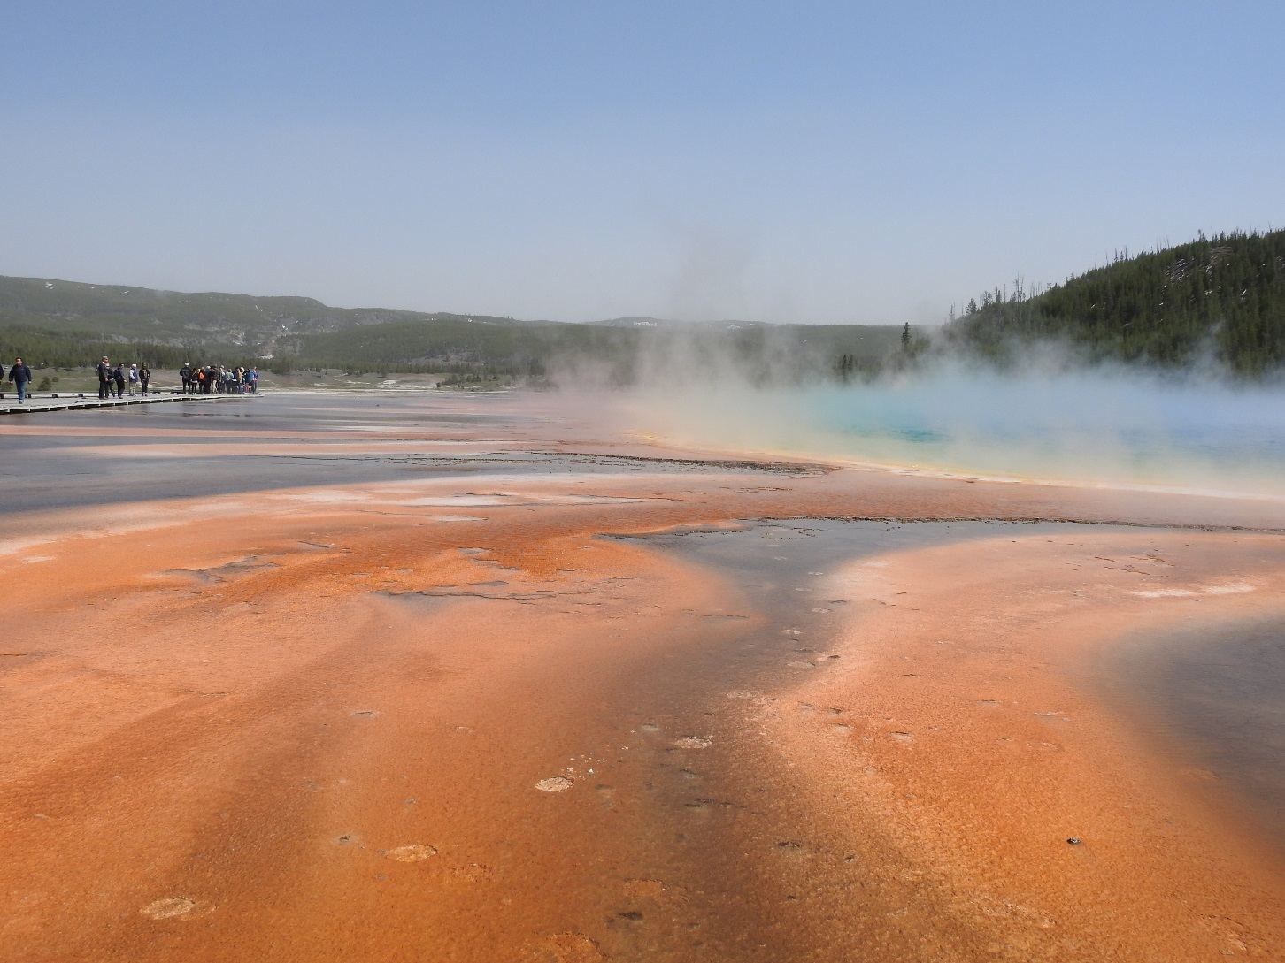
Questions about the survey?
Discussion about what it means?

Slide 35
Overview of Positions Received SCHOTI/COCOM
Flexible BIP Portfolio for a variety of audiences
Universities: research scientists, industry meteorologists, meteorologists ready for on the job training
National Meteorological Services: operational meteorologists or forecasters, advisors, observers, technicians, engineers, researchers, communicators
Industry: meteorologists, risk forecasters, meteorological service users, communicators
Meteorology essentials
Information required to talk confidently about the weather and processes
Everyone needs this
Operational essentials
Knowledge of weather processes needed for an operational role such as the public weather standard
For operational meteorologists, forecasters, aviation advisers, industrial meteorologists, engineers
Research and development essentials
Knowledge needed to fulfil research postions
Needed for researchers, industrial meteorologists, data scientists
Observational Technologies
Knowledge needed to design networks, install and maintain them, quality control
Needed for observers, technicians,

Slide 36
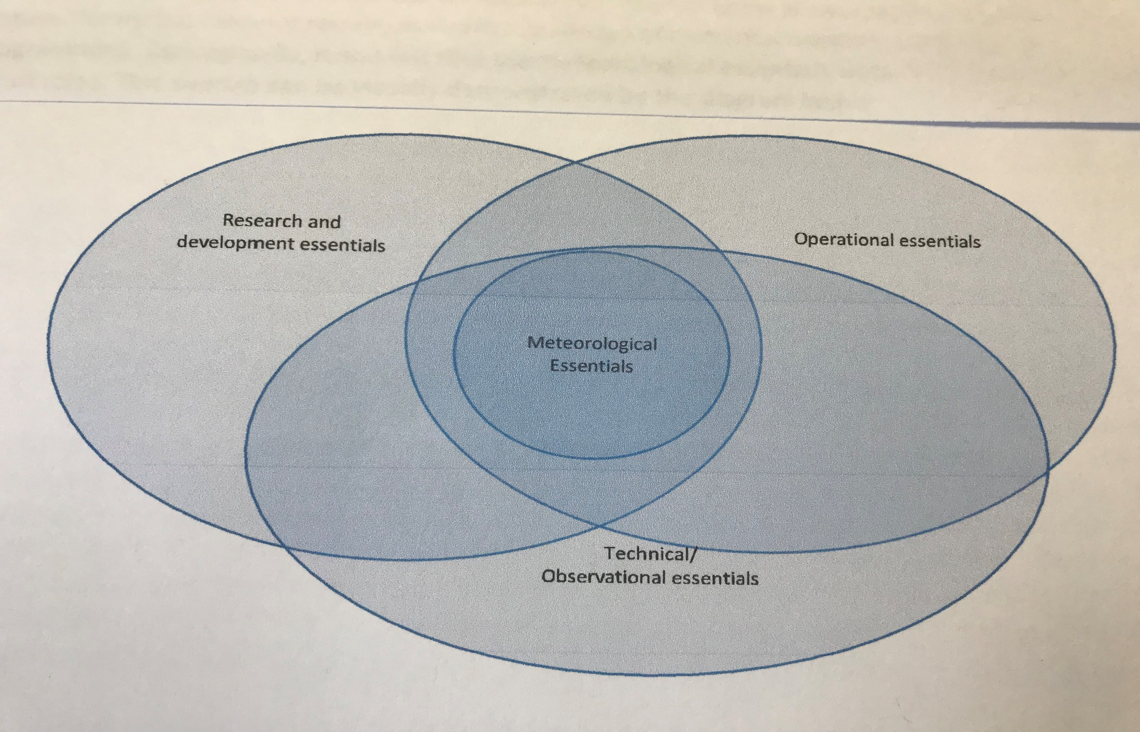
CoCOM

Slide 37
Position from the USA (John Ogren)
Current BIP-M is highly academic and doesn’t address needs of a rapidly changing world
NWP is changing the role of the forecaster – forecasting is a more automated process
Communication of impacts and working with customers is an increasing focus
A flexible approach to the BIP-M is needed
A rigorous academic approach for roles requiring advanced education
A flexible operational track that takes into account vocational competence for operational roles
The US remains committed to a worldwide standard
Consider development of an alternative path for operational/ aviation forecasters
That can be accomplished in 9 months or less
Focuses on performance based measures

Slide 38
Paper from the University of Reading (Sally Wolkowski and others)
The paper makes a case that meteorology and meteorological jobs are changing rapidly and the education of meteorologists has not. They list 14 new principles – some proposed skills
Comfortable working and discussing weather and climate over a range of timescales
Critically evaluate scientific literature
Develop transparent, robust, and well document scientific software
Work in Teams that develop models and modeling systems
Appreciate and critically evaluate observations and measurements
Competent design and use of statistical tools
Effectively communicate risk and uncertainty
Work in the context of a changing climate
The authors stress the value of enquiry based learning

Slide 39
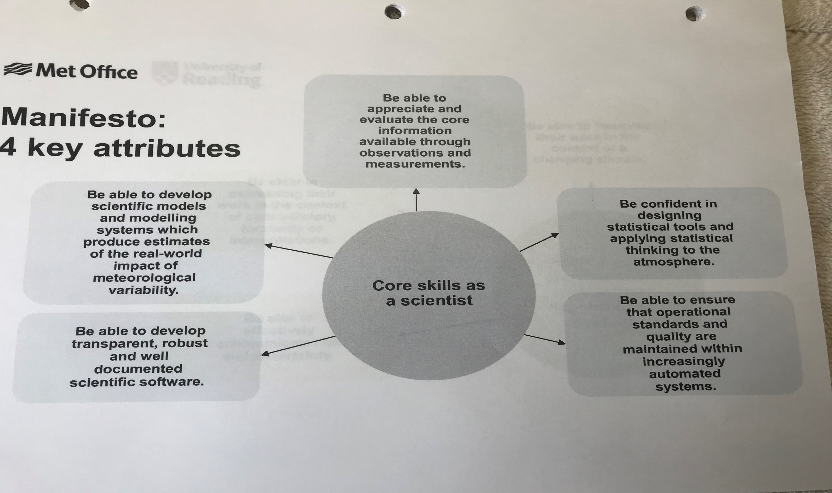

Slide 40
Position Paper received from Roshydromet ATI
ATI uses BIP-M and BIP-MT very rigorously with 17,000 staff having satisfied one or both
They have developed an additional path to satisfying the BIP-M for non-degree personnel
They are not seeing a need for assessments since the university community is quite adequate
They encourage efforts to keep the BIP-M focused on basic requirements and not add a lot of additional subjects
The BIP-MT seems pretty complex but needs more focus on data processing and IT
The two classes of personnel is sufficient

Slide 41
WMO RTC in Russia
Professional Development & Job Retraining
ATI
BIP-M + BIP-MT
Academic Education / Degree
RSHU
BIP-M
.
Vocational Education
MGMTech
BIP-MT

Slide 42
One Idea for Pathways to the BIP-M and MT
SCHOTI/COCOM
Research Meteorologist/Professor
Advanced Meteorological Theory and Quantitative Methods Qualifications
University Degree
R & D Meteorologist
Product Development
Core Meteorology Qualifications
Additional
Competency
Training
Managing Meteorologist
(may require both paths)
Additional Studies
University Degree-level
BIP-M
Applied Meteorology Qualifications
Public/DRR Forecaster & Advisor
Applied
Meteorologist
Aeronautical Forecaster & Advisor
University Degree or Advanced Studies and/or Assessment
Marine Forecaster & Advisor
Professional or University BIP-MT
Additional
Competency
Training and
OJT
Additional Studies
Environmental Forecaster & Advisor
Core Meteorology (Technician-level) Qualifications
Additional Technical Qualifications
Meteorologist
Technician
Meteorologist Technician / Observer
Degree, Advanced Studies and/or Assessment
Additional
Competencies
Training and OJT
Qualification Studies and Preparation
Qualifications
Example Job Categories

Slide 43
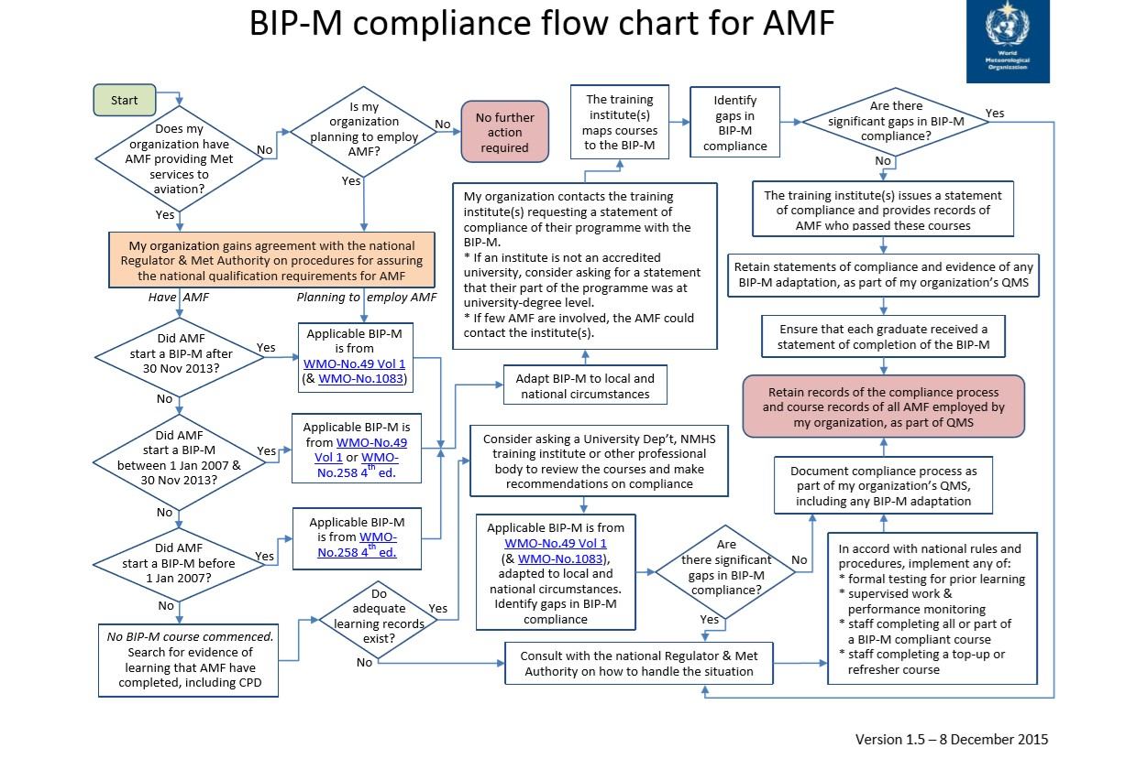

Slide 44
DISCUSSION

