Slide 1
Functional description of OSCAR/Surface
… Supporting adequate use of observations & rational network evolution
Jörg Klausen, MeteoSwiss
Timo Pröscholdt, WMO

Slide 2
Learning objectives
OSCAR contains information about observing stations
OSCAR is a web-based tool
OSCAR and its relation to the WIGOS metadata standard
Why is OSCAR useful?
How to get further information & help

Slide 3
Outline
Introduction
WIGOS Metadata Standard vs OSCAR/Surface
Basic functionality
View information
Add/edit information
Summary

Slide 4
Introduction

Slide 5
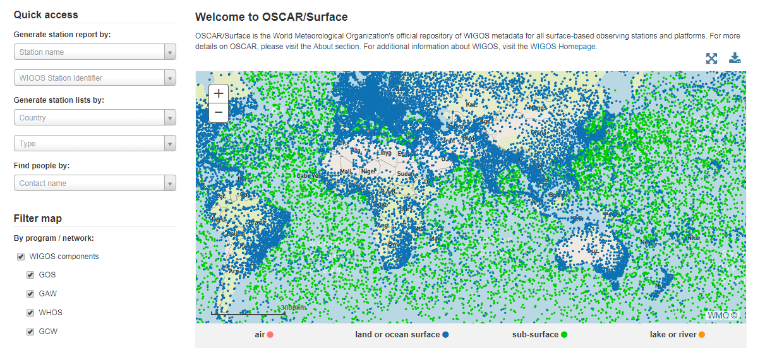
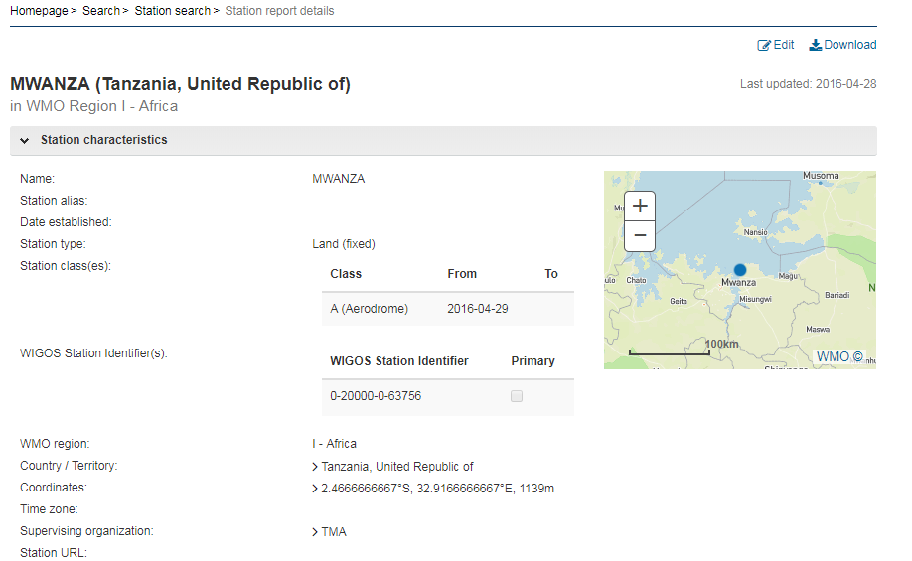
http://oscar.wmo.int/surface

Slide 6
WMDS vs OSCAR/Surface
1. Observed variable
2. Purpose of observation
3. Station/ platform
4. Environment
5. Instruments & methods of observation
6. Sampling
7. Data processing and reporting
8. Data Quality
9. Ownership and Data Policy
10. Contact
StationSet
Station/Platform (fixed, mobile)
Observation
Contact
Deployment
Instrument
Procedures
Contact
Contact
→ Defines categories and elements
→ «flat»
Reference implementation of WMDS
Hierarchical structure

Slide 7
Scope of OSCAR/Surface
Land, ocean, lower and upper atmosphere
Fixed, mobile observing facilities
In situ, remote-sensing instruments
Physical, chemical, biological, hydrological observations
Observations serving weather, climate, warnings, …

Slide 8
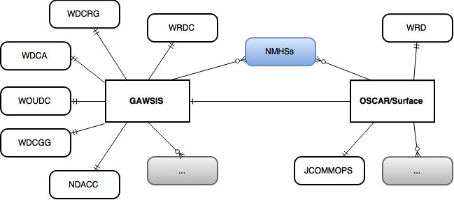
OSCAR/Surface metadata sources

Slide 9
VIEW Information

Slide 10
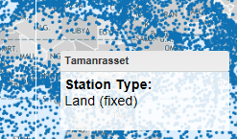
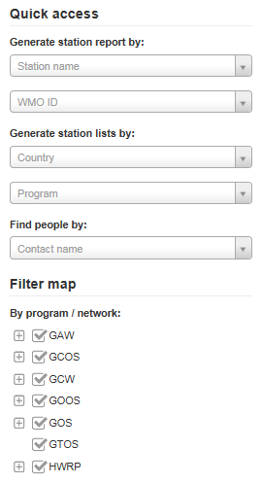
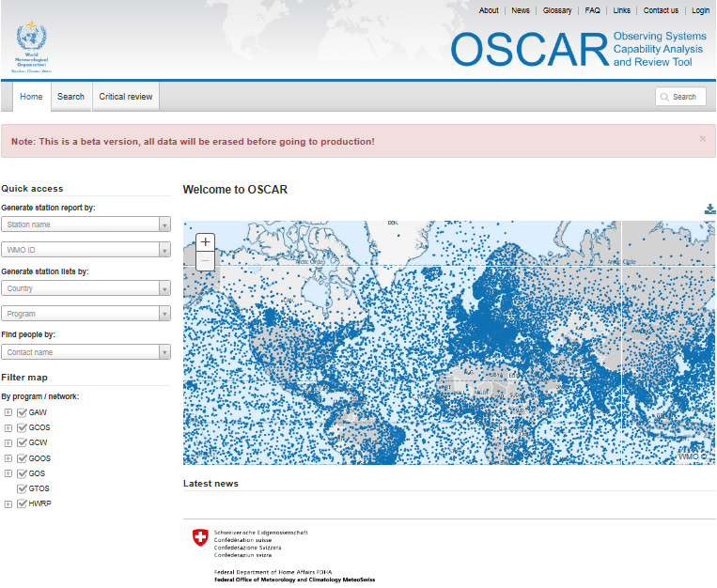
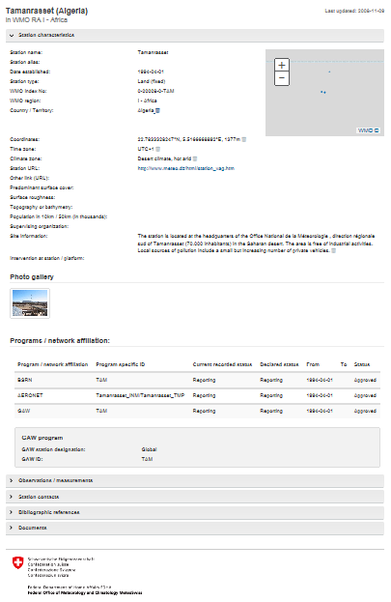
OSCAR quick access & reports
Quick access
&
Map filter
+ click
=
Detailed station report

Slide 11
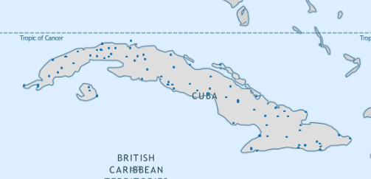
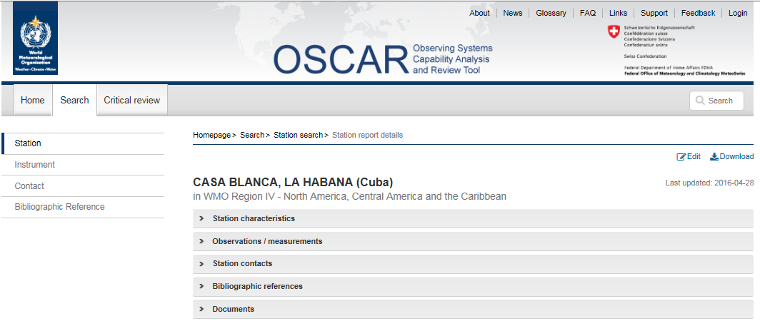
OSCAR/Surface Station Report (I)

Slide 12
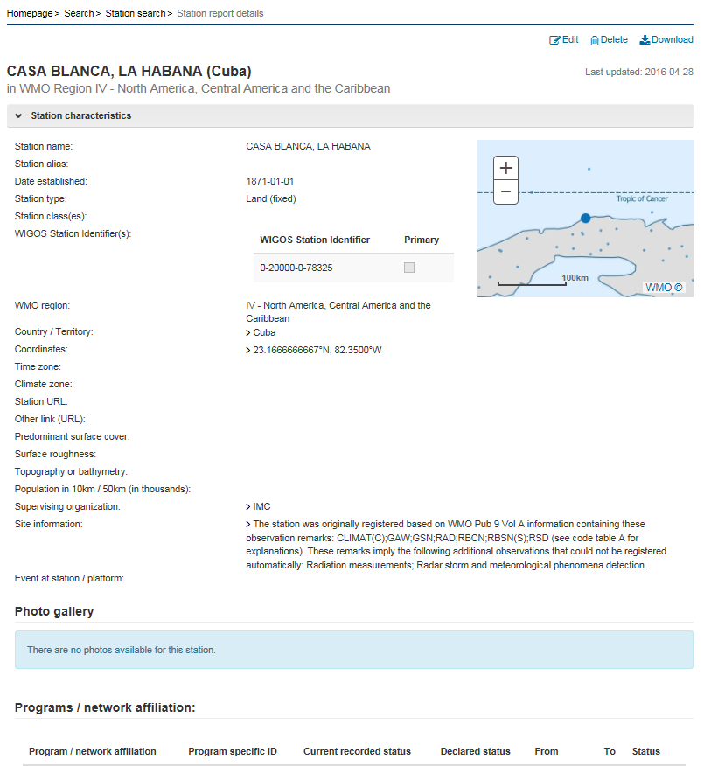
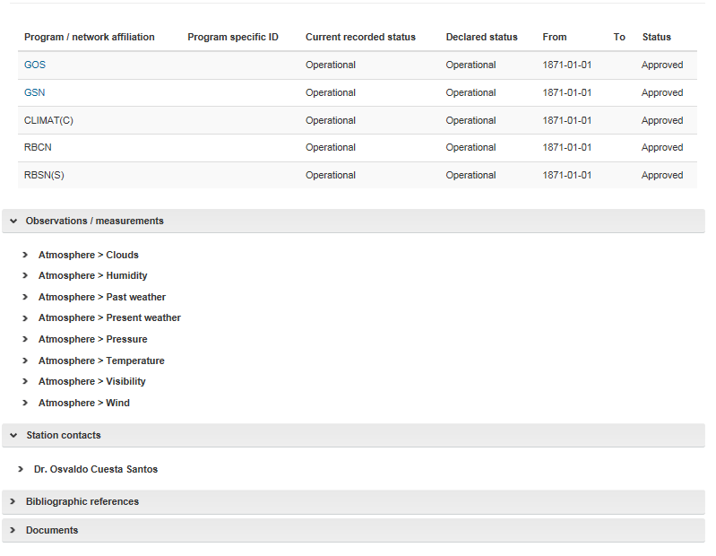
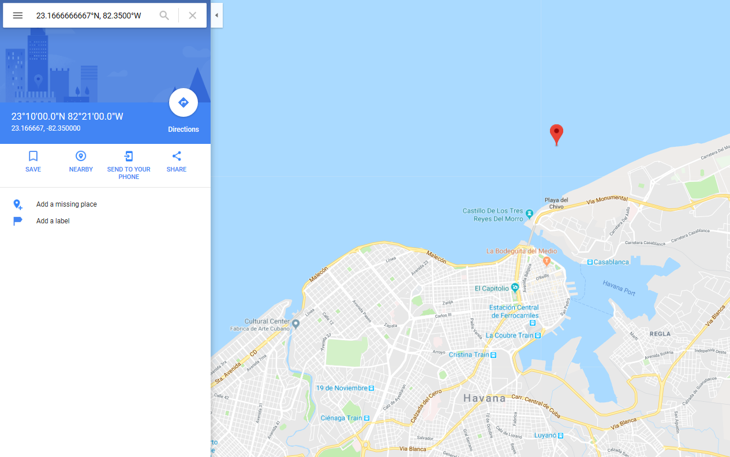
OSCAR/Surface Station Report (II)

Slide 13
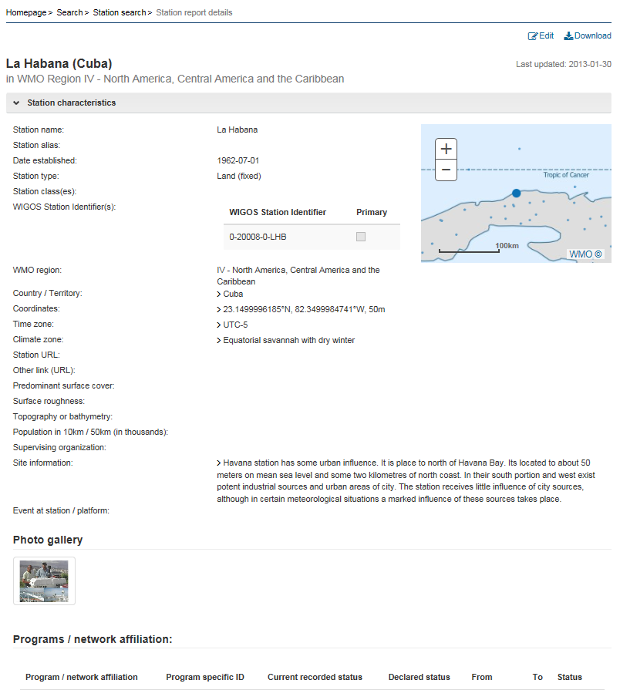
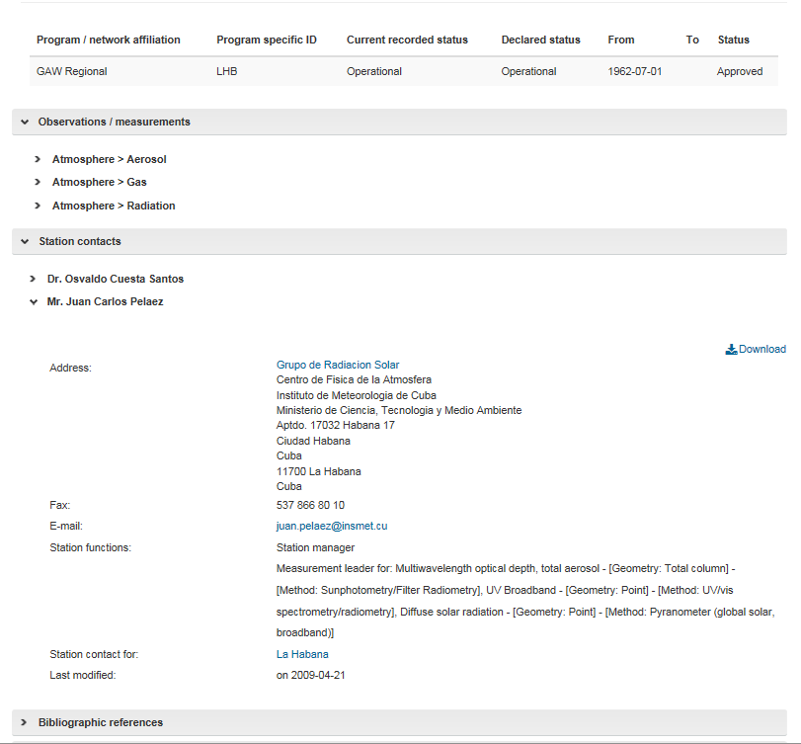
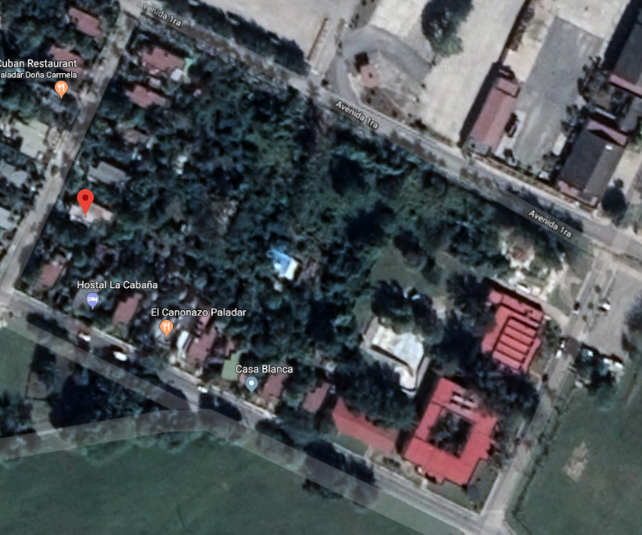
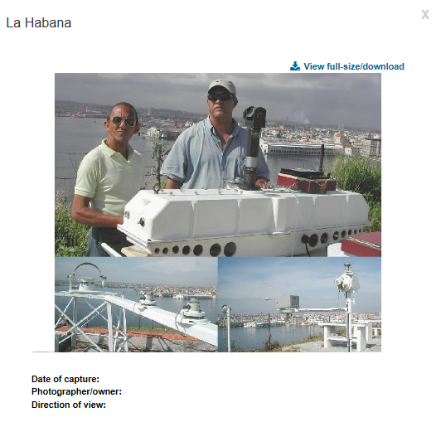
OSCAR/Surface Station Report (III)

Slide 14
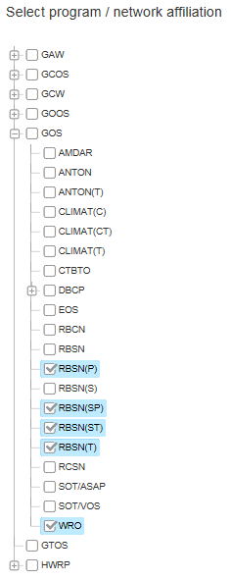
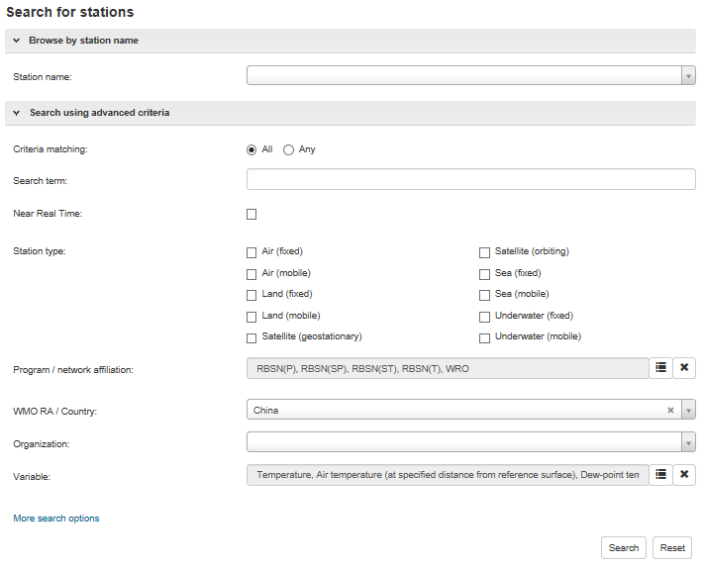
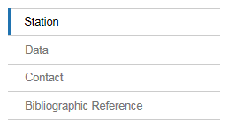
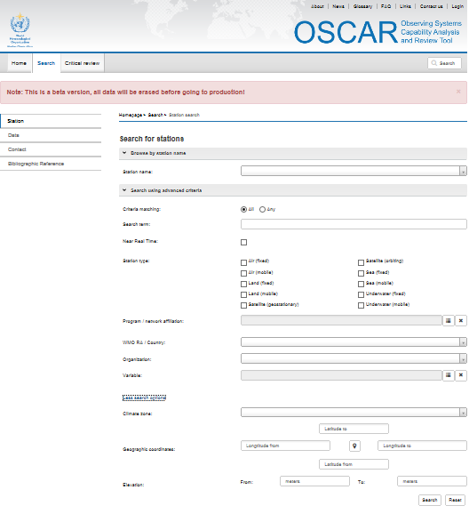
OSCAR detailed search
Various search targets
Instruments (soon)
Finely tuned search

Slide 15
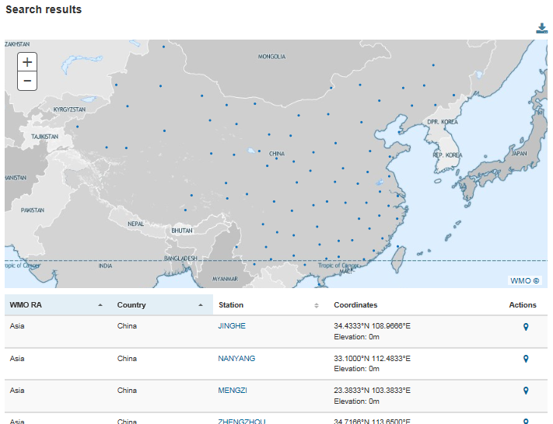
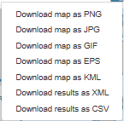
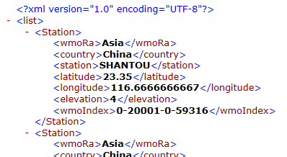
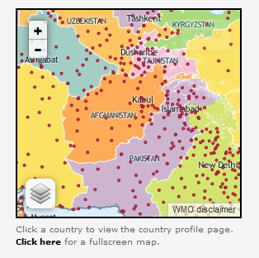
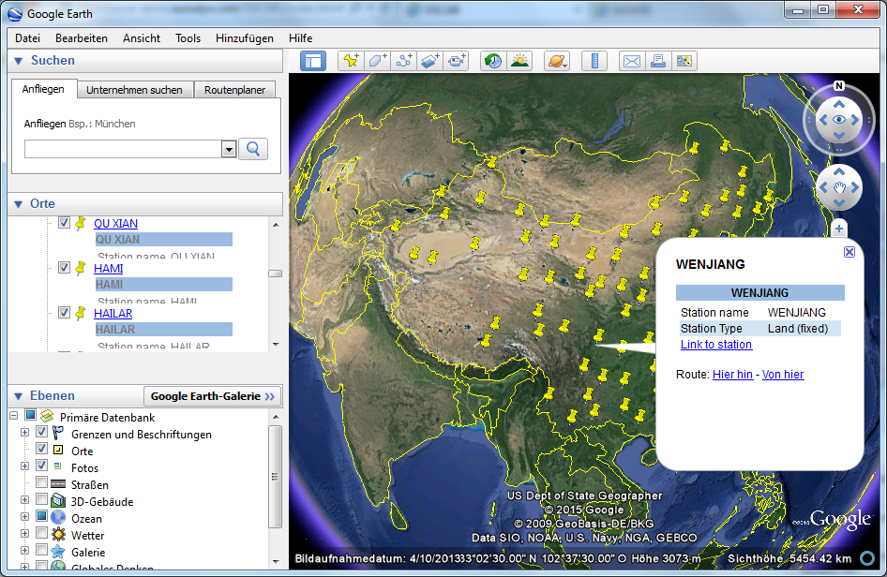
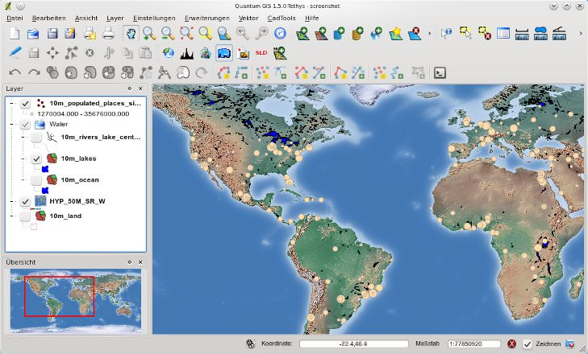
OSCAR search results
Download for further analysis
Integrate with geospatial tools
GoogleEarth, QuantumGIS, …
Mashup for online maps

Slide 16
Add/Edit Information

Slide 17
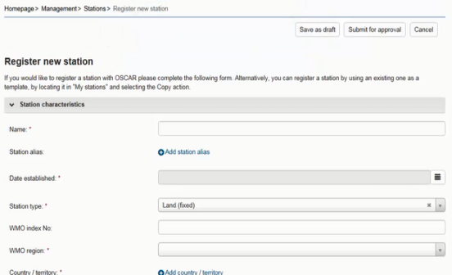
Security and user management
Authentification by identity provider (Swiss Government)
Authorization within application based on «trust-relationships» and various «user roles»
Register
Edit all stations in country
Also: register new contact
Admin
NFP
Edit assigned stations
Also: register new contact
Station contact

Slide 18
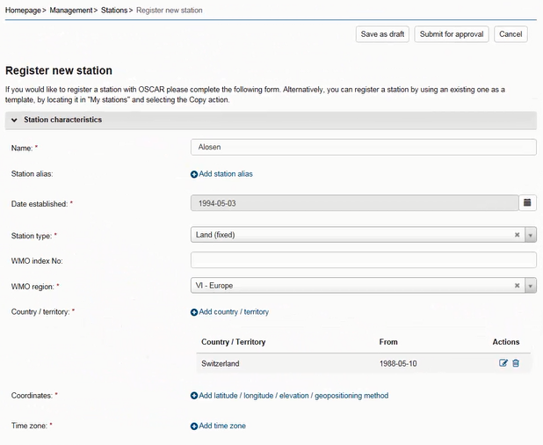
OSCAR management console
Stations
Basic characteristics
Photos
History
Observations
Location
Variable
Methods
Instruments
Quality and uncertainty
History
Contacts
Bibliographic references & documents

Slide 19
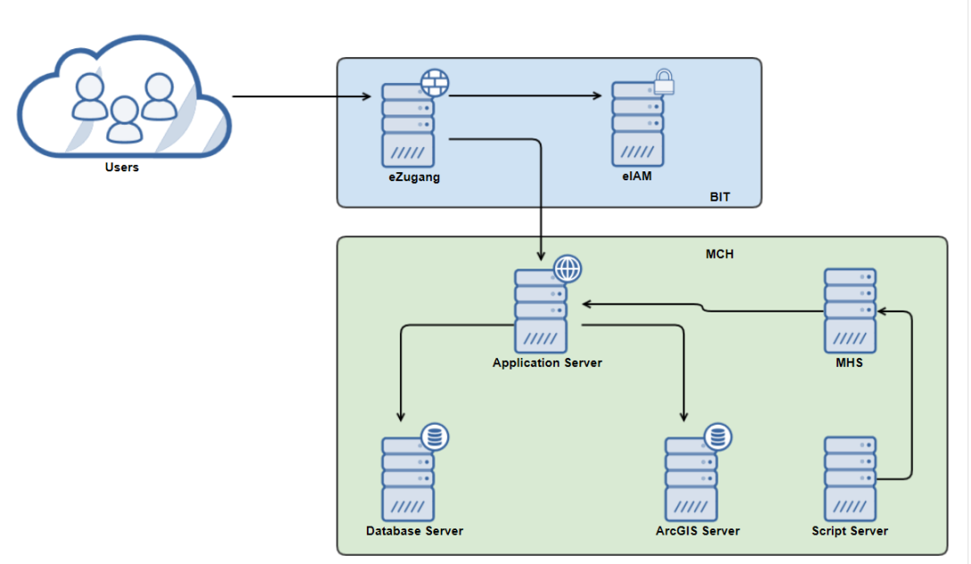
24/7 Operations
Industry tech stack & security architecture
Support organization
24/7 first level support
Office hours 2nd level support at MeteoSwiss & at WMO

Slide 20
Support and further help
OSCAR/Surface helpdek
1st and 2nd level support
Operated by MeteoSwiss
OSCAR/Surface Learning Resources Portal on WMO Moodle site
Presentations
Videos
Discussion forums
OSCAR/Surface blog
OSCAR/Surface User Manual
WMO OSCAR team (oscar@wmo.int)

Slide 21
Why is OSCAR useful
International exchange (GTS)
Planning (RRR process)
Get funding
Document that instruments are missing
Document impact of projects on network
Better understand observations
As a national DB
Regulatory obligation

Slide 22
summary

Slide 23
OSCAR/Surface implements the WMDS by specializing many of the categories/elements
GUI provides look-up, search filters, and a comprehensive management console
Quality of metadata needs to be checked, completeness of metadata improved → Your NMHS and related organizations are needed for OSCAR/Surface to be of benefit for all, including yourself!

Slide 24
Learning objectives
OSCAR contains information about observing stations
OSCAR is a web-based tool
OSCAR and its relation to the WIGOS metadata standard
Why is OSCAR useful?
How to get further information & help

Slide 25
Thank you
Merci
Questions?
¿Preguntas?

