Slide 1
OSCAR/Surface Initial Data Integration & Transition from Pub 9 Vol A
Jörg Klausen, MeteoSwiss

Slide 2
Outline
Introduction
Vol A integration
Vol A legacy file
Outlook

Slide 3
introduction

Slide 4
OSCAR/Surface
Is the WMO official repository of observation metadata of internationally exchanged [and other] observations
Shall serve all WIGOS components and WMO co-sponsored programmes
To assist Members, OSCAR/Surface was populated with information available at the time of launch [2 May 2016]

Slide 5
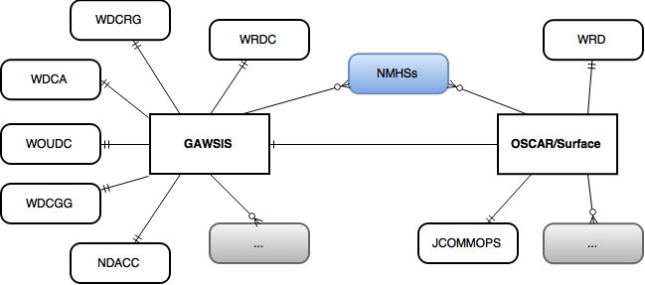
OSCAR/Surface metadata sources
integrated on 27 April 2016
EMEP
Vol A

Slide 6
Vol A integration

Slide 7
Vol A integration
Vol A contained very limited metadata
Station metadata incl. station «class»
Schedules of observation
Observed variables inferred from station «class» based on Manual on GOS
Automatic station (from “AUT” flag in ObsRems)
PTU, Wind, “Precipitation (yes/no)”
Manned station
PTU, Wind, plus "Present weather", "Past weather", "Cloud amount", "Type of cloud", "Height of cloud base", "Visibility“
→ Too many observations assumed for some stations

Slide 8
Vol A integration (cont’d)
OSCAR generates reports similar to the historical Vol A flat-files. The new “Vol A legacy report” has all current column headings but does not contain information in all columns.
Station information provided to WMO via current Vol A procedures are used to update WIGOS metadata in OSCAR (manually!)
By beginning of 2018, Vol A will officially cease to exist and related procedures used to maintain station information will be discontinued.
Machine-to-machine interface for automatic metadata transfer under development, expected for testing in July 2017

Slide 9
Pub 9 Vol A
Pub 9 Vol A was the official catalogue of surface and upper-air stations of WMO in the past
Vol A was available as a flatfile with complex encoding
Stations with limited metadata
Schedules of operation
Remarks
→ Transition of Vol A to OSCAR/Surface is a primary milestone on the way to operational use of WIGOS metadata

Slide 10
Station Metadata
WMO RA, Country/Territory
WIGOS ID (from WMO Index, SubIndex)
Station Name
Latitude, Longitude
Elevation (from Hha)
ObsRems (as character string under station description)
Station class (from ObsRems, cf. next slide for list)
No de-duplication with GAWSIS or other sources
Co-location could be attempted after integration
Integrate first, then consolidate
No hash-tags («#») for uncertain elevations
Country/territory corrected based on WMO CPDB

Slide 11
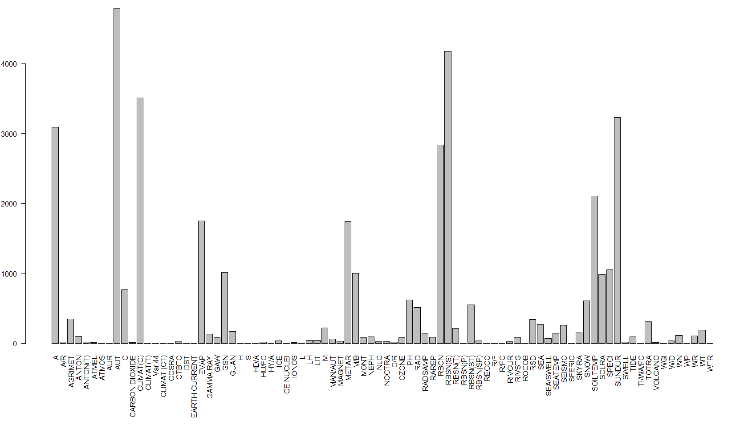
ObsRems
Not all ObsRems could be considered, but …
Not all ObsRems are relevant for observations

Slide 12
Station class «reference table»
A (aerodrome),
AGRIMET (agromet station),
C (coastal),
HD/A (helideck, offshore),
HU/FC (hurricane, tropical cyclone or typhoon forecast centre),
HY/A (seaplane base),
L (lightship),
LH (lighthouse),
M (mountain station),
R/FC (River forecast centre),
TI/WA/FC (Tidal wave forecast centre),
Radar, wind profiler were not considered as «station class» but as «instruments»
Views at WMO have changed meantime, some migration in progress, but discussion not concluded.

Slide 13
Observation Metadata (I)
Surface observation program (WMO No. 544, Manual on GOS)
Manned station
"Atm pressure", "Wind (direction and speed)", "Air temperature", "Humidity", "Present weather", "Past weather", "Cloud amount", "Type of cloud", "Height of cloud base", "Visibility“
Automatic station (from “AUT” flag in ObsRems)
"Atm pressure", "Wind (direction and speed)", "Air temperature", "Humidity“, “Precipitation (yes/no)”
Barometer height (from HP) for observation “pressure”
Instrument coordinates
Lat, lon from station coordinates
Elevation from Hha + conventional distance from reference surface (e.g., 10m for wind, 2m for T, RH)

Slide 14
Observation Metadata (II)
Additional observations (from ObsRems)
40 variables, some not very well defined cf. vola_code_table_A.csv
Need critical review and mapping to OSCAR variable reference table.
We can only integrate well-defined variables.
Upper-air observations (from UA-1 … UA-4)
«R»: PTU, wind
«P», «W», «WP»: wind
→ «X»: not considered (only 1 case)
Most certainly, too many observations assumed for some stations that need to be removed from OSCAR/Surface

Slide 15
Schedules
Surface
Consider synoptic schedules (from SO-1 … SO-8)
Consider (semi-)hourly observations (from ObsHs)
Consider some constraints concerning weekdays (from ObsRems)
Upper-Air
Consider upper-air schedules (from UA-1 … UA-4)
Consider some constraints concerning weekdays (from ObsRems)
Schedules are formally correct, but can be redundant
No schedules for «additional» observations (too little information available)

Slide 16
Initial Data integration
# stations
1’053
13’026
11’387
762
GAWSIS
Metadata for the Global Atmosphere Watch
WMO Pub 9 Vol A
Catalogue of synoptic and upper-air stations of GOS
JCOMMOPS
Marine element of GOS / GOOS
WMO Radar DB
World-wide radars
Amdar
Coming soon …
32’417 stations/platforms as of 9 May 2017

Slide 17
Vol a legacy file

Slide 18
Vol A «legacy file»
Produced daily, available at https://oscar.wmo.int/oscar/vola
Same format as previous flat file
UTF-8 encoding
No schedules (because schedules are bound to observations, not stations)
Some additional info in ObsRems
Temporary service!

Slide 19
outlook

Slide 20
Outlook
Co-located observing platforms should/could be consolidated, at least linked in sets
Reduced maintenance in future
Must be done by those responsible for stations
Vol A will officially cease to exist after 2018
Vol A «legacy file» no longer generated
OSCAR/Surface API
extract tailored information operationally
Link data sources for automatic updates of [certain] WIGOS metadata elements

Slide 21
Thank you
Merci
شكرا
You & your organization!
Financial support. Swiss Federal Office of Foreign Affairs, MeteoSwiss, WMO, Met Norway
Project Team at MeteoSwiss. (current) J Klausen, L Cappelletti, B Calpini, M Musa, M Brändli, L Koppa, C Walder, E Grüter, S Sandmeier, M Schäfer, A Rubli, Tom Hager, Attila Loos; (past) J Mannes, S Spreitzer, M Leutenegger, C Sigg, M Abbt, W Brunelli, J Mettler
Project Team at WMO (current). F Belda, LP Riishojgaard, T Pröscholdt
Project Team at European Dynamics (current). T Galousis, M Ulmann, L Christou, N Pappa, S Sklavos, …
ICG-WIGOS. S Barrell, B Calpini, …
TT-WMD. (current) K Monnik, J Klausen, J Swaykos, T Boston, U Looser, E Büyükbas, Zhao Licheng, T Oakley, S Foreman, D Lockett, L Nunes
IPET-MDRD. D Lowe, J Tandy, …
JCOMMOPS, GAW WDCs, ET-WDC, …

