Slide 1
IMAGINE!
Notes:
Simulations are much more than imagination.
But imagine what you could do with them in your training, if you are not already using them.
* Adapted from a presentation by Heleen ter Pelkwijk (2015)

Slide 2
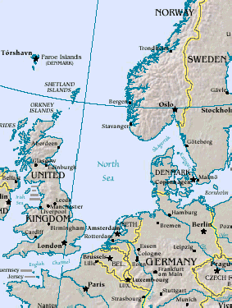
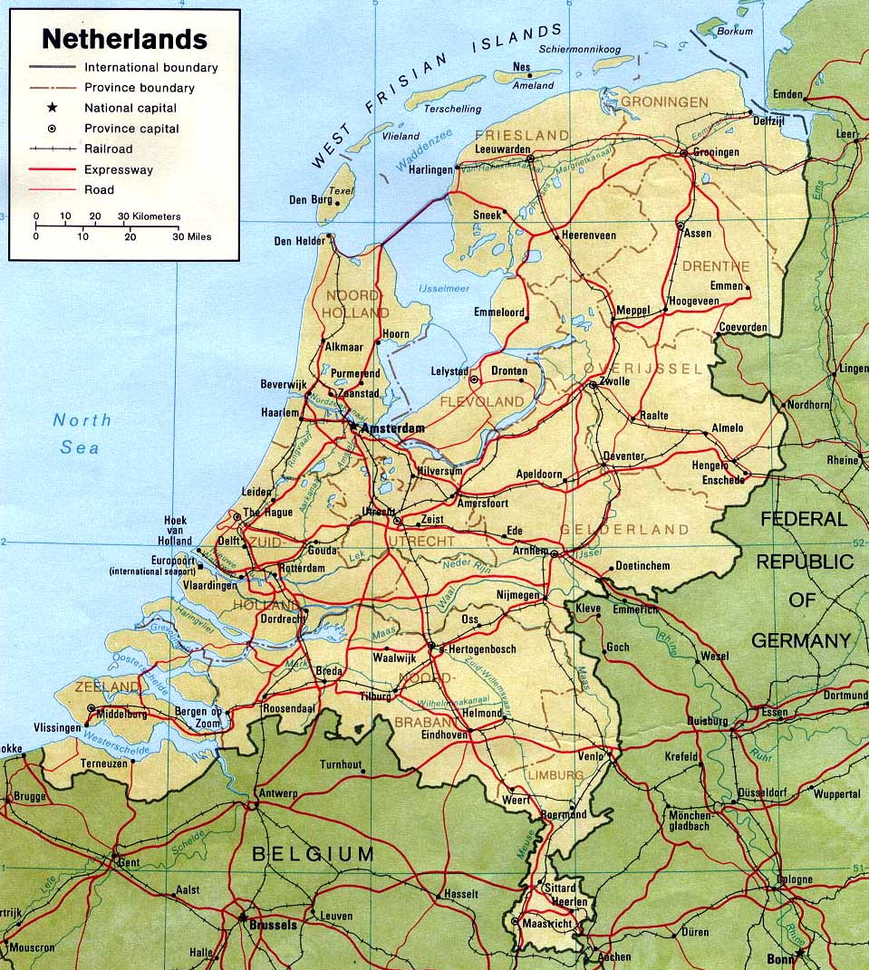
Notes:
Here you see the Netherlands and as you see we are surrounded by water
An other fact you should know is that a large part of the country is situated below sea level and protected by dunes and dikes.
Imagine!
Springtide is expected due to the position of the moon and the sun. We have a North Westerly gale blowing pushing al lot of the water into the North sea and In case of high water we can be treated by the water coming by the rivers from Central Europe and with a strong north-westerly flow we have a nice long fetch over the North sea which can cause extreme high tides especially during spring tides

Slide 3
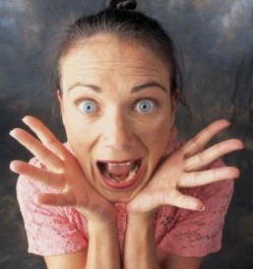
AND
Notes:
Next to that you have a forecaster who has only a little to no experience in these extreme circumstances and can’t remember where to find telephone numbers of key players, procedures how to handle in these circumstances or even worse freezes

Slide 4
How does it work in different sectors?
Notes:
How do other sectors prepare their people for difficult situations you can’t train in reality,
situations who doesn’t happen very often or emergency situations?

Slide 5
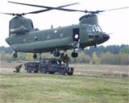
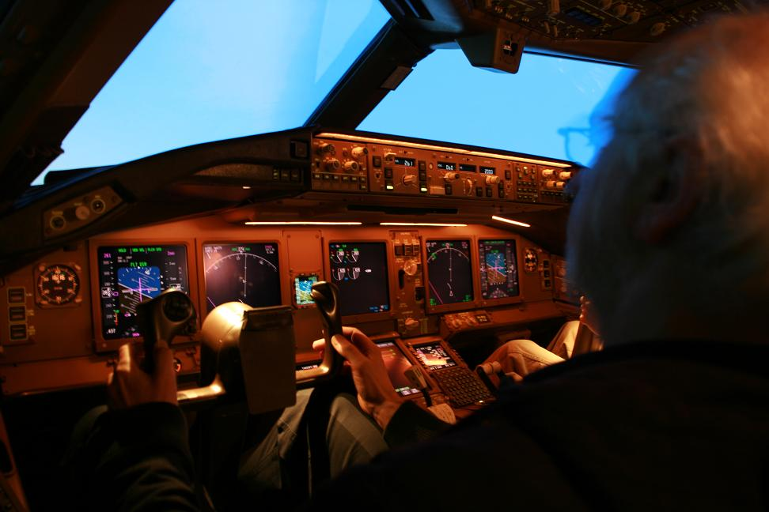
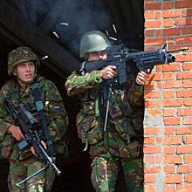
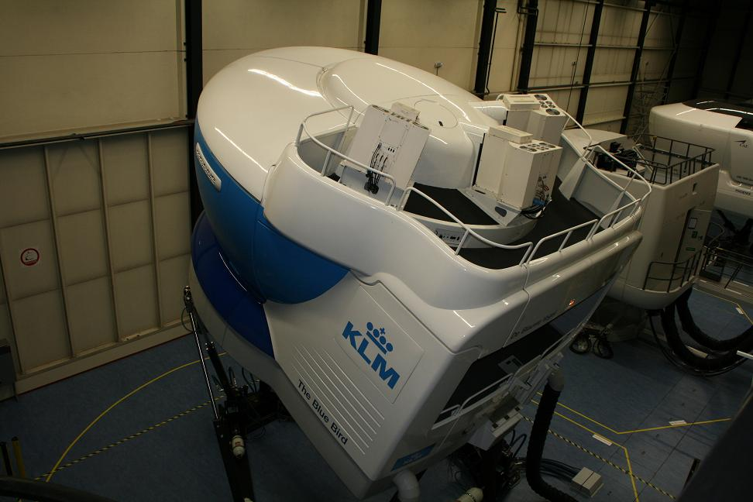
The Health Service of The Hague once had a simulation exercise in which a SARS epidemic had to be handled
Notes:
Pilots are trained in a simulator. At the KLM 5 times training and 2 exams in a simulator
We had a large simulation exercise where the army had to concur and airport in the Netherlands...
of all the parts of our army were working together in this simulation .
The Health service The Hague had a simulation exercise

Slide 6
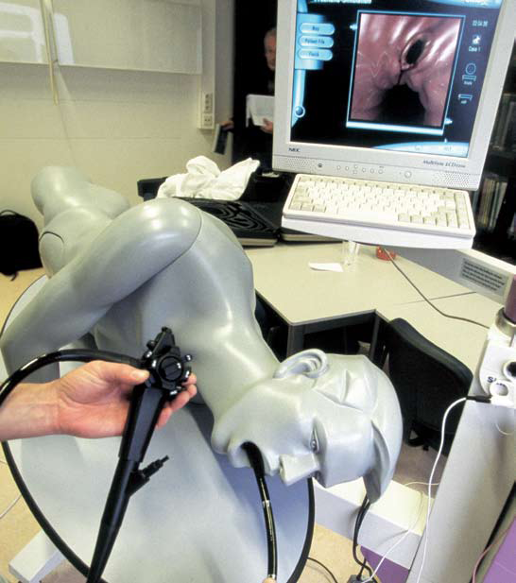
Notes:
Doctors use simulate people to practice medical procedure, like this one used for the SARS simulation.

Slide 7
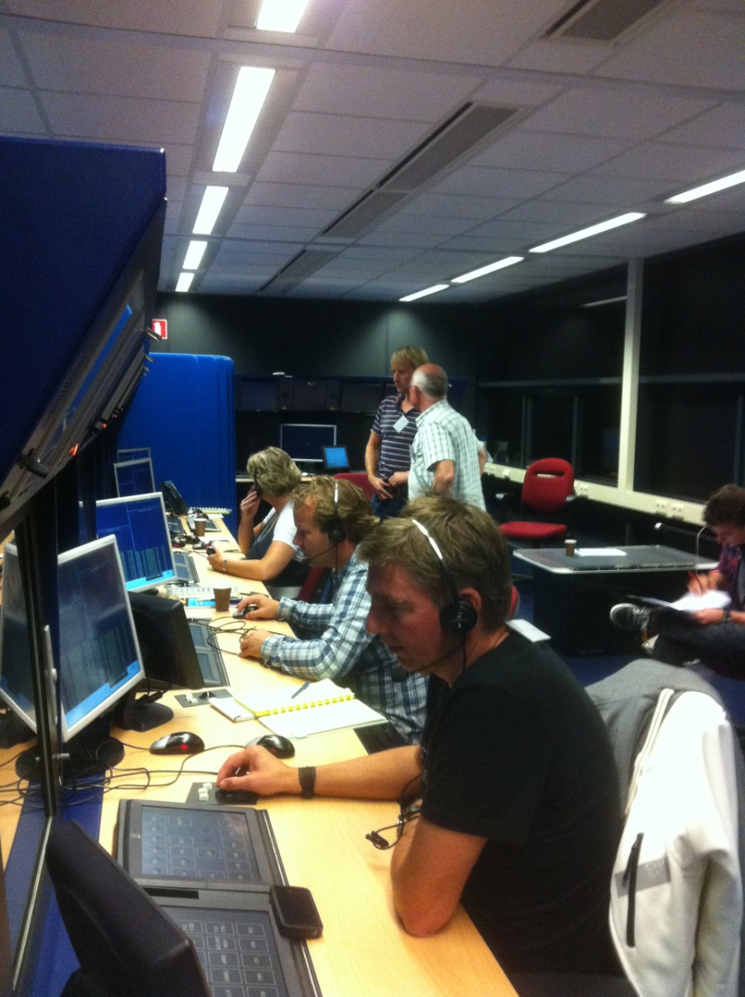
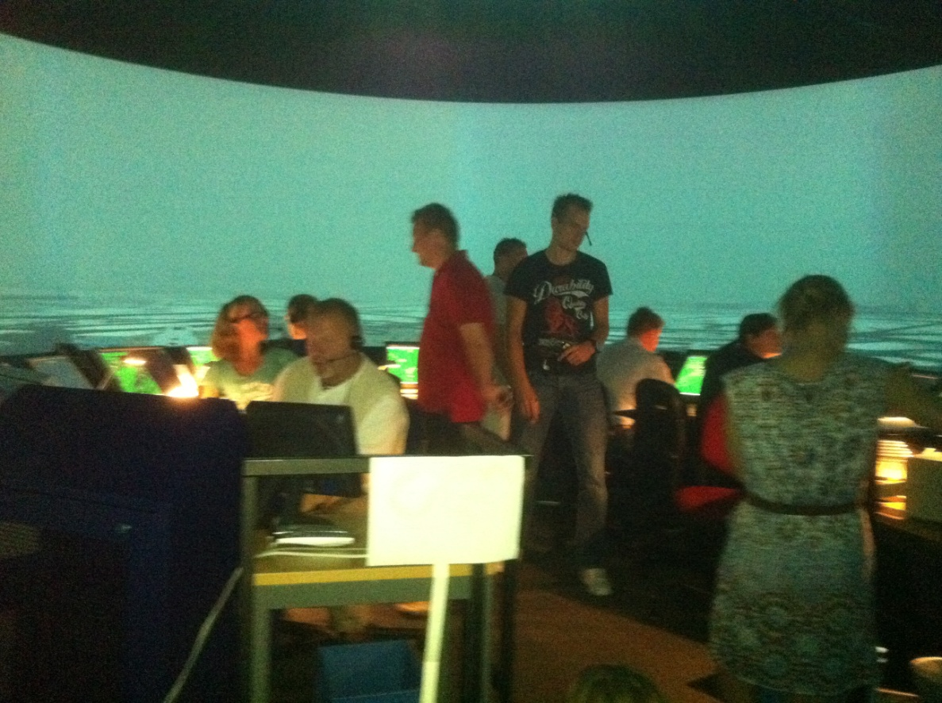
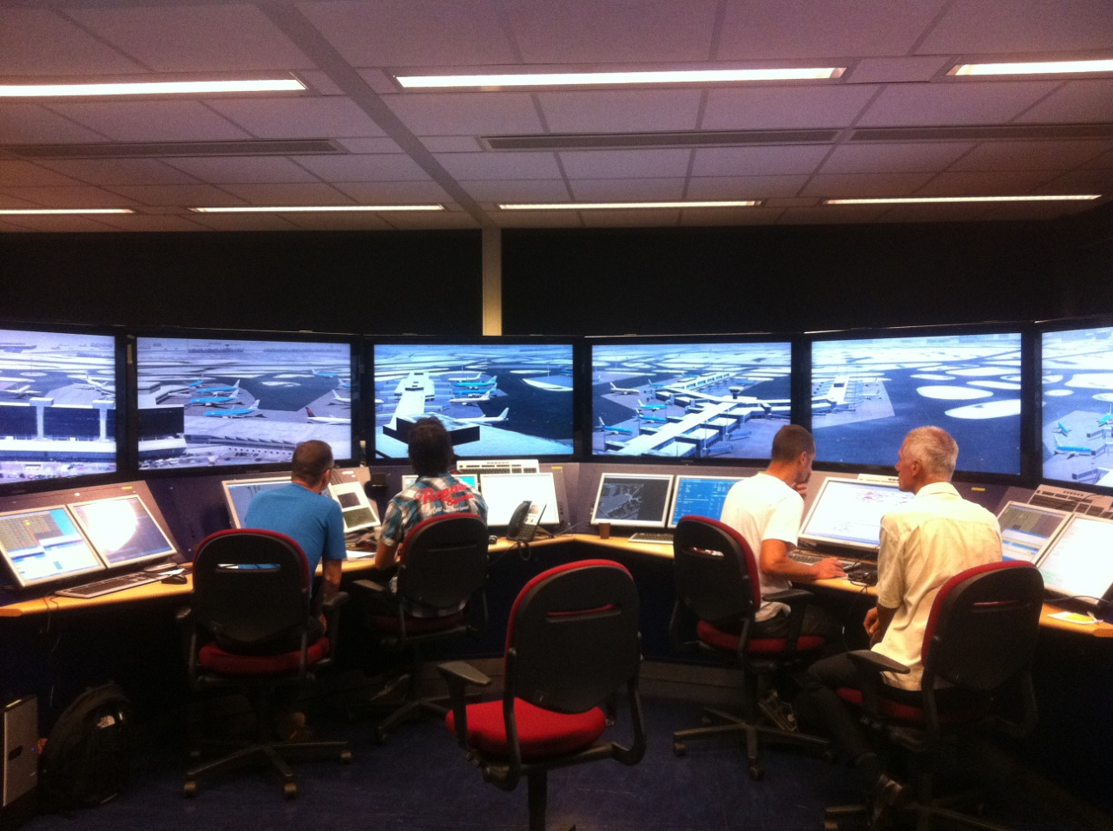
Notes:
Air traffic control and the people of the ground control from our Airport used a simulation
exercise to be prepared for snow situations in winter...

Slide 8
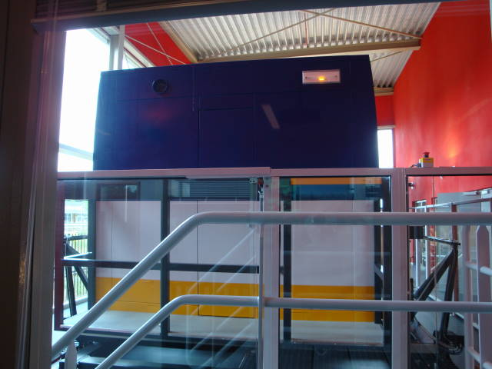
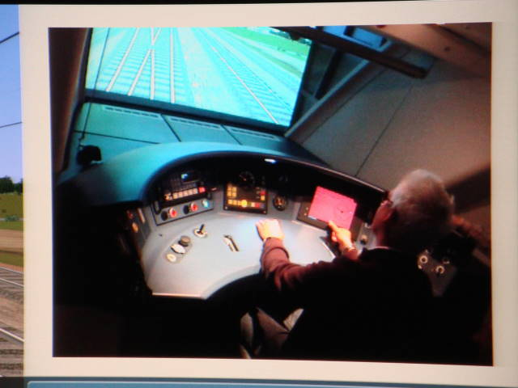
Notes:
Even our train drivers have their own simulator where they train twice a year!

Slide 9
Why don’t WE use simulators more often????
Notes:
So why do we not use simulator training more often in the Meteorology?
Are they scary? Too expensive?

Slide 10
What benefit can simulator training bring to your organisation ?
Notes:
What benefit can simulators bring to our organisations?

Slide 11
Theory 1
Daily life sometimes gives too little opportunity to gain relevant experience
extreme, high-impact situations
awareness on possibilities
realise the risks and develop competences to deal with them
better cooperation
Notes:
Forecasters need to be prepared for infrequent but high-impact events.

Slide 12
Theory 2
Experience is learning!
When exercising:
experience the process
get insights:
- how procedures work
- how collaboration/communication work (what can you do better)
- better decision making
Notes:
Learning by doing is the best way to ensure retention.

Slide 13
3 phases in learning
1) The education phase
2) The training phase
3) The practice phase
Notes:
There are 3 phases in learning where you have to go through to get your people competent to do their job:
1) The education phase: A phase in which you gain background knowledge
2) The training phase: In this phase you make knowledge to skills
3) The practice phase: A phase to secure skills also in situations with a lot of pressure
Simulation exercises can be used in different way in the last two phases of learning to learn tasks and competences to preform adequate in case of trouble.
However, they can also add to the education phase to provide context for learning.
13

Slide 14
My idea
Excellent for:
Determining gaps
Training
Assessment
Notes:
My idea is that training your people (or at least mine) with a simulator is an excellent way of
finding the gaps in the training programmes.......where does it go wrong? ... meteorological background? following procedures? or communicating with customers?
training your people for normal AND extreme situations....because in extreme situations people act differently from what you expect in normal situations...think of a little girl drowning in a pool...how many people are watching and not doing anything… That sort of thing happens in your weather service too if you don’t train your people for extreme situations!
last but not least.....I think training with a simulator is an excellent way to check out whether your people are competent to do their job

Slide 15
A Tip
Make a Situation Sketch:
the system
vulnerabilities
risks
organisation
SWOT
Notes:
A tip to help your managers work with you to develop good simulations….go through the situation sketch below…. it helps him/her to get their strategic views on training clear.
What does the system look like? make a list of
What products are made
What kind circumstances are possible (for instance weather types)
What actions/ procedures are available for what kind of situations
What customers
What production platforms are available
….
What are the vulnerabilities? What can go wrong in the process
- No data
- No production platform
- No personnel
- Communication: the telephone numbers to use are not correct
- Procedures are not followed
A risk analyses: What is the chance that something goes wrong and what will be the
consequences when things go wrong?
- what calamity situations can we expect?
- consequences for the office.
You can also ask the head of the forecasting office or account managers what went wrong and can be
done better next time ➔ very valuable information when you want to organise an exercise!
What did you organisation already do to have the people prepared for such situations? How well are
the people and your organisation prepared for extreme situations.
Last but not least, you can use a SWOT analyses (strengths, weaknesses, opportunities threats) to
set the priorities and goals of the training programme together with your boss.

Slide 16
Questions?
Notes:
Questions or ideas to share? Please use the CALMet Commons forum.

