Slide 1
WMO Global Campus: Open Educational Practice in Action
Patrick Parrish
Chief, Training Activities Divisions
Education and Training Office
Development and Regional Activities Department

Slide 2
WMO Global Campus Fundamentals
Builds upon the existing WMO ETR Programme (RTC network, national centres, and other national and international training partners)
Activities should increase learning opportunities for Members, through (a) increased visibility, (b) sharing resources, (c) facilitating innovations, (d) promoting compliance, (e) enhancing quality.
WMO Global Campus is an ETRP initiative, not a new programme or a proposal to move all training online.
Collaboration, Cooperation, Sharing

Slide 3
Global Campus Endorsements
SYMET-13: “…the feasibility activities in the WMO Global Campus demonstration show positive progress. SYMET-13 recommends the WMO Global Campus concept is further developed by the WMO Education and Training community for operational implementation during the 2020 to 2023 Financial period.”
EC Panel on ETR: “… decides to endorse the WMO Global Campus initiative for developing a coordinated and collaborative network of institutions that work together to meet the growing education and training needs of WMO Members…”
Executive Council -70: “…decides to endorse the WMO Global Campus initiative …, building upon the existing network of WMO Regional Training Centres (RTCs) and other WMO training partners.
Notes:
Rich

Slide 5
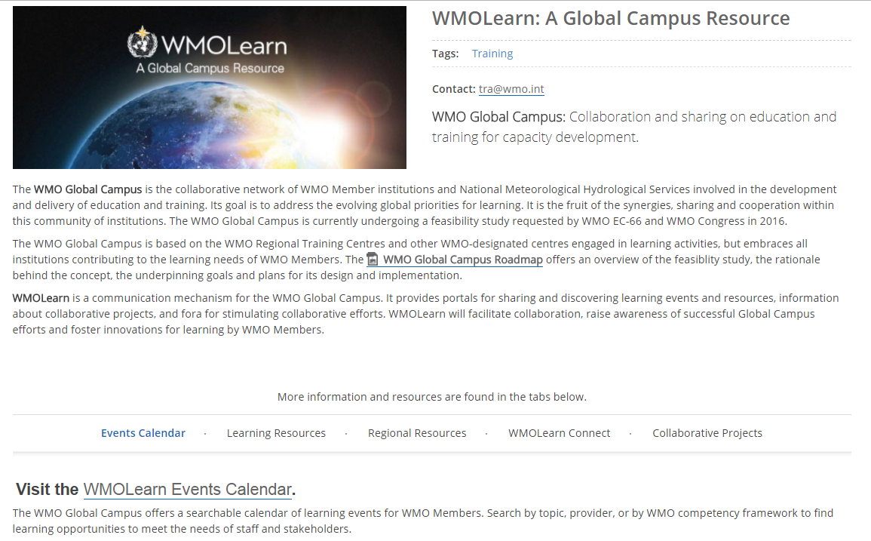
WMOLearn Portal
http://learn.wmo.int

Slide 6
WMOLearn Portal
Access to
Events calendar
Learning resources library
Regional resources
Social media
Collaborative projects
Global Campus Roadmap

Slide 7
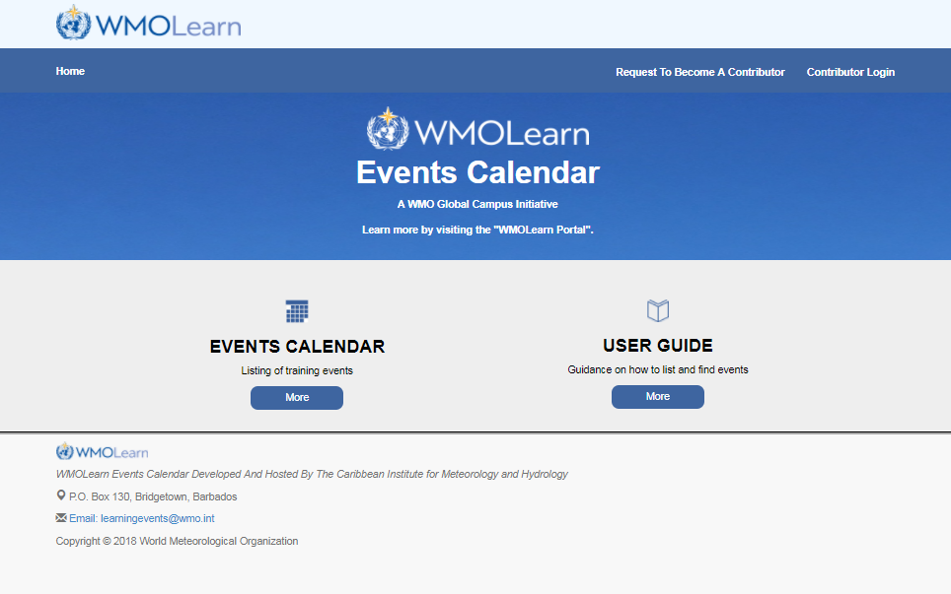
WMOLearn Events Calendar

Slide 8
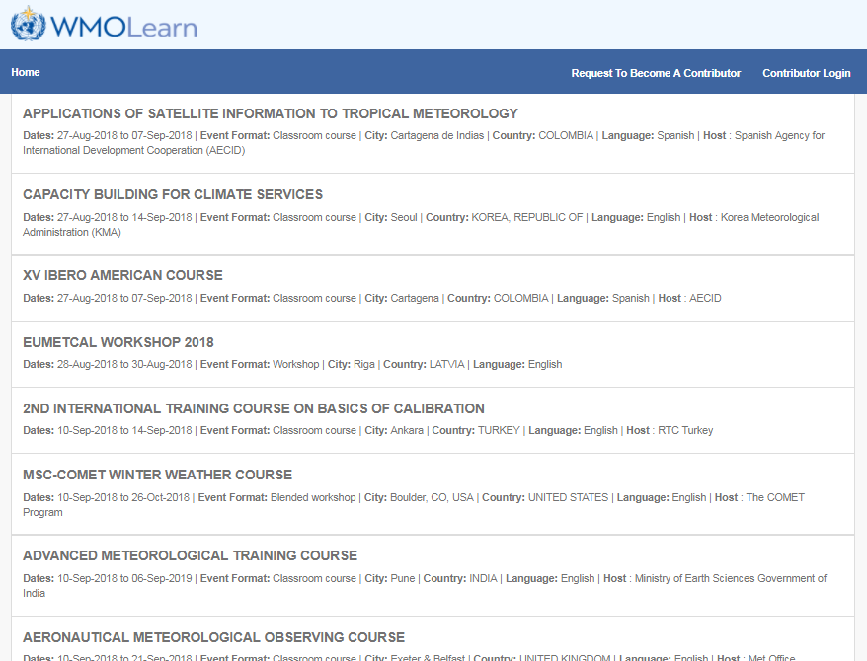
WMOLearn Events Calendar

Slide 9
WMOLearn Events Calendar
Features
Current and upcoming events around the world submitted by registered providers
Text search and filters by event metadata
Event notification (in development)
Synchronized databases (EUMETSAT/Vlab) and future partners
Collaborative projects

Slide 10
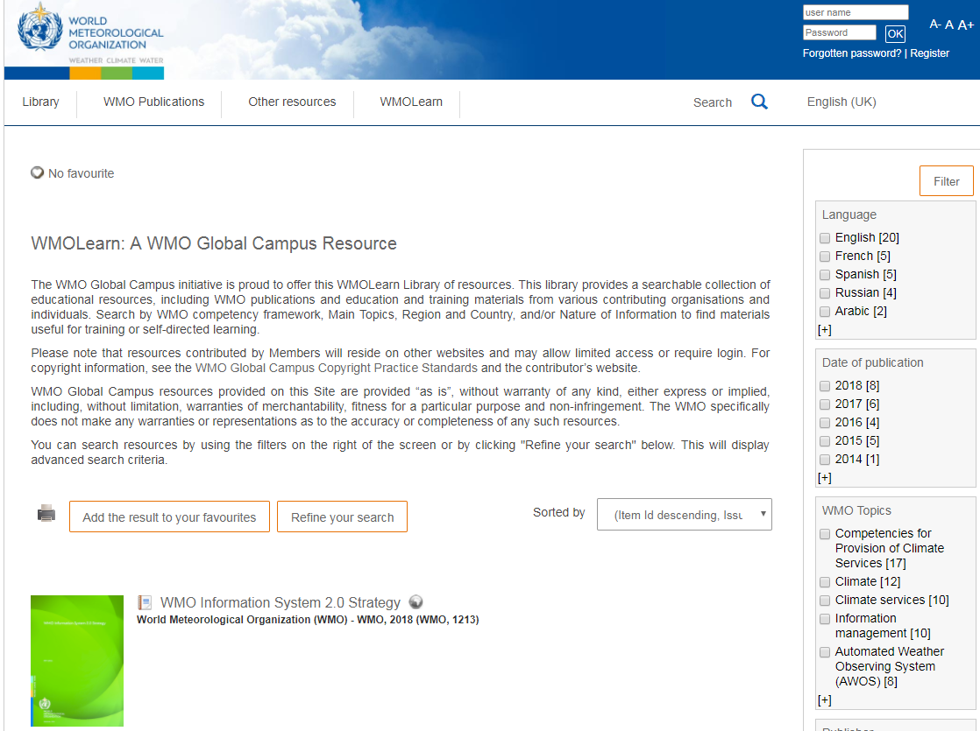
WMOLearn Resources Library

Slide 11
WMOLearn Resources Library
Features
Resources from WMO Secretariat, WMO Technical Commissions and all WMO Members who wish to share resources
External provider submission forms (in development)
Search by WMO Competency Framework
Filter by language, topic, publisher, document type, etc.
Metadata harvesting capability

Slide 12
Why should WMO promote OERs?
To drive innovation
To improve quality of content
To reduce costs
To allow for customization
To promote accessibility
Social justice—to increase opportunity

Slide 13
Why All institutions should want to use OERs
Build institutional reputation with stakeholders, funding sources and globally
Attract new staff and students
Share expertise within the institution
Encourage high-quality teaching and learning
Support modular course development
Support feelings of altruism—sharing knowledge is what we are here for
Encourage review of curriculum, pedagogy and assessment

Slide 14
Open Textbooks
A growing movement—academics choosing to by-pass commercial publishers to create affordable (free) textbooks for learners who might not otherwise be able to afford them.
https://open.umn.edu/opentextbooks/
https://research.cehd.umn.edu/otn/
https://www.oercommons.org/hubs/open-textbooks
http://ukopentextbooks.org/
https://textbooks.opensuny.org/

Slide 15
Additional activities
Translations Resource Center
Guidance on developing partnerships
Promoting innovative learning approaches (including new WMO publication)
Database of experts and institutional capabilities (a Global Campus topography)
Standard competency achievement certificates
Building a global E&T community of practice

Slide 16
Regional contributions to WMO Global Campus
WMO regional structures will benefit the WMO Global Campus and receive benefit
Regional coordination and leadership expected from the WMO Regional Training Centres and other institutions and programmes that address regional training needs
Regional coordination meetings, consortia, and other partnerships are in planning

Slide 17
Increased efficiency through Collaboration and Sharing
Collaborative Partnerships
New Collaborative Efforts
Workshops and Resources
New Customized Workshops and Resources
Events Announced in Calendar and Resources Shared
in Library
New Events Announced and Resources Shared
Outputs support new projects, adapted events and resources
Notes:
Pat speaks to this:
NOAA country projects includes additional partners
WMO-Argentina workshop include experts from USA, Australia, Brazil, UK, and France

Slide 18
Global Campus Challenges
Limited budget and human resources to support all defined activities
Complexity of activities requires many partners and shared leadership
Strong outreach required to inform stakeholder communities of benefits and encourage participation
Monitoring and reporting framework to evaluate use, usefulness, and efficiency
Success requires participation by ALL Members

Slide 19
Thank you
Merci

