Slide 1
Eumetcal
The European E&T Programma
Since 1998
Heleen.ter.pelkwijk@knmi.nl
Notes:
This presentation is about Eumetcal.
The first few slides I borrowed from our friend Alessandro Chiarello & Lisa Haga. Programme management of Eumetcal.

Slide 2
Notes:
The situation in Europe is that we have
1)
2)
3)
These all work together in the area of E&T under the umbrella of EUMETNET

Slide 4
Notes:
As this is an old slide Russia is missing on the list of official collaborations we have.

Slide 6
Notes:
The programme now focusses on operational forecasters

Slide 9
Notes:
Example are:
Training how to train people with the help of simulators
Training to train the assessors
Online course on Convection

Slide 11
Eumetcal 2
The European E&T Programma
2019 - 2023
Notes:
At the 1st of January 2019 a new EUMETNET phase will start with a Eumetcal 2 programme that will build further on the great work FMI has done with the Eumetcal work so far.

Slide 12
Eumetcal 2: Partnership between
&
Notes:
The Eumetcal 2 programme will be lead by a consortium consisting of KNMI and me as a programme manager and the Croatian Meteorological and Hydrological Service who will deliver a TSO.

Slide 13
Eumetcal 2 in EUMETNET Phase 2019 - 2023
Continuation of most important the Eumetcal features
Training infrastructure
Communication of training activities
Eumetcal Workshop
WMO Train the Trainer
Perform an extensive training and infrastructure needs assessment under all Members and partnering institutes involved with EUMETNET
Reconsider all the objectives of the EUMETNET E&T Programme
Make a plan for the continuation of the Eumetcal 2 Programme for the rest of the period
Create different packages for subscription by Members when growth is needed
Notes:
During the first two years we will focus on:

Slide 14
Ultimate goal Eumetcal 2
Increase the education and training opportunities for our members in the EUMETNET domain
AND
Prevent that we double work
Notes:
And the ultimate goal is

Slide 15
How
Spider Functionality!
Notes:
As programme management of Eumetcal 2 we are going use our spider in the web place to actively stimulate the community to cooperate, to share information and material and to collaborate to answer the E&T questions asked by the community.

Slide 16
How
To facilitate collaboration
Use gained information to match the institutes with same training needs and possible providers
Use tools that give better insight in what is available within the community
Build and support an active community of practice
Exchange information
on training methods
Infrastructure support on the tools
Story telling to inspire each other
Just a place were you can ask questions and find answers to all meteorological education and training related matters of your concern.
Notes:
Through using the information gained during the training and infrastructure needs assessment to match the institutes with the same training needs and possible providers right from the start. Next to that we will do our best to find tools that will give a better insight in the activities and the available material within our community. That will help to make the communication among Members easier enabling them to learn from each other and to be aware of what is happening within the community. It will be up to them to get in contact and to see whether cooperation is possible.
Next to that we will do our best to build and support an active community of practice where the Member community can exchange information on training methods, infrastructure support on the tools, failures and successes and ask all education and training related questions regarding matters of their concern.
Personally I think that the advantages of this all goes well beyond the European borders!

Slide 17
Warning!
If you want to take advantage of these types of network
Then you also need to put your effort into it to make it happen!
Notes:
But I do have a warning! If you want to take advantage of these types of network then you also need to put your effort into it to make it happen. Because an one way stream will dry and therefore will not work on the longer term.

Slide 18
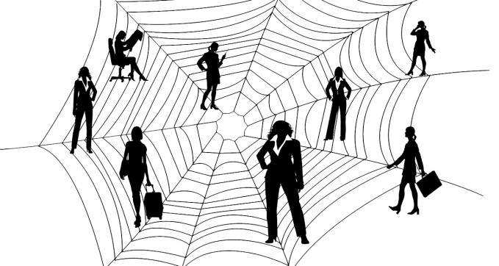
1+1 = 3
Notes:
By working very closely together with WMO Global Campus in realising our plans I really hope that the E&T web worldwide will be more populated with communities that will supplement and help each other and that we will come to a situation where 1 + 1 = 3!

Slide 19
Last but not least!!
Please visit the site: calmet.org
Notes:
Last but not least: please join us for CALMet next summer.
CALMet is a worldwide community of practice where we share our knowledge, best practices and learn from each other in education and training for the meteorological, hydrological and climate workforce.
Every two years we meet each other somewhere on this planet and please don’t worry when you don’t have the budget to come. In the in between years have online activities available in which you can take part in or contribute to.
I really look forward to see and work with you all again somewhere in (nearby) future.

