Slide 1
RA-I WMO Global Campus Meeting
SYMET Outcomes: An International Agenda for Education and Training in Meteorology and Hydrology

Slide 2
SYMET 13 Context How to meet the unmet learning demand
From ETR, 21. Status of Human Resources in National Meteorological and Hydrological Services

Slide 3
SYMET 13 Context RA-I reported unmet learning demand
From ETR, 21. Status of Human Resources in National Meteorological and Hydrological Services

Slide 4
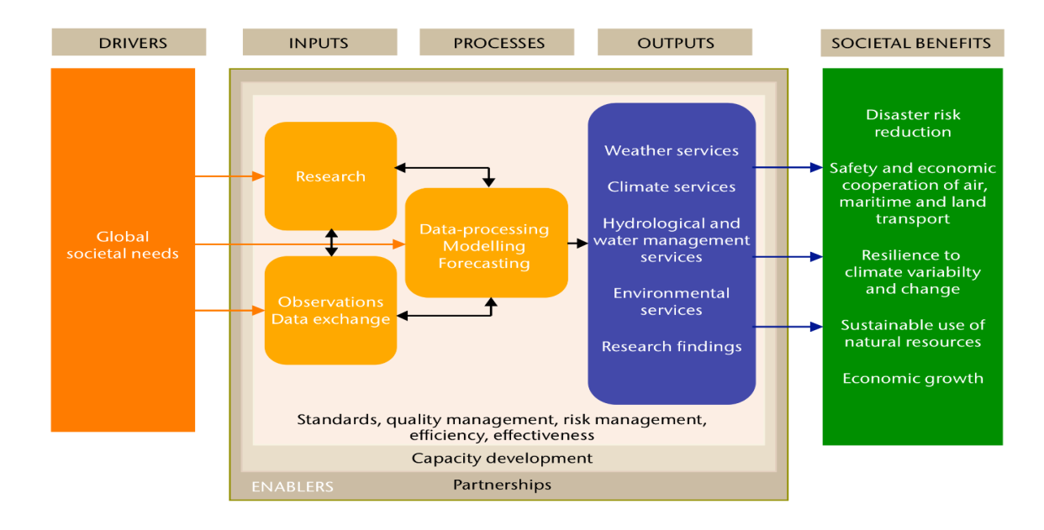
SYMET 13 Context Changing service delivery demands
From WMO-1219, An International Agenda for Education and Training in Meteorology and Hydrology

Slide 5
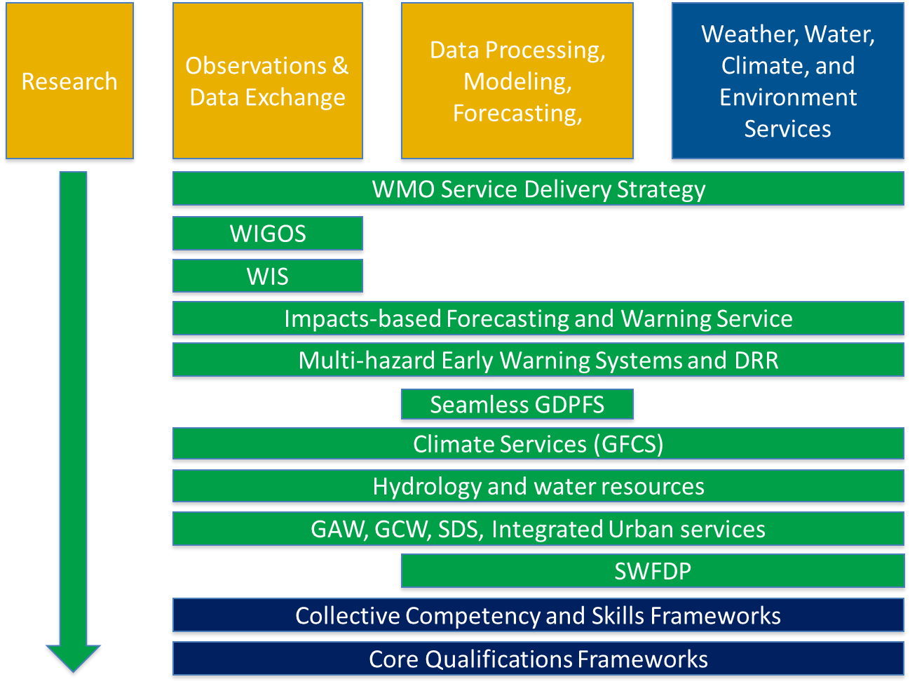
SYMET 13 Context Changing service delivery demands
From WMO-1219, An International Agenda for Education and Training in Meteorology and Hydrology

Slide 6
SYMET & RTC Directors Meeting Recommendations (condensed)
Resourcing for infrastructure and personnel of training institutions must increase to meet the growing demands for education and training across all societal sectors.
Management, leadership, communication and advocacy skills need to be introduced into initial and continuous professional development programmes.
National and international foundations and projects need to pay more attention to research, education and training relevant to all potential audiences of environmental issues.
From WMO-1219, An International Agenda for Education and Training in Meteorology and Hydrology

Slide 7
SYMET & RTC Directors Meeting Recommendations
WMO regulatory material on competencies and standards for initial education and training should be regularly reviewed and updated in light of the evolving service requirements.
Technical Commissions should be requested to assist service providers to streamline methods of setting up and maintaining competency systems and assessment.
The WMO Global Campus concept is further developed by the WMO Education and Training community for operational implementation during the 2020 to 2023 financial period
The WMO Secretariat is requested to play an active role in supporting the development and ongoing activities that comprise the WMO Global Campus concept.
From WMO-1219, An International Agenda for Education and Training in Meteorology and Hydrology

Slide 8
Additional SYMET & RTC Meeting Outcomes
Need to address the large number of learners with growing and changing needs
Recommendations:
Encourage foundations and projects to pay more attention to education and training needs to respond to environmental challenges
RTCs must actively participate in raising resources for Fellowships and training
Increase training capacity and effectiveness through further development of training skills and capabilities to use new training technologies

Slide 9
Additional SYMET & RTC Meeting Outcomes
Need to address training needs in new and emerging service delivery areas
Recommendations:
Need for management, leadership, communication, and advocacy skills
Regulatory material concerning competency standards must be regularly reviewed
Technical commissions and departments should assist in implementing competency systems
Management development must be considered a priority for all areas
RTCs must align programmes to support new competency and qualification frameworks
RTCs and other training providers must align to changes in technology and user-oriented service delivery areas

Slide 10
Additional SYMET & RTC Directors Meeting Outcomes
Need to enhance infrastructure, practices, and visibility of training institutions
Recommendations:
Resources for infrastructure upgrades and personnel must be increased to meet increasing demand
Institutional strengths and specializations in priority areas should be documented and shared in highly visible ways to Members
Training institutions should share learning and trainer resources and collaborate to meet regional needs
Training institutions should adapt programmes to address changing needs
Research should be encouraged and results must be better disseminated and utilized
RTCs should share results on improved processes and successful projects

Slide 11
Additional SYMET & RTC Meeting Outcomes
Need to increase collaboration and cooperation
Recommendations:
The WMO Global Campus initiative should be further developed and promoted for operational implementation
The WMO Secretariat should play an active role in supporting and developing WMO Global Campus activities
WMO Global Campus initiative should seek regional consultation in its development

Slide 12
Thank you
Merci

