Slide 1
WIGOS Metadata Standard
… Supporting adequate use of observations & rational network evolution
Jörg Klausen, MeteoSwiss
ICG-WIGOS TT-WMD

Slide 2
Outline
Introduction
WMDS Basics
WMDS Advanced
Summary

Slide 3
introduction

Slide 4
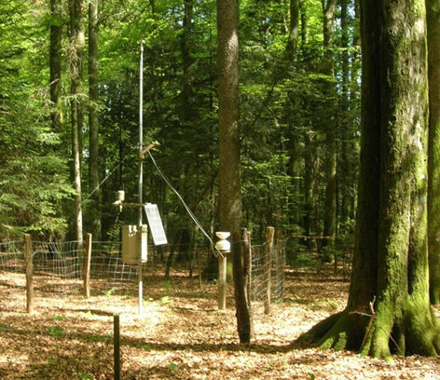
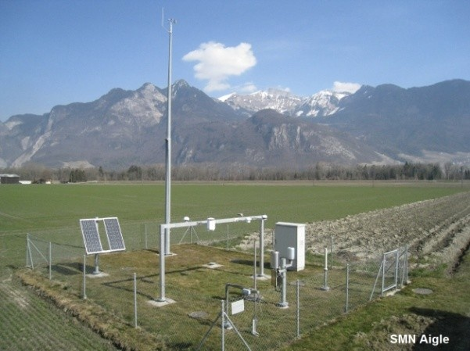
What are metadata? Why are they essential?
Metadata = documentation describing data, context of observations
Observed variable
Location
Environment
Intended use
…
Essential data are exchanged globally, but metadata are not.
Even though metadata are needed to make adequate use of observations, they have not always been easily available to users.
T=17°C
T=17°C
T=17°C
T=17°C

Slide 5
Metadata for climate applications
“The details and history of local conditions, instruments, operating procedures, data processing algorithms and other factors pertinent to interpreting data (i.e. metadata) should be documented and treated with the same care as the data themselves.”
GCOS Climate Monitoring Principle #3

Slide 6
Objectives and Approach
Enable adequate use of meteorological and climatological observations for various application areas serving society.
Inform Members how to evolve their observing systems rationally, with a view to the needs of the global systems.
Develop a common metadata standard to improve the documentation and exchange of information.
Establish a web-based platform for the management, archival and exchange of such information world-wide.

Slide 7
Purposes of Metadata
Describe products
Support discovery, access, retrieval
Formalized using ISO19115 metadata standard
Describe observations, stations
Enable adequate use of observations
Support rational evolution of observing systems
→Formalized using ISO19156 (includes ISO19115) metadata standard
WIS
WIGOS

Slide 8
WMDS Basics
WIGOS MetaData Standard

Slide 9
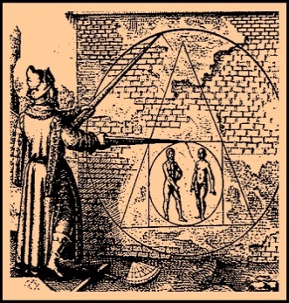
Requirements
Enable adequate use of observations
Cover all types of observations
Cover all disciplines / application areas
Forward-looking but also respecting legacy
Acceptable to and applicable by all Members
Keep it simple, not too many items
… or, how to square the circle

Slide 10
10 WIGOS metadata categories
Observed variable
Purpose of observation
Station/platform
Environment
Instruments and method of observation
Sampling
Data processing and reporting
Data quality
Ownership and data policy
Contact

Slide 11
Hierarchy of WMD categories
StationSet
Station/Platform (fixed, mobile)
Observation
Environment
Deployment
Data Quality
Contact
Instrument
Procedures
→ Sampling
→ Processing
→ Reporting
Purpose of observation
Ownership
Data Policy
Contact

Slide 12
WMDS Advanced

Slide 13
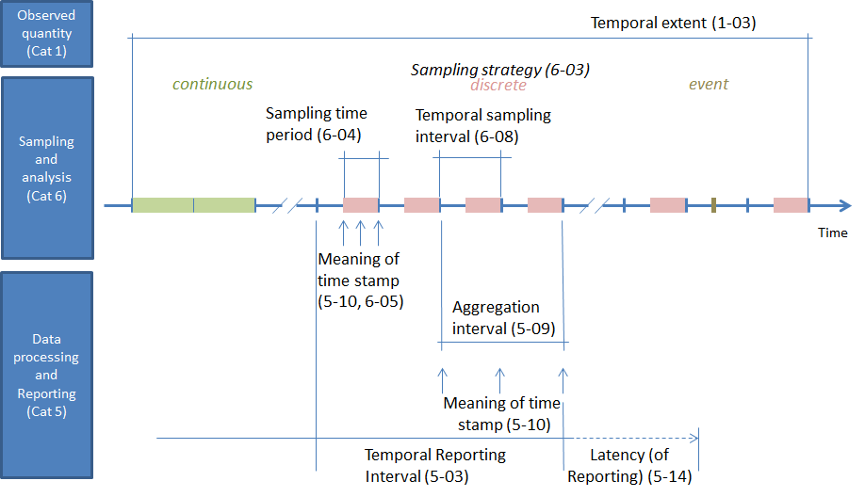
Concepts of Time in WMDS

Slide 14
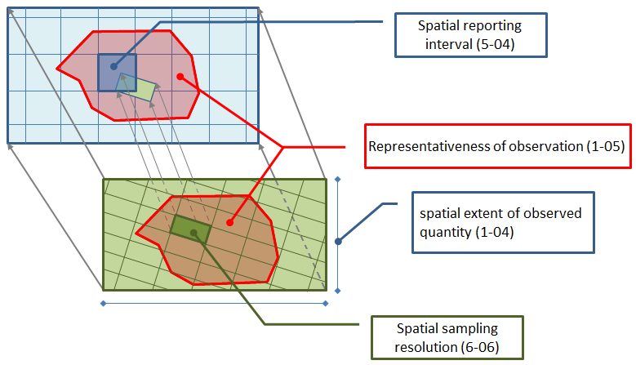
Concepts of space in WMDS

Slide 15
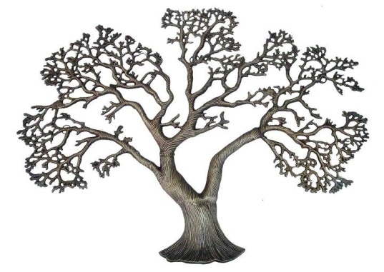
Characteristics of WIGOS Metadata
WIGOS
Generation
Various levels of granularity
Transmission
Various intervals for (incremental) update
Access and use
By humans (researchers, managers, the public)
By machines (services)
WIS
Rather invariant
intermediate
Very dynamic

Slide 16
Implementation of WMDS
Reporting obligations
Mandatory items (28)
Conditional items (21)
Optional items (18)
Adoption in 3 phases
Phase I 2016 (24)
Phase II 2017-2018 (19)
Phase III 2019-2020 (24)
Some elements consist of multiple «atomic» entities

Slide 17
Category | Phase I (2016) | Phase II (2017–2018) | Phase III (2019–2020)
1. Observed variable | 1-01 Observed variable – measurand (M) | 1-05 Representativeness (O)
 | 1-02 Measurement unit (C)
 | 1-03 Temporal extent (M)
 | 1-04 Spatial extent (M)
2. Purpose of observation | 2-01 Application area(s) (M)
 | 2-02 Programmes/network affiliation (M)
3. Station/ platform | 3-01 Region of origin of data (C) | 3-04 Station/platform type (M) | 3-05 Station/platform model (M)
 | 3-02 Territory of origin of data (C) | 3-08 Data communication method (O)
 | 3-03 Station/platform name (M)
 | 3-06 Station/platform unique identifier (M)
 | 3-07 Geospatial location (M)
 | 3-09 Station operating status (M)
4. Environment |  | 4-04 Events at station/platform (O) | 4-01 Surface cover (C)
 |  | 4-05 Site information (O) | 4-02 Surface cover classification scheme (C)
 |  |  | 4-03 Topography or bathymetry (C)
 |  |  | 4-06 Surface roughness (O)
 |  |  | 4-07 Climate zone (O)
5. Instruments and methods of observation | 5-01 Source of observation (M) | 5-11 Maintenance party (O) | 5-04 Instrument operating status (O)
 | 5-02 Measurement/observing method (M) | 5-12 Geospatial location (C) | 5-06 Configuration of instrumentation (C)
 | 5-03 Instrument specifications (C) | 5-15 Exposure of instrument (C) | 5-07 Instrument control schedule (C)
 | 5-05 Vertical distance of sensor (C) |  | 5-08 Instrument control result (C)
 |  |  | 5-09 Instrument model and serial number (C)
 |  |  | 5-10 Instrument routine maintenance (C)
 |  |  | 5-13 Maintenance activity (O)
 |  |  | 5-14 Status of observation (O)
6. Sampling | 6-03 Sampling strategy (O) | 6-05 Spatial sampling resolution (M) | 6-01 Sampling procedures (O)
 | 6-07 Diurnal base time (C) |  | 6-02 Sample treatment (O)
 | 6-08 Schedule of observation (M) |  | 6-04 Sampling time period (M)
 |  |  | 6-06 Temporal sampling interval (M)
7. Data processing and reporting | 7-03 Temporal reporting period (M) | 7-02 Processing/analysis centre (O) | 7-01 Data processing methods and algorithms (O)
 | 7-04 Spatial reporting interval (C) | 7-06 Level of data (O) | 7-05 Software/processor and version (O)
 | 7-11 Reference datum (C) | 7-09 Aggregation period (M) | 7-07 Data format (M)
 |  | 7-10 Reference time (M) | 7-08 Version of data format (M)
 |  |  | 7-12 Numerical resolution (O)
 |  |  | 7-13 Latency (of reporting) (M)
8. Data Quality |  | 8-01 Uncertainty of measurement (C)
 |  | 8-02 Procedure used to estimate uncertainty (C)
 |  | 8-03 Quality flag (M)
 |  | 8-04 Quality flagging system (M)
 |  | 8-05 Traceability (C)
9. Ownership and Data Policy | 9-02 Data policy/use constraints (M) | 9-01 Supervising organization (M)
10. Contact | 10-01 Contact (nominated focal point) (M)

Slide 18
summary

Slide 19
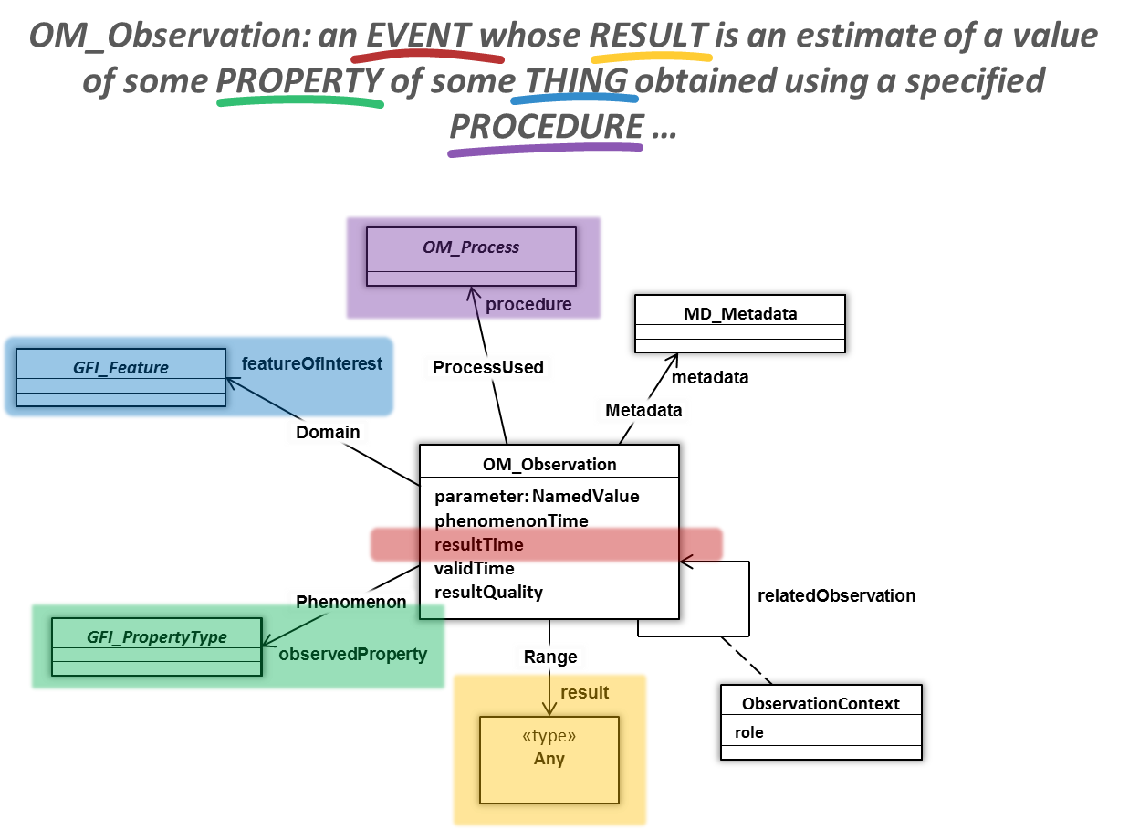
Summary
WIS
Describe products
Discovery, access & retrieval
ISO 19115-2
Geographical Extent
Keywords
MD_Metadata
Contact
Distribution
Describe observations, stations
Enable adequate use
Support rational evolution of observing systems → RRR
Manadatory, conditional, optional items
Phased adoption 2016-2020
ISO 19156 with extensions
Legal Constraints
WIGOS
MD_Metadata: Something somewhere that can be accessed under certain conditions and about which someone knows more.

Slide 20
Thank you
Merci
شكرا
You & your organization!
Financial support. Swiss Federal Office of Foreign Affairs, MeteoSwiss, WMO, Met Norway
Project Team at MeteoSwiss. (current) J Klausen, L Cappelletti, B Calpini, M Musa, M Brändli, L Koppa, C Walder, E Grüter, S Sandmeier, M Schäfer, A Rubli, Tom Hager, Attila Loos; (past) J Mannes, S Spreitzer, M Leutenegger, C Sigg, M Abbt, W Brunelli, J Mettler
Project Team at WMO (current). F Belda, LP Riishojgaard, T Pröscholdt
Project Team at European Dynamics (current). T Galousis, M Ulmann, L Christou, N Pappa, S Sklavos, …
ICG-WIGOS. S Barrell, B Calpini, …
TT-WMD. (current) K Monnik, J Klausen, J Swaykos, T Boston, U Looser, E Büyükbas, Zhao Licheng, T Oakley, S Foreman, D Lockett, L Nunes
IPET-MDRD. D Lowe, J Tandy, …
JCOMMOPS, GAW WDCs, ET-WDC, …

Slide 21
What Members will need to do:
Comply with the WMO Technical Regulations; WMO-No. 49, Volume I, Part I – WIGOS and the Manual on WIGOS:
Keep records of WIGOS metadata
For those observations that are exchanged internationally:
Exchange also the associated WIGOS metadata
Review the information in OSCAR/Surface
Keep entries in OSCAR/Surface up to date
The more accurate and up-to-date the information in OSCAR/Surface is, the more useful it will be!

