Slide 1
OSCAR/Surface training course
Tokyo/Japan
13-15 November 2019

Slide 2
Agenda
Event logistics
Overview WIGOS, RRR and OSCAR
Country presentation template
Preparations (moodle, OSCAR/Surface)
Your expectations and Q&A

Slide 3
Event logistics
Travel arrangements / DSA
Hotel reservations
Local transport
Visa
Agenda

Slide 4
The WMO Integrated Global Observing System;
Status of pre-operational phase, plans for transition to operational phase;
OSCAR/Surface training course for R A II – Tokyo/Japan
WMO Secretariat

Slide 5
The WIGOS Pre-Operational Phase (2016-2019) decided by Cg-17 in 2015
Increased emphasis on regional and national activities
Five main priority areas:
WIGOS Regulatory Material, supplemented with necessary guidance material;(already covered under draft resolution Cg-18 6.1(1)/3);
WIGOS Information Resource, including the Observing Systems Capabilities analysis and Review tool (OSCAR), especially OSCAR/Surface;
WIGOS Data Quality Monitoring System (WDQMS);
Regional Structure; Regional WIGOS Centers;
National WIGOS Implementation, coordination and governance mechanisms; undertaken by Members, supported by items I-IV

Slide 6
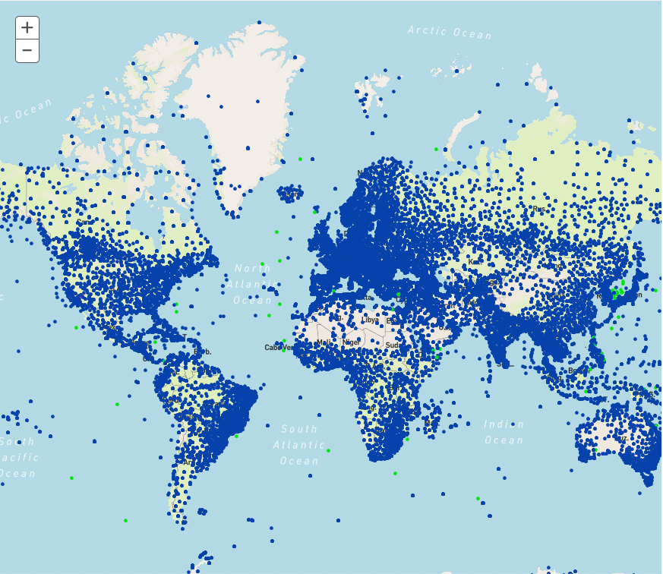
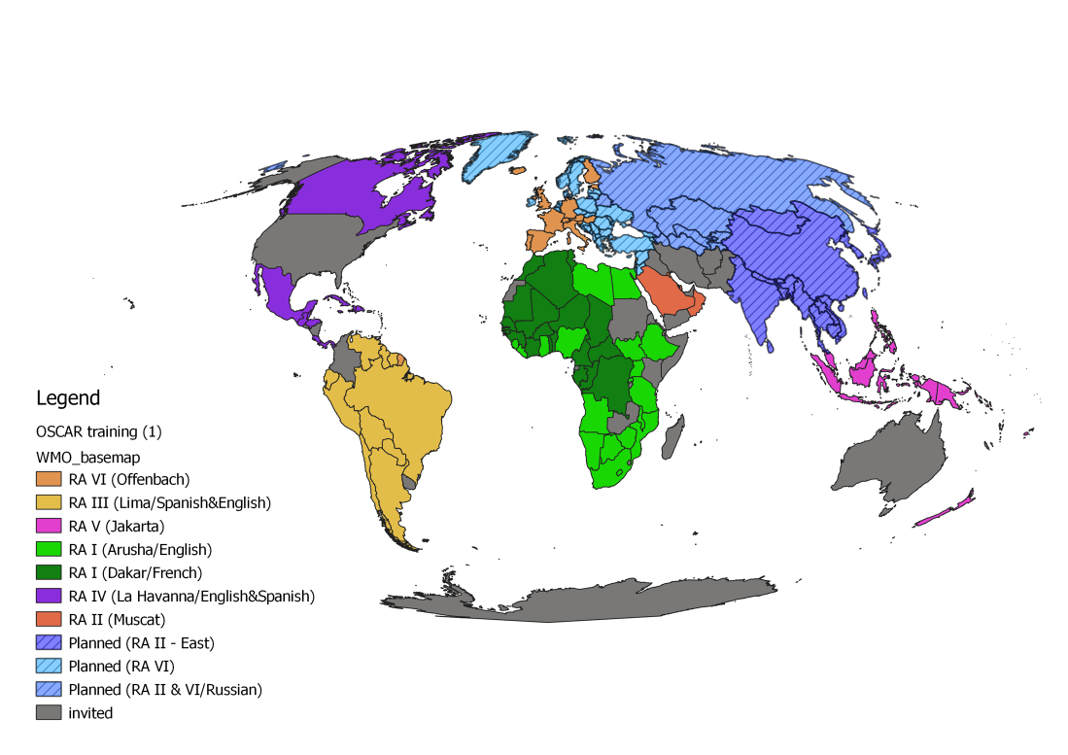
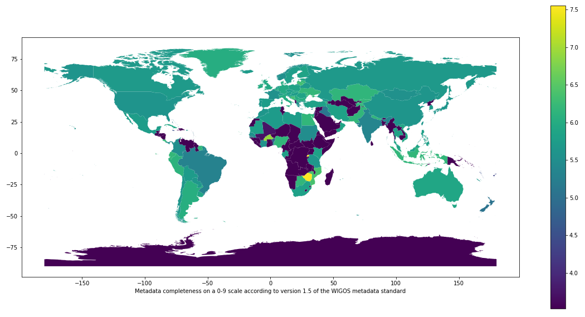
II. WIGOS Information Resource (Observing Systems Capabilities and Review, OSCAR)
Three operational databases supporting WIGOS:
OSCAR/Requirements, in which “technology free” requirements are provided for all WMO application areas;
OSCAR/Space, listing the capabilities of all satellite sensors;
OSCAR/Surface, list surface-based capabilities; developed by MeteoSwiss for WMO, operational since May 2016;
OSCAR homepage
WIGOS self portrait (OSCAR); stations operating on June 6 2019
OSCAR training delivered worldwide
OSCAR metadata completeness (lighter colors is better)

Slide 7
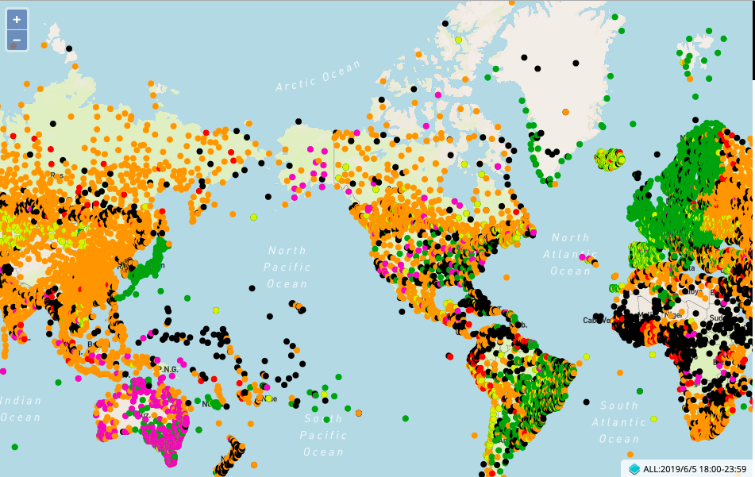
III. WIGOS Data Quality Monitoring System
Tool to measure how well WIGOS is functioning
Real-time monitoring of performance
data availability (implemented) and quality (in development),
searchable by region, country, station type, period, etc.
for all WIGOS components (GOS, GAW, WHOS, GCW, GCOS),
Incident management component for mitigation of issues
WDQMS data delivery; surface pressure observations exchanged internationally, June 5 2019, 18Z
Current status:
Pilot project on NWP-based monitoring: data from ECMWF, NCEP, DWD, JMA;
Data analysis and web display tool now being developed in pre-operational mode by ECMWF

Slide 8
IV. Regional WIGOS Centers (RWC)
What?
Critical support of national WIGOS Implementation especially for
OSCAR/Surface; input and updating of metadata, QC
WDQMS; monitoring and coordination of mitigation efforts
How?
To be decided by the WMO Regions – in alignment with existing cultural, linguistic and/or political groupings
The relatively slow pace of engagement of NMHSs in RWC development has been a risk factor for WIGOS!
Recent signs of progress have been encouraging
Region I: RWC pilot planned in East Africa (Kenya and Tanzania); South Africa has submitted proposal; interest from Morocco;
Region II : China and Japan have RA-II approved RWC pilots; national commitment from Saudi Arabia; interest from India and Russia;
Region III: Plans for Virtual RWC approved by RA-III-17 in November 2018;
Region IV: CMO has expressed interest; Canada, USA may help; to be discussed during Cg-18
Region V; Formal decision by RA-V-17 in October 2018 to request Australia and Singapore to submit RWC proposal; encouraging Fiji, Indonesia to join;
Region VI: successful RWC operating in pilot mode thanks to EUMETNET; tentative plan for RWCs also in Russia/Belarus and Croatia (specifically for marine observing systems). Interest also from Greece, Italy, Turkey.

Slide 9
V. National WIGOS Implementation
Almost all Members have had exposure to both the WIGOS concept and to the specifics of the WIGOS Technical Systems via dedicated WIGOS Workshops arranged by the WMO Secretariat in all Regions;
A majority of Members have had at least some level of activity in using the OSCAR/Surface database to manage their surface-based observing systems;
Assessment of national observing capabilities made for several Members;
A small number of countries have developed and approved their National WIGOS Implementation Plans;
The bulk of the national WIGOS implementation work is expected to take place once the Regional WIGOS Centres are fully functional and once National WIGOS Implementation Plans have been developed and approved.

Slide 10
Res. 6.1(1)/4: WIGOS is now mature enough to transition from project to operational status, as basic WMO infrastructure, with the following six priority areas:
National WIGOS implementation;
Implementation of the Global Basic Observing Network and the Regional Basic Observing Networks;
Operational deployment of the WIGOS Data Quality Monitoring System;
Operational deployment of Regional WIGOS Centres;
Further development of the Observing Systems Capability Analysis and Review (OSCAR) databases and integration with other system elements;
Fostering a culture of compliance with the WIGOS technical regulations.
Request Infrastructure Commission to develop a plan for these activities for the 2020-2023 period and submit to EC-72 for approval

Slide 11
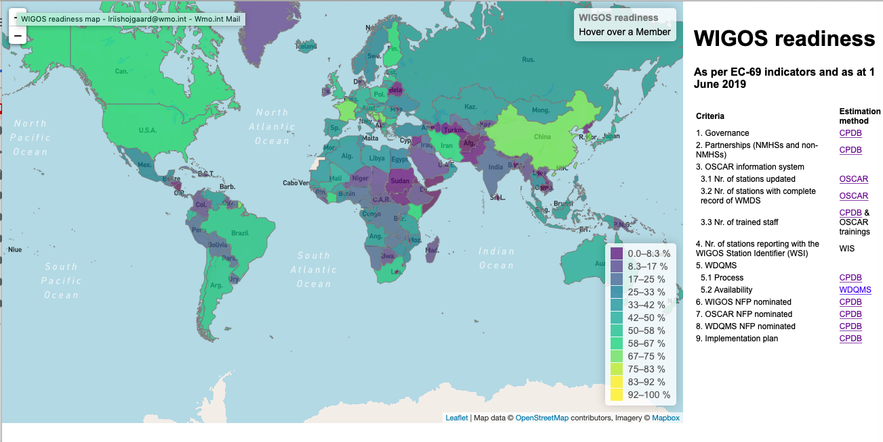
Fostering a culture of compliance Monitoring of WIGOS Implementation by country; 1st step

Slide 12
Member Country Name
Submitted by
OSCR/Surface Training for RA II
13-15 November 2019, Tokyo, Japan

Slide 13
Introduction to the country and the NMHS (1 slide maximum)
General overview of the country
Physical context
Climate, including extreme events
Brief introduction to the NMHS
Mandate
Infrastructure
Staff

Slide 14
National requirements for observations (1 slide maximum)
National priority application areas
Health? Agriculture? Hydrology? Transports?
…
Most relevant observed variables:
Temperature, humidity, precipitation, wind
Pressure, radiation, …

Slide 15
Inventory of current national observing capabilities (maps and lists – 2 or 3 slides in total)
Networks description with metadata
Map and list of meteorological/climatological operational stations (identifying the technology used):
Surface observing stations
Precipitation stations
Upper-air/radiosonde stations
Weather Radars
Lightning detection networks
Map and list of other surface operational stations:
Hydrological stations
Sea stations
Atmospheric composition and other stations

Slide 16
Station list example
Name | Latitude | Longitude | Elevation | Station type | Variables | Schedule
MyStation | 66.123 | 56.78 | 1234 | SYNOP | Pressure, temperature, humidity, .. | Hourly

Slide 17
Your preparations before the coursE
Register in Moodle and OSCAR/Surface

Slide 18
Moodle
Find our OSCAR/Surface learning plattform here:
https://etrp.wmo.int/course/view.php?id=146
And the Moodle course for this training event here:
https://etrp.wmo.int/course/view.php?id=177

Slide 19
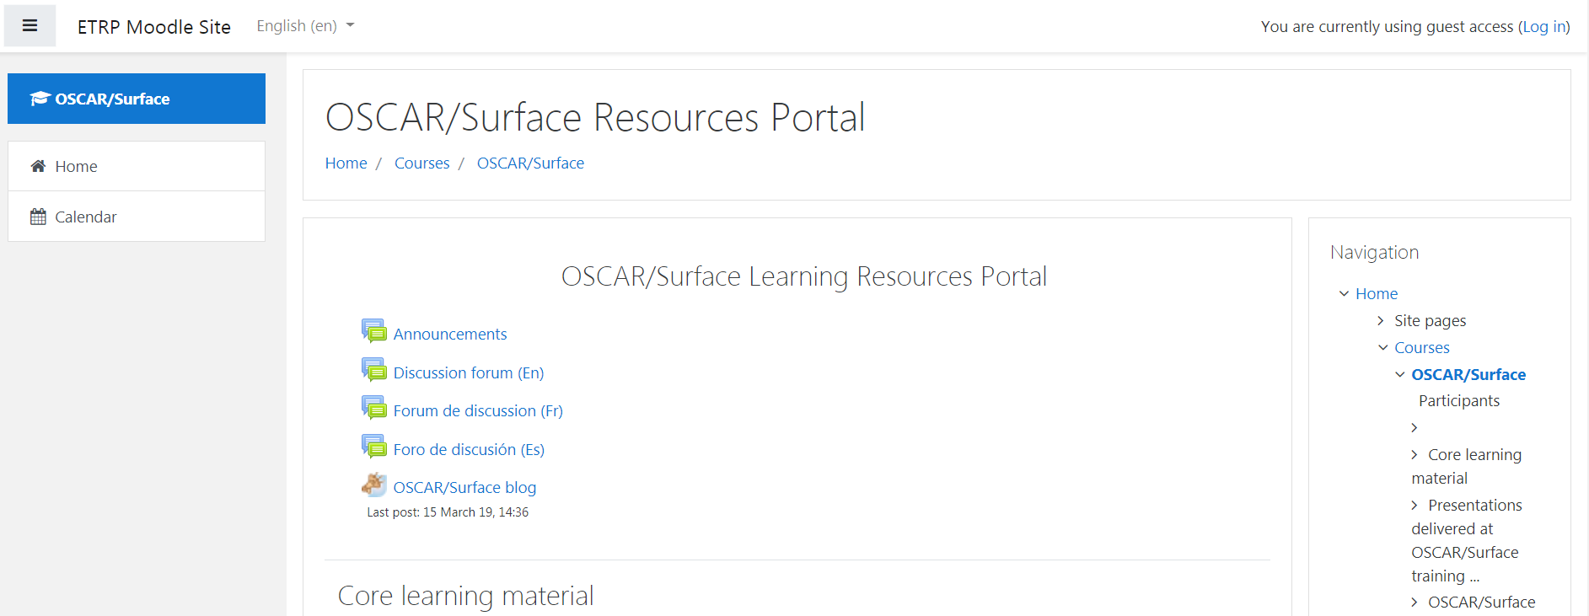
How to register for a course in Moodle

Slide 20
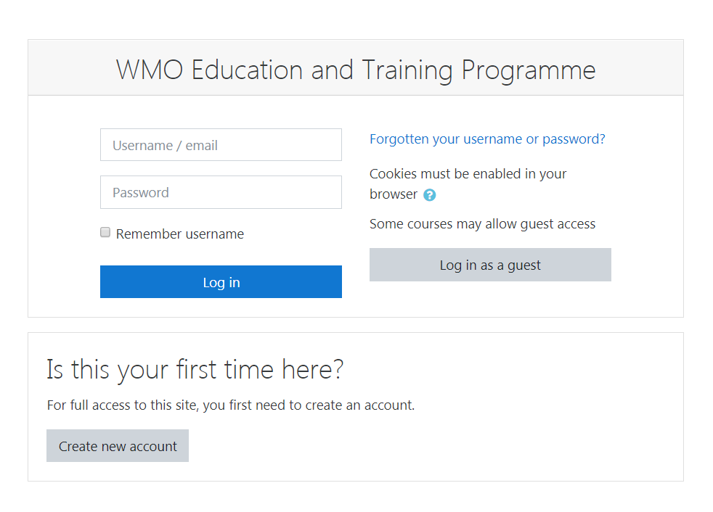
Create an account on Moodle

Slide 21
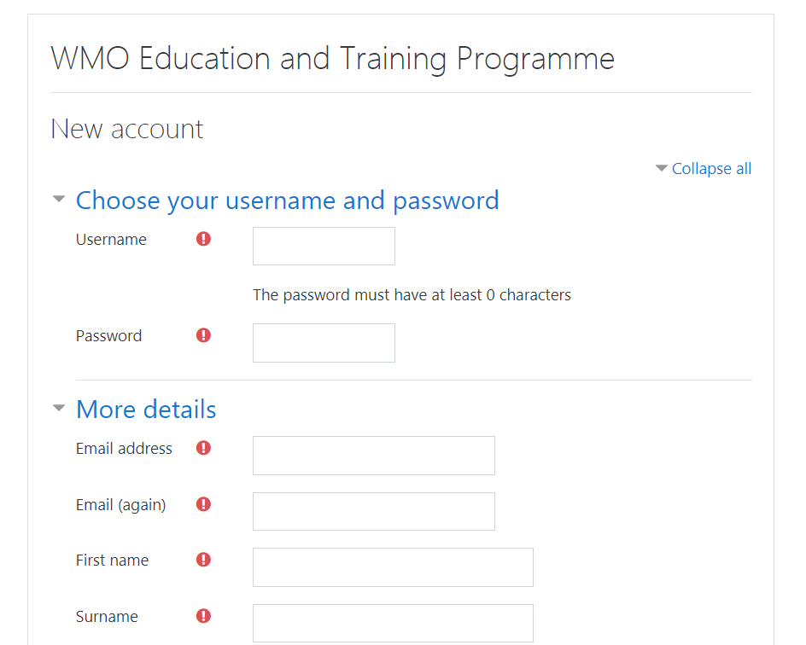

Slide 22
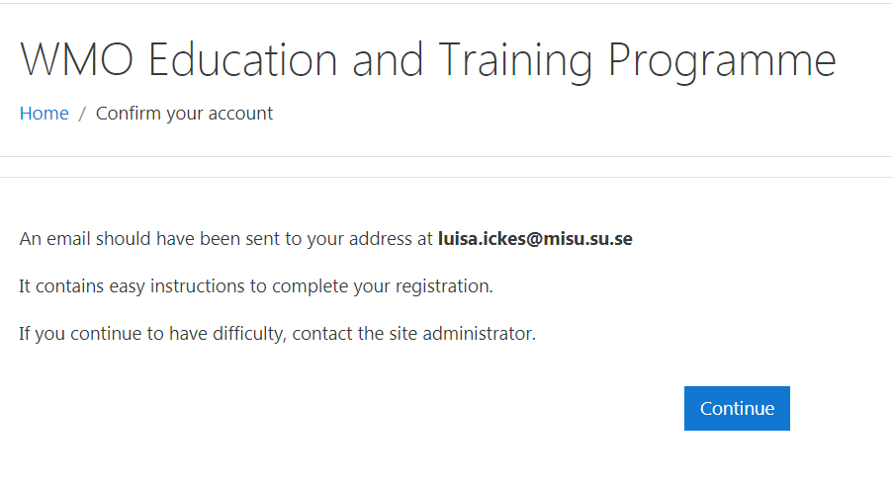
Confirm your account (e-mail)

Slide 23
Self-enroll to the courses

Slide 24
Self-enroll to the courses

Slide 25
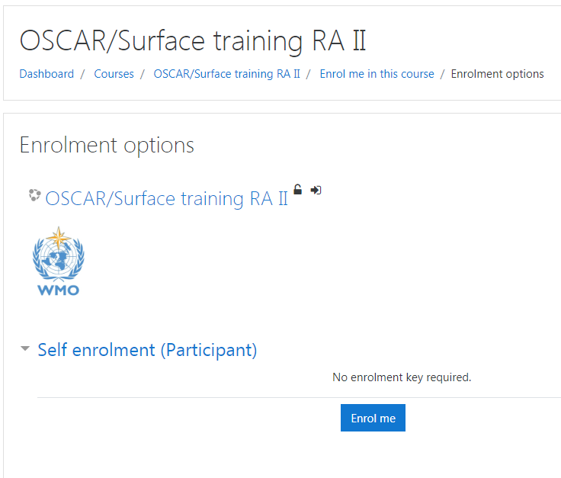
Self-enroll to the courses

Slide 26
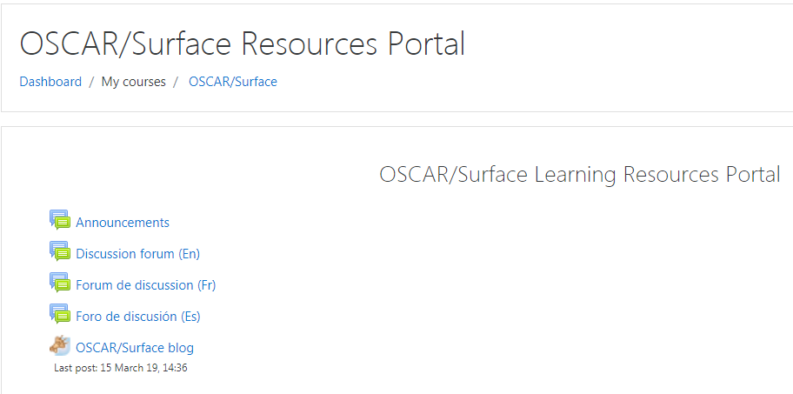
How to find the different courses you are enrolled in?

Slide 27
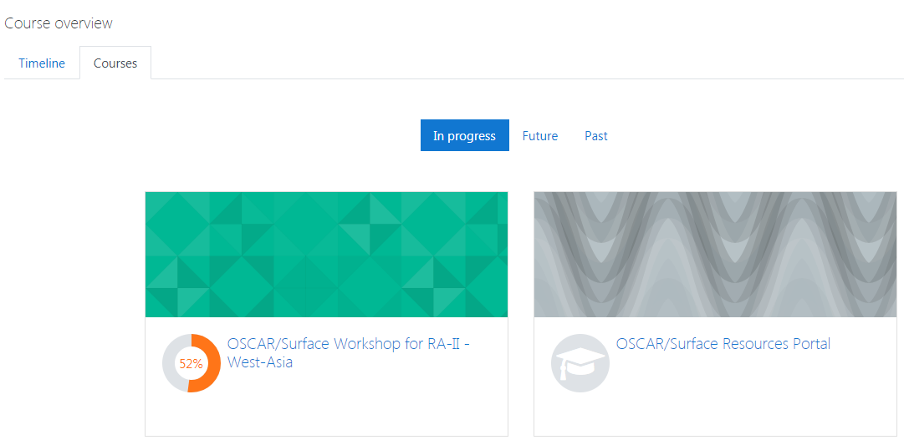
How to find the different courses you are enrolled in?

Slide 28
OSCAR/Surface
https://oscar.wmo.int/surface//index.html#/
Two step process:
Get an account: designation as National Focal Point (NFP) by PR or user created by NFP etc.
Register with the OSCAR/Surface Electronic Identity and Access Management System (EIAM) – once, afterwards linked to OSCAR/Surface account (login with your e-mail and your PW)

Slide 29
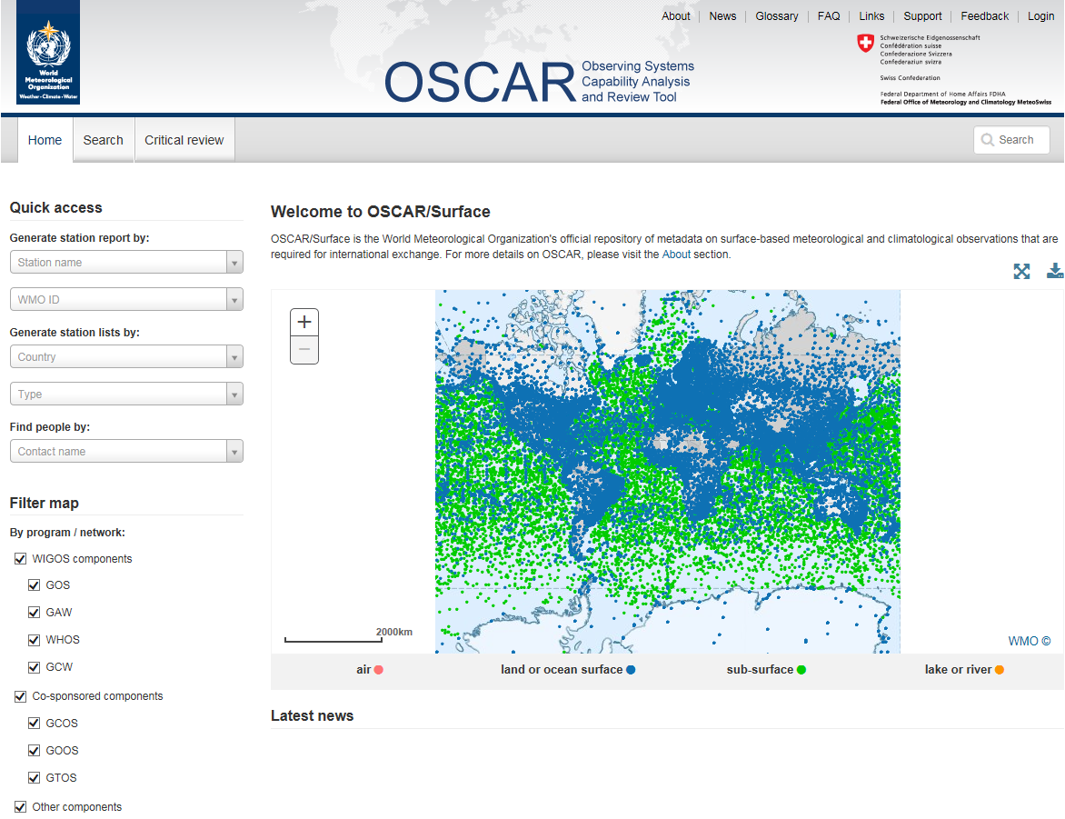
Check if an OSCAR/Surface account exists for you

Slide 30
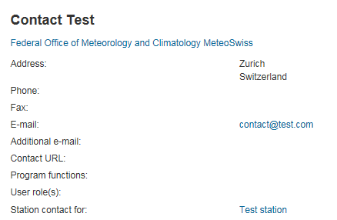
On the «free text search» field type your name
As soon as your name appears select it to view your contact details
Check if your email is correct
If your name does NOT appear in the search results ask your national focal point to add you in the list of contacts (personal info needed: first name, last name, email, organization, city, country). A compatriot colleague already registered in the application can also add you as contact. As soon as you are included in the contacts list you will receive a confirmation email with a link to the application URL.
If your name is included you can continue with the following registration procedure.

Slide 31
Register with the OSCAR/Surface EIAM

Slide 32
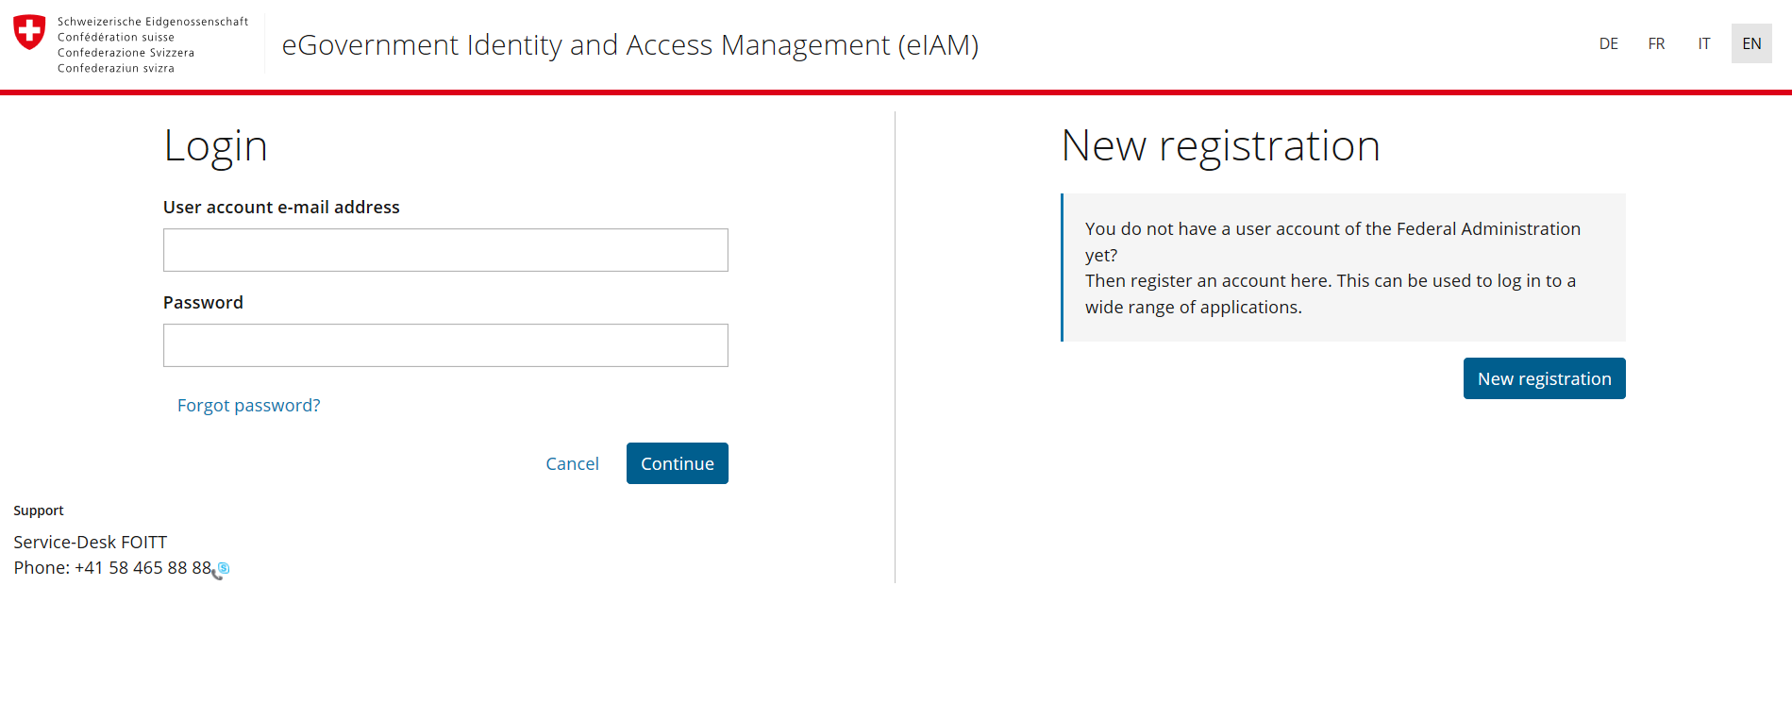
Choose the language...
…and click on «new registration»

Slide 33
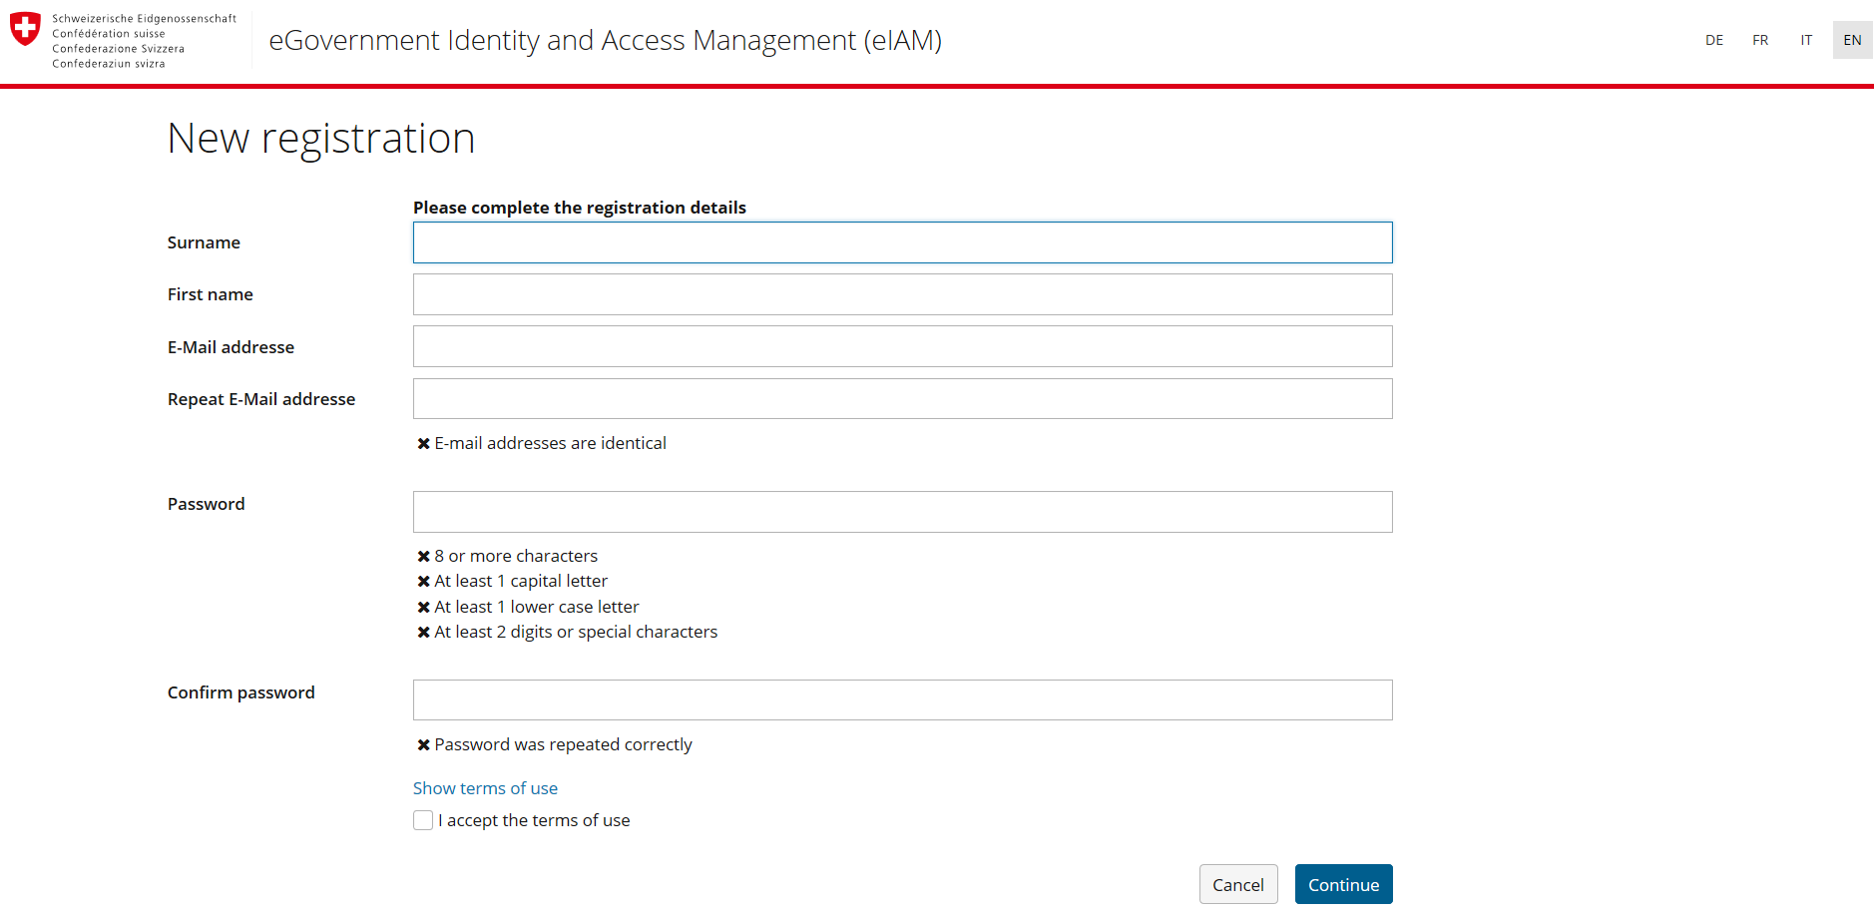
Fill out the form,
do not forget to use the same email as in your contact details…
….then click on «continue»

Slide 34
Check your email for the validation code and insert it…
..then click «next»
Now that you have created an account click on «continue» to request access to the application

Slide 35
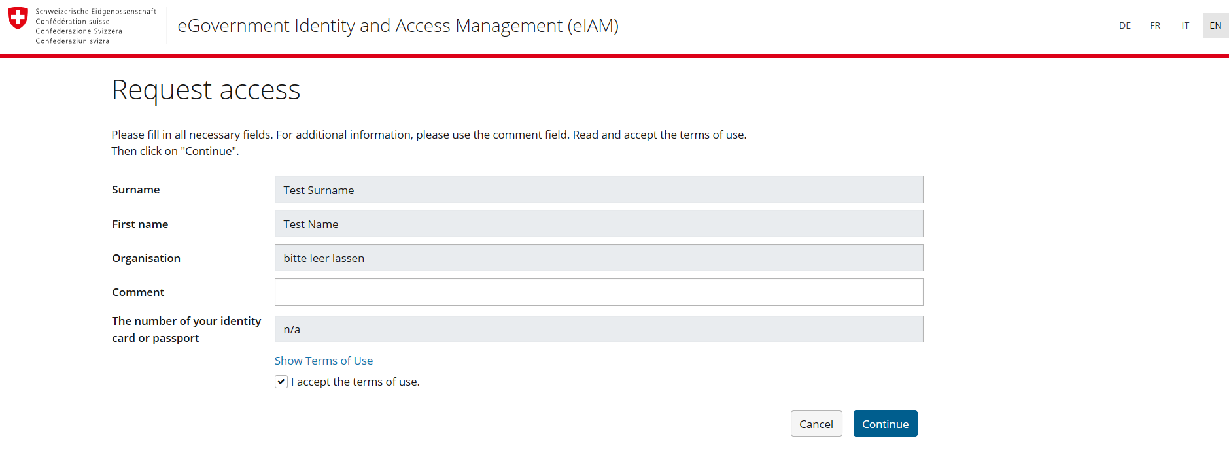
click on «request access»….
…. Accept the terms of use and click on «continue»

Slide 36
How to register in OSCAR or GAWSIS
How to register in OSCAR or GAWSIS
4. Request access to the application
Click on «back to the application»
Your registration is complete, go back to the application and login to add/edit information

Slide 37
Thank you

