Slide 1
Hands-on Exercise Flash Flood Warnings, Dissemination, and how FFGS forecaster-support can contribute to saving lives and property

Slide 2
Role Play
Student-centric approach to learning
Role-play is a technique that allows students to explore realistic situations by interacting with other people in a managed way in order to develop experience and trial different strategies in a supported environment.
Role play can allow everyone to participate.

Slide 3
FORECASTER

Slide 4
1) How should flash flood warnings be structured from your perspective?
2) What information should be included
in the flash flood warning?
3) What is the minimum lead time that
you think is necessary to respond
effectively to flash flood hazards?
4) Which dissemination channels do you prefer to use for dissemination
of flash flood warnings?
5) How FFGS forecaster-support can contribute to saving lives and property?
6) From your perspective what type of
public education would be needed for the public to effectively respond to warnings?
1) How should flash flood warnings be structured from your perspective?
2) What information should be included in the flash flood warning?
3) What is the minimum lead time that you think is necessary to respond
effectively to flash flood hazards?
4) Which dissemination channels do you prefer to use for dissemination
of flash flood warnings?
5) How FFGS forecaster-support can contribute to saving lives and property?
6) From your perspective what type of public education would be needed
for the public to effectively respond to warnings?

Slide 5
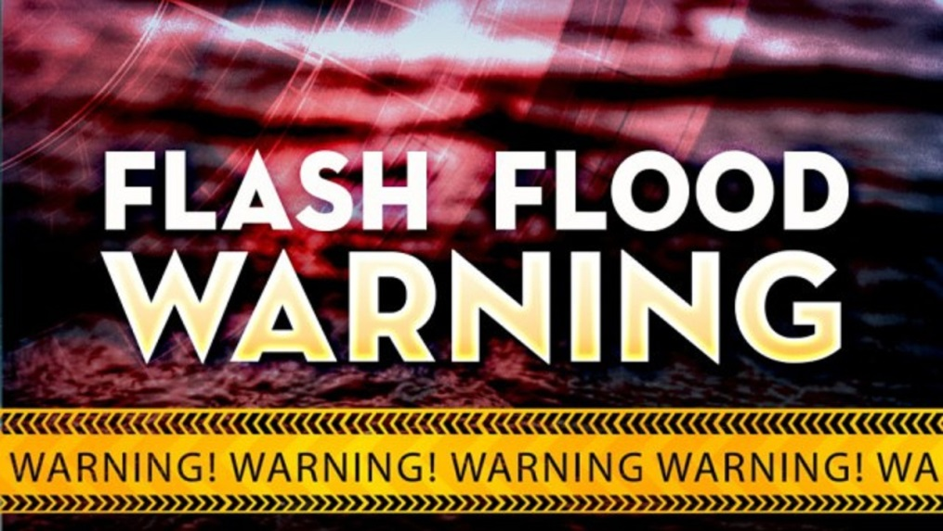
TV
REPRESENTATIVE

Slide 6
1) How should flash flood warnings be structured from your perspective?
2) What information should be included
in the flash flood warning?
3) What is the minimum lead time that
you think is necessary to respond
effectively to flash flood hazards?
4) Which dissemination channels do you prefer to use for dissemination
of flash flood warnings?
5) How FFGS forecaster-support can contribute to saving lives and property?
6) From your perspective what type of
public education would be needed for the public to effectively respond to warnings?
1) How should flash flood warnings be structured from your perspective?
2) What information should be included in the flash flood warning?
3) What is the minimum lead time that you think is necessary to respond
effectively to flash flood hazards?
4) Which dissemination channels do you prefer to use for dissemination
of flash flood warnings?
5) How FFGS forecaster-support can contribute to saving lives and property?
6) From your perspective what type of public education would be needed
for the public to effectively respond to warnings?

Slide 7
REPRESENTATIVE OF MAYOR OFFICE

Slide 8
1) How should flash flood warnings be structured from your perspective?
2) What information should be included
in the flash flood warning?
3) What is the minimum lead time that
you think is necessary to respond
effectively to flash flood hazards?
4) Which dissemination channels do you prefer to use for dissemination
of flash flood warnings?
5) How FFGS forecaster-support can contribute to saving lives and property?
6) From your perspective what type of
public education would be needed for the public to effectively respond to warnings?
1) How should flash flood warnings be structured from your perspective?
2) What information should be included in the flash flood warning?
3) What is the minimum lead time that you think is necessary to respond
effectively to flash flood hazards?
4) Which dissemination channels do you prefer to use for dissemination
of flash flood warnings?
5) How FFGS forecaster-support can contribute to saving lives and property?
6) From your perspective what type of public education would be needed
for the public to effectively respond to warnings?

Slide 9
DISASTER MANAGER

Slide 10
1) How should flash flood warnings be structured from your perspective?
2) What information should be included
in the flash flood warning?
3) What is the minimum lead time that
you think is necessary to respond
effectively to flash flood hazards?
4) Which dissemination channels do you prefer to use for dissemination
of flash flood warnings?
5) How FFGS forecaster-support can contribute to saving lives and property?
6) From your perspective what type of
public education would be needed for the public to effectively respond to warnings?
1) How should flash flood warnings be structured from your perspective?
2) What information should be included in the flash flood warning?
3) What is the minimum lead time that you think is necessary to respond
effectively to flash flood hazards?
4) Which dissemination channels do you prefer to use for dissemination
of flash flood warnings?
5) How FFGS forecaster-support can contribute to saving lives and property?
6) From your perspective what type of public education would be needed
for the public to effectively respond to warnings?

Slide 11
REPRESENTATIVE OF UTILITY
COMPANIES

Slide 12
1) How should flash flood warnings be structured from your perspective?
2) What information should be included
in the flash flood warning?
3) What is the minimum lead time that
you think is necessary to respond
effectively to flash flood hazards?
4) Which dissemination channels do you prefer to use for dissemination
of flash flood warnings?
5) How FFGS forecaster-support can contribute to saving lives and property?
6) From your perspective what type of
public education would be needed for the public to effectively respond to warnings?
1) How should flash flood warnings be structured from your perspective?
2) What information should be included in the flash flood warning?
3) What is the minimum lead time that you think is necessary to respond
effectively to flash flood hazards?
4) Which dissemination channels do you prefer to use for dissemination
of flash flood warnings?
5) How FFGS forecaster-support can contribute to saving lives and property?
6) From your perspective what type of public education would be needed
for the public to effectively respond to warnings?

Slide 13
1) How should flash flood warnings be structured from your perspective?
2) What information should be included
in the flash flood warning?
3) What is the minimum lead time that
you think is necessary to respond
effectively to flash flood hazards?
4) Which dissemination channels do you prefer to use for dissemination
of flash flood warnings?
5) How FFGS forecaster-support can contribute to saving lives and property?
6) From your perspective what type of
public education would be needed for the public to effectively respond to warnings?
REPRESENTATIVE OF AIRPORT AUTHORITIES

Slide 14
1) How should flash flood warnings be structured from your perspective?
2) What information should be included
in the flash flood warning?
3) What is the minimum lead time that
you think is necessary to respond
effectively to flash flood hazards?
4) Which dissemination channels do you prefer to use for dissemination
of flash flood warnings?
5) How FFGS forecaster-support can contribute to saving lives and property?
6) From your perspective what type of
public education would be needed for the public to effectively respond to warnings?
1) How should flash flood warnings be structured from your perspective?
2) What information should be included in the flash flood warning?
3) What is the minimum lead time that you think is necessary to respond
effectively to flash flood hazards?
4) Which dissemination channels do you prefer to use for dissemination
of flash flood warnings?
5) How FFGS forecaster-support can contribute to saving lives and property?
6) From your perspective what type of public education would be needed
for the public to effectively respond to warnings?

Slide 15
REPRESENTATIVE OF EMERGENCY MEDICAL SERVICES

Slide 16
1) How should flash flood warnings be structured from your perspective?
2) What information should be included
in the flash flood warning?
3) What is the minimum lead time that
you think is necessary to respond
effectively to flash flood hazards?
4) Which dissemination channels do you prefer to use for dissemination
of flash flood warnings?
5) How FFGS forecaster-support can contribute to saving lives and property?
6) From your perspective what type of
public education would be needed for the public to effectively respond to warnings?
1) How should flash flood warnings be structured from your perspective?
2) What information should be included in the flash flood warning?
3) What is the minimum lead time that you think is necessary to respond
effectively to flash flood hazards?
4) Which dissemination channels do you prefer to use for dissemination
of flash flood warnings?
5) How FFGS forecaster-support can contribute to saving lives and property?
6) From your perspective what type of public education would be needed
for the public to effectively respond to warnings?

Slide 17
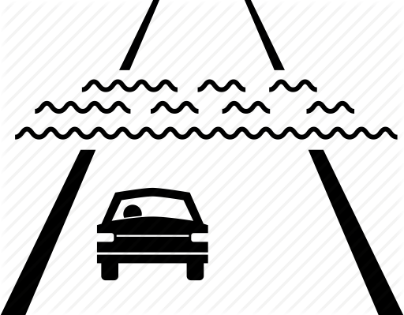
1) How should flash flood warnings be structured from your perspective?
2) What information should be included
in the flash flood warning?
3) What is the minimum lead time that
you think is necessary to respond
effectively to flash flood hazards?
4) Which dissemination channels do you prefer to use for dissemination
of flash flood warnings?
5) How FFGS forecaster-support can contribute to saving lives and property?
6) From your perspective what type of
public education would be needed for the public to effectively respond to warnings?
REPRESENTATIVE OF ROAD
AUTHORITY

Slide 18
1) How should flash flood warnings be structured from your perspective?
2) What information should be included
in the flash flood warning?
3) What is the minimum lead time that
you think is necessary to respond
effectively to flash flood hazards?
4) Which dissemination channels do you prefer to use for dissemination
of flash flood warnings?
5) How FFGS forecaster-support can contribute to saving lives and property?
6) From your perspective what type of
public education would be needed for the public to effectively respond to warnings?
1) How should flash flood warnings be structured from your perspective?
2) What information should be included in the flash flood warning?
3) What is the minimum lead time that you think is necessary to respond
effectively to flash flood hazards?
4) Which dissemination channels do you prefer to use for dissemination
of flash flood warnings?
5) How FFGS forecaster-support can contribute to saving lives and property?
6) From your perspective what type of public education would be needed
for the public to effectively respond to warnings?

Slide 19
URBAN CITIZEN

Slide 20
1) How should flash flood warnings be structured from your perspective?
2) What information should be included
in the flash flood warning?
3) What is the minimum lead time that
you think is necessary to respond
effectively to flash flood hazards?
4) Which dissemination channels do you prefer to use for dissemination
of flash flood warnings?
5) How FFGS forecaster-support can contribute to saving lives and property?
6) From your perspective what type of
public education would be needed for the public to effectively respond to warnings?
1) How should flash flood warnings be structured from your perspective?
2) What information should be included in the flash flood warning?
3) What is the minimum lead time that you think is necessary to respond
effectively to flash flood hazards?
4) Which dissemination channels do you prefer to use for dissemination
of flash flood warnings?
5) How FFGS forecaster-support can contribute to saving lives and property?
6) From your perspective what type of public education would be needed
for the public to effectively respond to warnings?

Slide 21
1) How should flash flood warnings be structured from your perspective?
2) What information should be included
in the flash flood warning?
3) What is the minimum lead time that
you think is necessary to respond
effectively to flash flood hazards?
4) Which dissemination channels do you prefer to use for dissemination
of flash flood warnings?
5) How FFGS forecaster-support can contribute to saving lives and property?
6) From your perspective what type of
public education would be needed for the public to effectively respond to warnings?
REPRESENTATIVE OF
HYDROPOWER
PLANT

Slide 22
1) How should flash flood warnings be structured from your perspective?
2) What information should be included
in the flash flood warning?
3) What is the minimum lead time that
you think is necessary to respond
effectively to flash flood hazards?
4) Which dissemination channels do you prefer to use for dissemination
of flash flood warnings?
5) How FFGS forecaster-support can contribute to saving lives and property?
6) From your perspective what type of
public education would be needed for the public to effectively respond to warnings?
1) How should flash flood warnings be structured from your perspective?
2) What information should be included in the flash flood warning?
3) What is the minimum lead time that you think is necessary to respond
effectively to flash flood hazards?
4) Which dissemination channels do you prefer to use for dissemination
of flash flood warnings?
5) How FFGS forecaster-support can contribute to saving lives and property?
6) From your perspective what type of public education would be needed
for the public to effectively respond to warnings?

Slide 23
REPRESENTATIVE OF RED CROSS
AND RED CRESCENT

Slide 24
1) How should flash flood warnings be structured from your perspective?
2) What information should be included
in the flash flood warning?
3) What is the minimum lead time that
you think is necessary to respond
effectively to flash flood hazards?
4) Which dissemination channels do you prefer to use for dissemination
of flash flood warnings?
5) How FFGS forecaster-support can contribute to saving lives and property?
6) From your perspective what type of
public education would be needed for the public to effectively respond to warnings?
1) How should flash flood warnings be structured from your perspective?
2) What information should be included in the flash flood warning?
3) What is the minimum lead time that you think is necessary to respond
effectively to flash flood hazards?
4) Which dissemination channels do you prefer to use for dissemination
of flash flood warnings?
5) How FFGS forecaster-support can contribute to saving lives and property?
6) From your perspective what type of public education would be needed
for the public to effectively respond to warnings?

Slide 25
REPRESENTATIVE OF RED CROSS

Slide 26
1) How should flash flood warnings be structured from your perspective?
2) What information should be included
in the flash flood warning?
3) What is the minimum lead time that
you think is necessary to respond
effectively to flash flood hazards?
4) Which dissemination channels do you prefer to use for dissemination
of flash flood warnings?
5) How FFGS forecaster-support can contribute to saving lives and property?
6) From your perspective what type of
public education would be needed for the public to effectively respond to warnings?
1) How should flash flood warnings be structured from your perspective?
2) What information should be included in the flash flood warning?
3) What is the minimum lead time that you think is necessary to respond
effectively to flash flood hazards?
4) Which dissemination channels do you prefer to use for dissemination
of flash flood warnings?
5) How FFGS forecaster-support can contribute to saving lives and property?
6) From your perspective what type of public education would be needed
for the public to effectively respond to warnings?

Slide 27
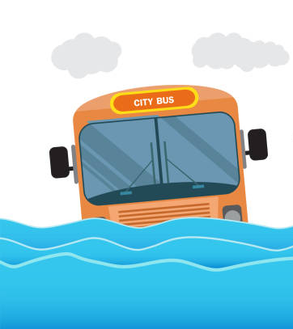
BUS DRIVER

Slide 28
1) How should flash flood warnings be structured from your perspective?
2) What information should be included
in the flash flood warning?
3) What is the minimum lead time that
you think is necessary to respond
effectively to flash flood hazards?
4) Which dissemination channels do you prefer to use for dissemination
of flash flood warnings?
5) How FFGS forecaster-support can contribute to saving lives and property?
6) From your perspective what type of
public education would be needed for the public to effectively respond to warnings?
1) How should flash flood warnings be structured from your perspective?
2) What information should be included in the flash flood warning?
3) What is the minimum lead time that you think is necessary to respond
effectively to flash flood hazards?
4) Which dissemination channels do you prefer to use for dissemination
of flash flood warnings?
5) How FFGS forecaster-support can contribute to saving lives and property?
6) From your perspective what type of public education would be needed
for the public to effectively respond to warnings?

Slide 29
OWNER OF A HOUSE BELOW THE HILL PRONE TO LANDSLIDE

Slide 30
1) How should flash flood warnings be structured from your perspective?
2) What information should be included
in the flash flood warning?
3) What is the minimum lead time that
you think is necessary to respond
effectively to flash flood hazards?
4) Which dissemination channels do you prefer to use for dissemination
of flash flood warnings?
5) How FFGS forecaster-support can contribute to saving lives and property?
6) From your perspective what type of
public education would be needed for the public to effectively respond to warnings?
1) How should flash flood warnings be structured from your perspective?
2) What information should be included in the flash flood warning?
3) What is the minimum lead time that you think is necessary to respond
effectively to flash flood hazards?
4) Which dissemination channels do you prefer to use for dissemination
of flash flood warnings?
5) How FFGS forecaster-support can contribute to saving lives and property?
6) From your perspective what type of public education would be needed
for the public to effectively respond to warnings?

Slide 31
1) How should flash flood warnings be structured from your perspective?
2) What information should be included
in the flash flood warning?
3) What is the minimum lead time that
you think is necessary to respond
effectively to flash flood hazards?
4) Which dissemination channels do you prefer to use for dissemination
of flash flood warnings?
5) How FFGS forecaster-support can contribute to saving lives and property?
6) From your perspective what type of
public education would be needed for the public to effectively respond to warnings?
ELDERLY
PERSON

Slide 32
1) How should flash flood warnings be structured from your perspective?
2) What information should be included
in the flash flood warning?
3) What is the minimum lead time that
you think is necessary to respond
effectively to flash flood hazards?
4) Which dissemination channels do you prefer to use for dissemination
of flash flood warnings?
5) How FFGS forecaster-support can contribute to saving lives and property?
6) From your perspective what type of
public education would be needed for the public to effectively respond to warnings?
1) How should flash flood warnings be structured from your perspective?
2) What information should be included in the flash flood warning?
3) What is the minimum lead time that you think is necessary to respond
effectively to flash flood hazards?
4) Which dissemination channels do you prefer to use for dissemination
of flash flood warnings?
5) How FFGS forecaster-support can contribute to saving lives and property?
6) From your perspective what type of public education would be needed
for the public to effectively respond to warnings?

Slide 33
PERSON
WITH VISUAL
DISABILITY

Slide 34
1) How should flash flood warnings be structured from your perspective?
2) What information should be included
in the flash flood warning?
3) What is the minimum lead time that
you think is necessary to respond
effectively to flash flood hazards?
4) Which dissemination channels do you prefer to use for dissemination
of flash flood warnings?
5) How FFGS forecaster-support can contribute to saving lives and property?
6) From your perspective what type of
public education would be needed for the public to effectively respond to warnings?
1) How should flash flood warnings be structured from your perspective?
2) What information should be included in the flash flood warning?
3) What is the minimum lead time that you think is necessary to respond
effectively to flash flood hazards?
4) Which dissemination channels do you prefer to use for dissemination
of flash flood warnings?
5) How FFGS forecaster-support can contribute to saving lives and property?
6) From your perspective what type of public education would be needed
for the public to effectively respond to warnings?

Slide 35
PERSON
WITH HEARING
DISABILITY

Slide 36
1) How should flash flood warnings be structured from your perspective?
2) What information should be included
in the flash flood warning?
3) What is the minimum lead time that
you think is necessary to respond
effectively to flash flood hazards?
4) Which dissemination channels do you prefer to use for dissemination
of flash flood warnings?
5) How FFGS forecaster-support can contribute to saving lives and property?
6) From your perspective what type of
public education would be needed for the public to effectively respond to warnings?
1) How should flash flood warnings be structured from your perspective?
2) What information should be included in the flash flood warning?
3) What is the minimum lead time that you think is necessary to respond
effectively to flash flood hazards?
4) Which dissemination channels do you prefer to use for dissemination
of flash flood warnings?
5) How FFGS forecaster-support can contribute to saving lives and property?
6) From your perspective what type of public education would be needed
for the public to effectively respond to warnings?

Slide 37
1) How should flash flood warnings be structured from your perspective?
?
TOURIST GUIDE

Slide 38
1) How should flash flood warnings be structured from your perspective?
2) What information should be included
in the flash flood warning?
3) What is the minimum lead time that
you think is necessary to respond
effectively to flash flood hazards?
4) Which dissemination channels do you prefer to use for dissemination
of flash flood warnings?
5) How FFGS forecaster-support can contribute to saving lives and property?
6) From your perspective what type of
public education would be needed for the public to effectively respond to warnings?
1) How should flash flood warnings be structured from your perspective?
2) What information should be included in the flash flood warning?
3) What is the minimum lead time that you think is necessary to respond
effectively to flash flood hazards?
4) Which dissemination channels do you prefer to use for dissemination
of flash flood warnings?
5) How FFGS forecaster-support can contribute to saving lives and property?
6) From your perspective what type of public education would be needed
for the public to effectively respond to warnings?

Slide 39
HOTEL MANAGER

Slide 40
1) How should flash flood warnings be structured from your perspective?
2) What information should be included
in the flash flood warning?
3) What is the minimum lead time that
you think is necessary to respond
effectively to flash flood hazards?
4) Which dissemination channels do you prefer to use for dissemination
of flash flood warnings?
5) How FFGS forecaster-support can contribute to saving lives and property?
6) From your perspective what type of
public education would be needed for the public to effectively respond to warnings?
1) How should flash flood warnings be structured from your perspective?
2) What information should be included in the flash flood warning?
3) What is the minimum lead time that you think is necessary to respond
effectively to flash flood hazards?
4) Which dissemination channels do you prefer to use for dissemination
of flash flood warnings?
5) How FFGS forecaster-support can contribute to saving lives and property?
6) From your perspective what type of public education would be needed
for the public to effectively respond to warnings?

Slide 41
TOURIST

Slide 42
1) How should flash flood warnings be structured from your perspective?
2) What information should be included
in the flash flood warning?
3) What is the minimum lead time that
you think is necessary to respond
effectively to flash flood hazards?
4) Which dissemination channels do you prefer to use for dissemination
of flash flood warnings?
5) How FFGS forecaster-support can contribute to saving lives and property?
6) From your perspective what type of
public education would be needed for the public to effectively respond to warnings?
1) How should flash flood warnings be structured from your perspective?
2) What information should be included in the flash flood warning?
3) What is the minimum lead time that you think is necessary to respond
effectively to flash flood hazards?
4) Which dissemination channels do you prefer to use for dissemination
of flash flood warnings?
5) How FFGS forecaster-support can contribute to saving lives and property?
6) From your perspective what type of public education would be needed
for the public to effectively respond to warnings?

Slide 43
FARMER

Slide 44
1) How should flash flood warnings be structured from your perspective?
2) What information should be included
in the flash flood warning?
3) What is the minimum lead time that
you think is necessary to respond
effectively to flash flood hazards?
4) Which dissemination channels do you prefer to use for dissemination
of flash flood warnings?
5) How FFGS forecaster-support can contribute to saving lives and property?
6) From your perspective what type of
public education would be needed for the public to effectively respond to warnings?
1) How should flash flood warnings be structured from your perspective?
2) What information should be included in the flash flood warning?
3) What is the minimum lead time that you think is necessary to respond
effectively to flash flood hazards?
4) Which dissemination channels do you prefer to use for dissemination
of flash flood warnings?
5) How FFGS forecaster-support can contribute to saving lives and property?
6) From your perspective what type of public education would be needed
for the public to effectively respond to warnings?

Slide 45
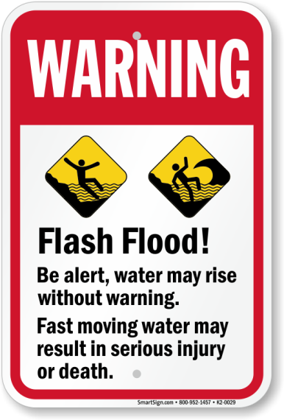
10-YEAR
CHILDREN

Slide 46
1) How should flash flood warnings be structured from your perspective?
2) What information should be included
in the flash flood warning?
3) What is the minimum lead time that
you think is necessary to respond
effectively to flash flood hazards?
4) Which dissemination channels do you prefer to use for dissemination
of flash flood warnings?
5) How FFGS forecaster-support can contribute to saving lives and property?
6) From your perspective what type of
public education would be needed for the public to effectively respond to warnings?
1) How should flash flood warnings be structured from your perspective?
2) What information should be included in the flash flood warning?
3) What is the minimum lead time that you think is necessary to respond
effectively to flash flood hazards?
4) Which dissemination channels do you prefer to use for dissemination
of flash flood warnings?
5) How FFGS forecaster-support can contribute to saving lives and property?
6) From your perspective what type of public education would be needed
for the public to effectively respond to warnings?

Slide 47
REPRESENTATIVE OF MINISTRY
OF FORESTRY

Slide 48
1) How should flash flood warnings be structured from your perspective?
2) What information should be included
in the flash flood warning?
3) What is the minimum lead time that
you think is necessary to respond
effectively to flash flood hazards?
4) Which dissemination channels do you prefer to use for dissemination
of flash flood warnings?
5) How FFGS forecaster-support can contribute to saving lives and property?
6) From your perspective what type of
public education would be needed for the public to effectively respond to warnings?
1) How should flash flood warnings be structured from your perspective?
2) What information should be included in the flash flood warning?
3) What is the minimum lead time that you think is necessary to respond
effectively to flash flood hazards?
4) Which dissemination channels do you prefer to use for dissemination
of flash flood warnings?
5) How FFGS forecaster-support can contribute to saving lives and property?
6) From your perspective what type of public education would be needed
for the public to effectively respond to warnings?

Slide 49
PRODUCER

Slide 50
1) How should flash flood warnings be structured from your perspective?
2) What information should be included
in the flash flood warning?
3) What is the minimum lead time that
you think is necessary to respond
effectively to flash flood hazards?
4) Which dissemination channels do you prefer to use for dissemination
of flash flood warnings?
5) How FFGS forecaster-support can contribute to saving lives and property?
6) From your perspective what type of
public education would be needed for the public to effectively respond to warnings?
1) How should flash flood warnings be structured from your perspective?
2) What information should be included in the flash flood warning?
3) What is the minimum lead time that you think is necessary to respond
effectively to flash flood hazards?
4) Which dissemination channels do you prefer to use for dissemination
of flash flood warnings?
5) How FFGS forecaster-support can contribute to saving lives and property?
6) From your perspective what type of public education would be needed
for the public to effectively respond to warnings?

Slide 51
For more information please visit: | http://www.wmo.int/ffgs
 | http://www.hrcwater.org

