Slide 1
Climate Services Application of Global Campus
Enric Aguilar,
Center for Climate Change, C3
Unversidad Rovira i Virgili, Tarragona, Spain

Slide 2
Wish List for the future of education and training for Climate Services
Enric Aguilar,
Center for Climate Change, C3
Unversidad Rovira i Virgili, Tarragona, Spain

Slide 3
Commission for Climatology, XVII, ET-HRD
To develop a Basic Instructional Package for Climate Services (BIP-CS) to guide curriculum development and assist in standardizing the education and training on climate services, within the WMO RTC network and at other training centres;
To finalize the CCl Guidelines for the Assessment of Competencies for Provision of Climate Services, with a focus on learning outcomes, to complement the WMO Guide to Competency (WMO-No. 1205, 2018) climate services area;
Collect input for an open-access repository of climate training course materials and e-courses.

Slide 4
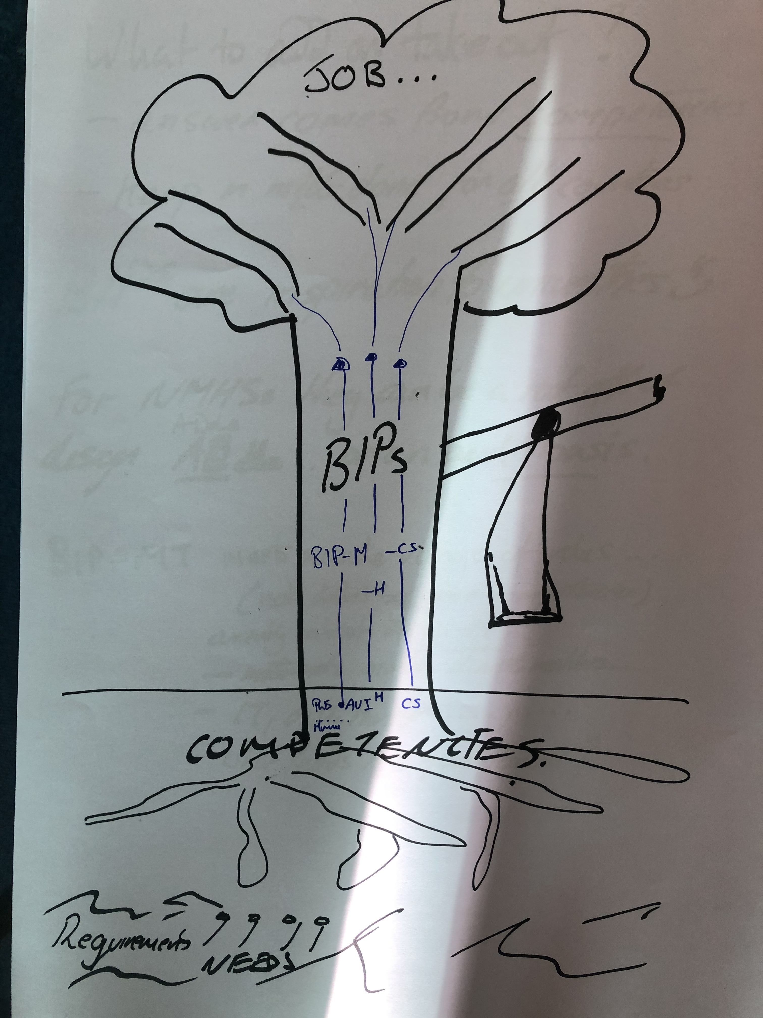
Commission for Climatology, XVII, ET-HRD
To develop a Basic Instructional Package for Climate Services (BIP-CS) to guide curriculum development and assist in standardizing the education and training on climate services, within the WMO RTC network and at other training centres;
To finalize the CCl Guidelines for the Assessment of Competencies for Provision of Climate Services, with a focus on learning outcomes, to complement the WMO Guide to Competency (WMO-No. 1205, 2018) climate services area;
Collect input for an open-access repository of climate training course materials and e-courses.

Slide 5
What is Global Campus

Slide 6
Global Campus is a Playground

Slide 7
Things you do in a playground
Meet other kids to play with (they will tell you new games and will play along your favorites)
Lend your football (still yours)
Use other kid’s bicycle (still belongs to the other kid)
Help small children (they are building capacities)
Learn from the elder (they are resourceful)

Slide 8
How to contribute to the Global Campus Playground (from WMO Bulletin paper)
Engage & Contribute
Engage institutions involved in Climate Services ETR to share and use
Find & Adapt
Find, use, adapt, translate (do not reinvent the wheel)
Recognize Achievements
Recognize trainee’s achievements
Network
Network for the creation of higher education programs
Mobilize Resources
Be active in capturing human and economic resources
Multiply
The effects of training by using adequate training approaches

Slide 9
CRF-Spain and the Global Campus
NMHS
ACADEMIA
Contribute with materials and academic staff …
Two weeks TRAINING on climate services adapting and translating into Spanish Météo-France’s “Climatology a Foundation for Climate Services”. Covers all 5 competencies. Face to Face
FORMAL EDUCATION: POST-GRADUATE course on Climate Services. Based on parts of the BIP-CS (as of know in learning outcomes associated to competencies) Distance learning. Targeting Spanish Speaking public
Contribute with materials and academic staff …
Engage & Contribute, Find and Adapt, Multiply, Recognize Achievements, Network, Mobilize Resources

Slide 10
ENGAGE AND CONTRIBUTE
Paper at WMO Bulletin 67(2): Developing Human Resources for Providing Climate Services

Slide 11
FIND AND ADAPT

Slide 12
MULITPLY

Slide 13
RECOGNIZE ACHIEVEMENTS

Slide 14
NETWORK

Slide 15
RESOURCE MOBILITZATION

Slide 16
Thanks for your attention. Come and play!

