Slide 1
OSCAR/Surface How to register

Slide 2
Learning topics
How to get an account
How to sign-up for an account

Slide 3
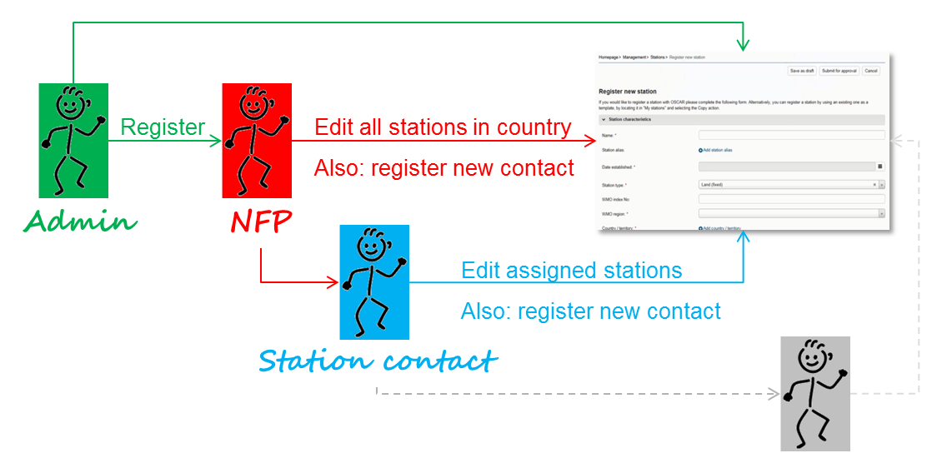
How to get an account?
There are two ways to get an account
Designation as National Focal Point (NFP) for OSCAR/Surface by Permanent Representative
NFP, or other delegee, creates a user in OSCAR/Surface

Slide 4
Registration in OSCAR
Once the account is created in OSCAR/Surface, the user receives an email, requesting registration with the OSCAR/Surface Electronic Identity and Access Management System (EIAM).
While your user account has been created in OSCAR/Surface already, you need to register with EIAM once and link the EIAM account with the OSCAR/Surface account.
Once this is done, you can then logon to OSCAR by entering the EIAM username and password.

Slide 5
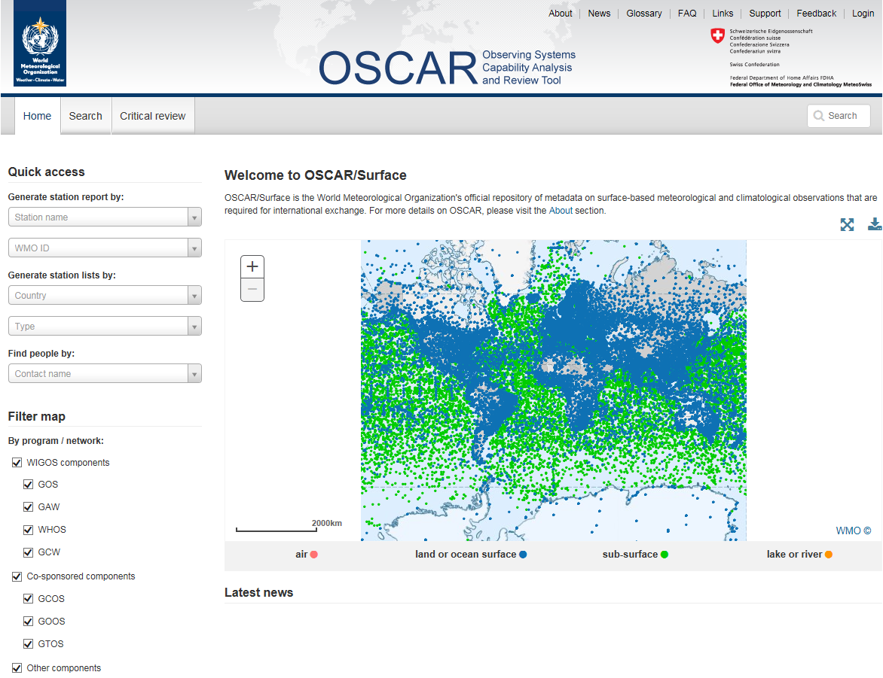
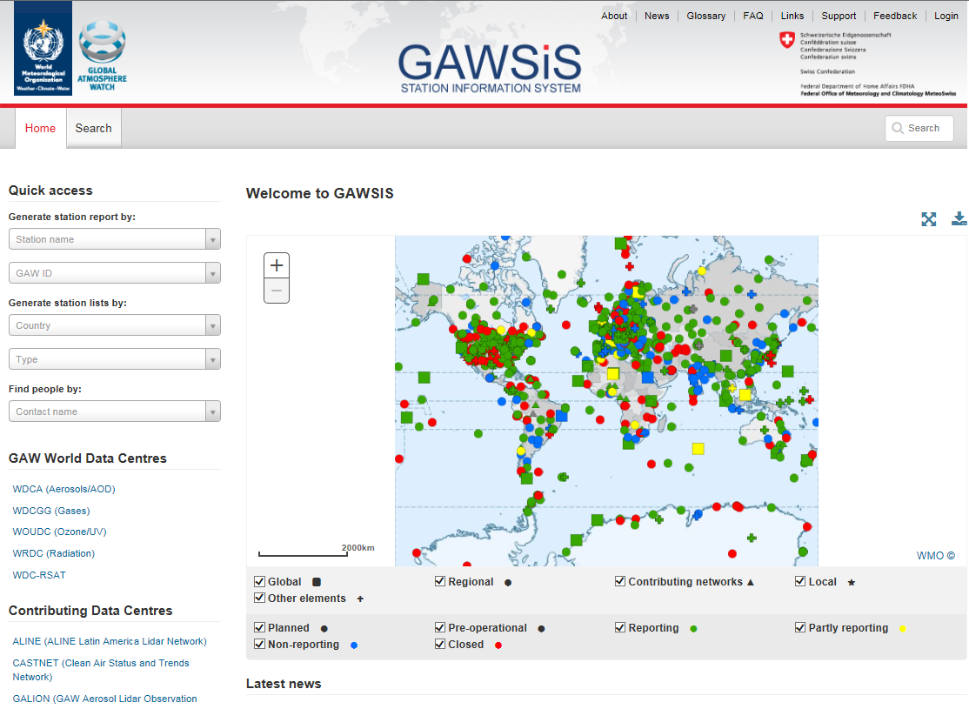
How to register in OSCAR or GAWSIS
1. check if you are already included in the list of available contacts
https://oscar.wmo.int/surface
https://gawsis.meteoswiss.ch/GAWSIS

Slide 6
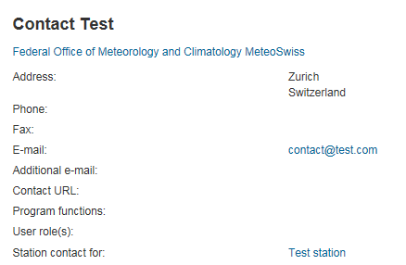
How to register in OSCAR or GAWSIS
check if you are included in the list of available contacts
On the «free text search» field type your name
As soon as your name appears select it to view your contact details
Check if your email is correct
If your name does NOT appear in the search results ask your national focal point to add you in the list of contacts (personal info needed: first name, last name, email, organization, city, country). A compatriot colleague already registered in the application can also add you as contact. As soon as you are included in the contacts list you will receive a confirmation email with a link to the application URL.
If your name is included you can continue with the following registration procedure.

Slide 7
How to register in OSCAR or GAWSIS
2. Click on "login“ on the top-right of the page.

Slide 8
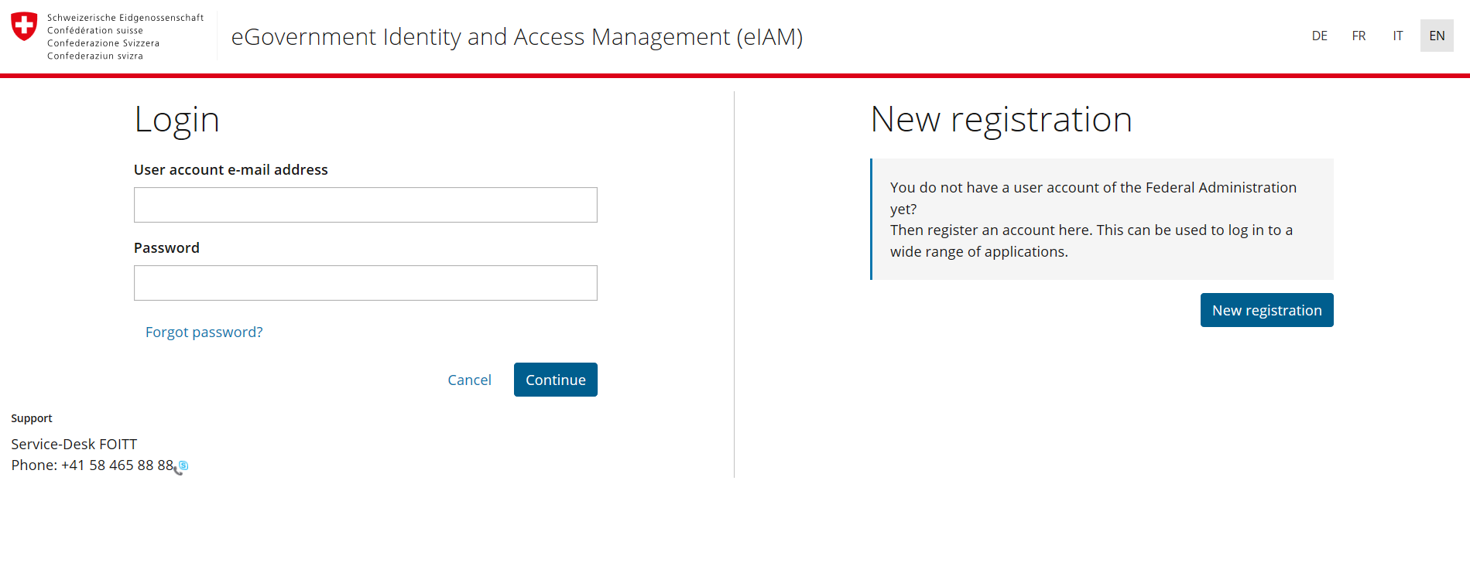
How to register in OSCAR or GAWSIS
3. complete the following steps for the attribution of the username and password
Choose the language...
…and click on «new registration»

Slide 9
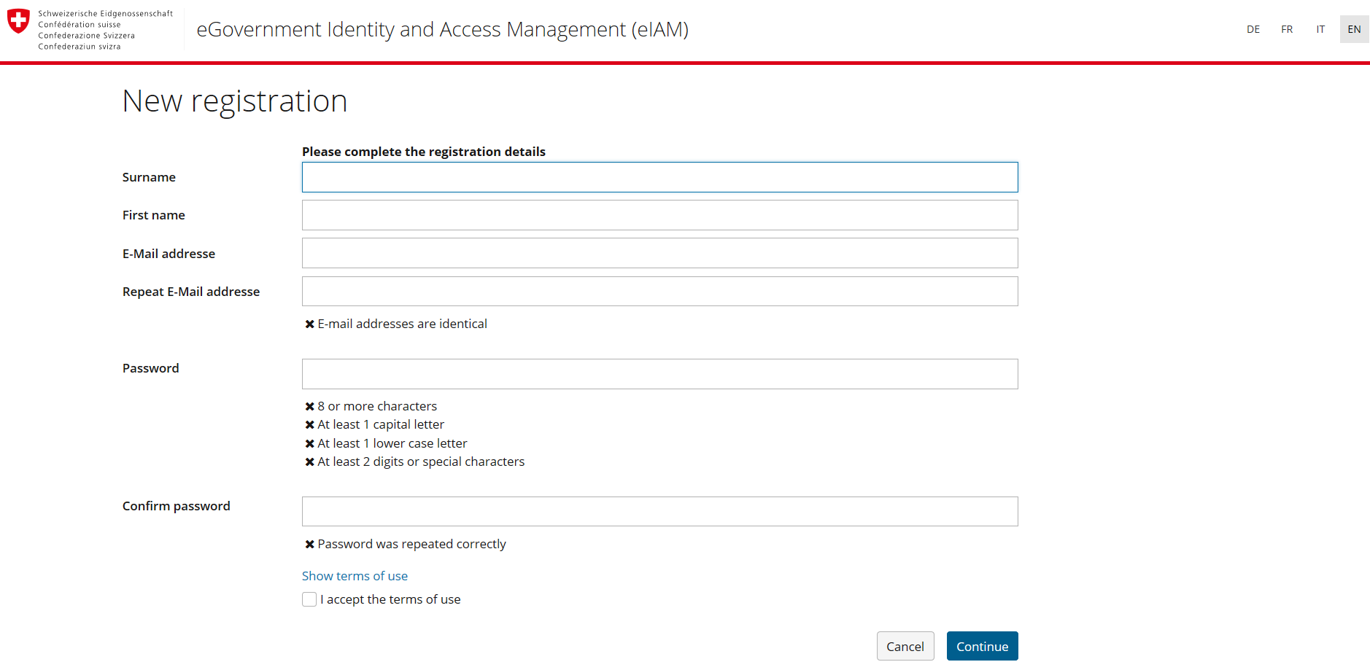
How to register in OSCAR or GAWSIS
3. complete the following steps for the attribution of the username and password
Fill out the form,
do not forget to use the same email as in your contact details…
….then click on «continue»

Slide 10
How to register in OSCAR or GAWSIS
How to register in OSCAR or GAWSIS
3. complete the following steps for the attribution of the username and password
Check your email for the validation code and insert it…
..then click «next»
Now that you have created an account click on «continue» to request access to the application

Slide 11
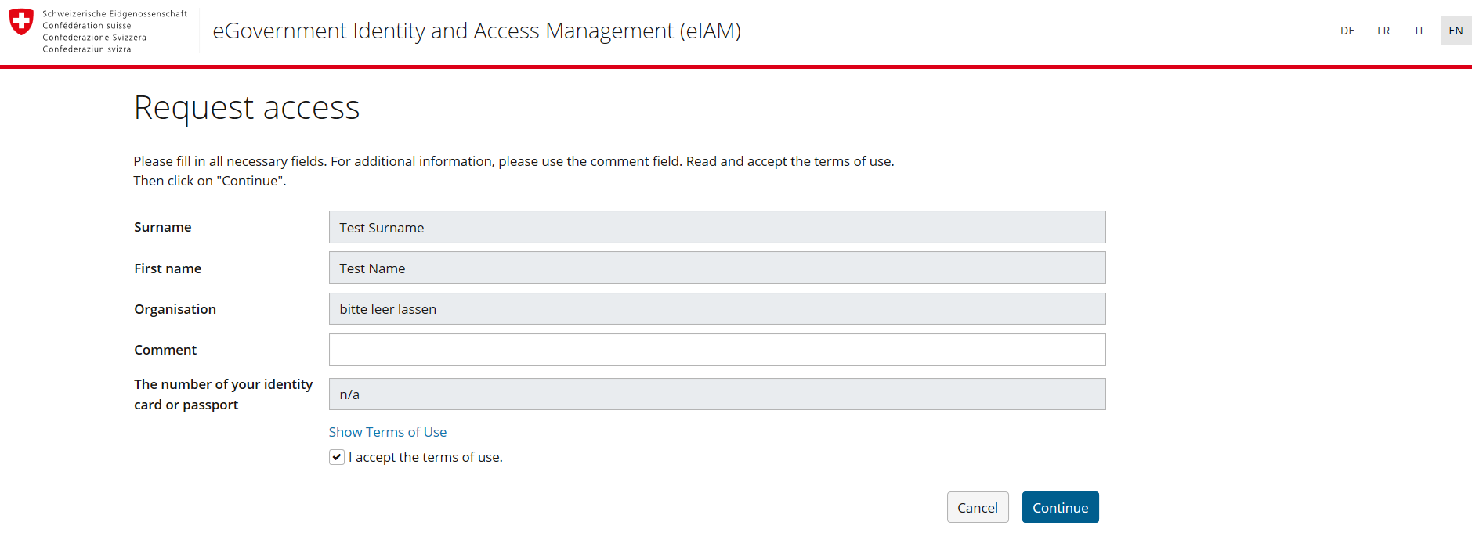
How to register in OSCAR or GAWSIS
How to register in OSCAR or GAWSIS
4. Request access to the application
click on «request access»….
…. Accept the terms of use and click on «continue»
Your registration is complete, go back to the application and login to add/edit information

Slide 12
How to register in OSCAR or GAWSIS
How to register in OSCAR or GAWSIS
4. Request access to the application
Click on «back to the application»
Your registration is complete, go back to the application and login to add/edit information

Slide 13
Thank you
Merci

